Slide 1
iRT Retention Time Prediction with Skyline
Tutorial Webinar #7
With
Brendan MacLean (Principal Developer)

Slide 2
Agenda
Welcome from the Skyline team!
iRT Retention Time Prediction
Introduction with Brendan MacLean
  Overview of iRT key concepts
Tutorial with Brendan MacLean
  Calibrating and building an iRT library
  Using the iRT library for retention time prediction
Audience Q&A – submit questions to Google Form:
https://skyline.gs.washington.edu/labkey/qa4skyline.url

Slide 3
Prior Knowledge and Consistency
Based on empirical measurement
Powerful enough to be used cross-lab / cross experiment
More powerful run-to-run
Relative ion abundance
  Library: Spectral and chromatogram
  Prediction: Zhang, Anal. Chem., 2004
Retention time
  Library: iRT (and AMT)
  Prediction: Krokhin, Anal. Chem., 2006 (SSRCalc)
Notes:
Confidence in what is being measured

Slide 4
Chromatography-based Quantification
Hypothesis testing (Verification)
SRM
PRM
MS1 chromatogram extraction (DDA)
Data independent acquisition (DIA)
Acquisition | Targeted | Survey
More Selective | PRM | DIA
Less Selective | SRM | DDA
Scheduling & Detection
Source
Extraction & Detection

Slide 5
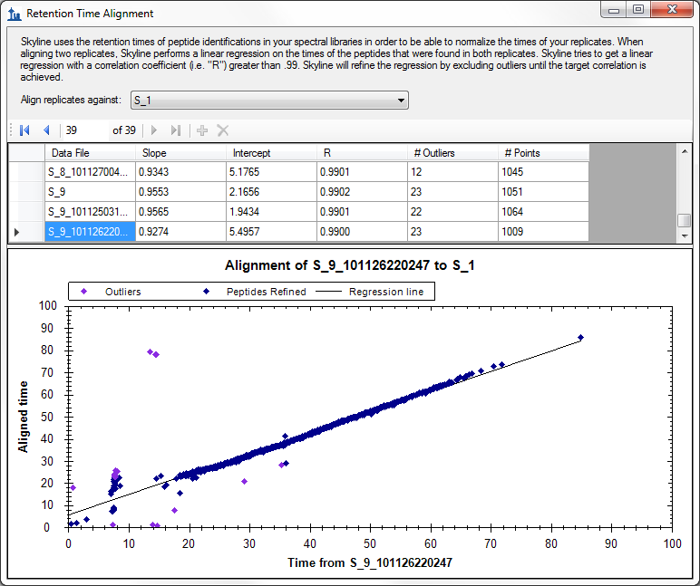
Retention Time Alignment by ID in DDA

Slide 6
Retention Times for SIVPSGASTGVHEALEMR
Logical Order

Slide 7
Retention Times for SIVPSGASTGVHEALEMR
Acquired Time Order

Slide 8
Retention Times for SIVPSGASTGVHEALEMR
Aligned Times

Slide 9
iRT Standard Peptides
Escher, Proteomics, 2012

Slide 10
Retention Time Alignment by Standards

Slide 11
iRT Standard Attributes
10-20 peptides
Consistently measurable in sample
Spanning gradient range of interest
Biognosys
Pierce
Sigma Aldrich
Heavy reference peptides
Analyte peptides – ApoA1

Slide 12
Defining an iRT Scale
Retention time “independent”

Slide 13
Defining an iRT Scale
Points on a line (score = time * slope + intercept)

Slide 14
Defining an iRT Scale
Points on a line (score = time * slope + intercept)

Slide 15
Building an iRT Library
*
*
*
*
*
*
*
*
*
*
*

Slide 16
Building an iRT Library
Score

Slide 17
Building an iRT Library

Slide 18
Building an iRT Library
Score

Slide 19
Using the iRT Library (Prediction)
Score

Slide 20
Using the iRT Library to Measure

Slide 21
SSRCalc Predictor Correlation

Slide 22
Tutorial
Calibrating, building and using an iRT library

Slide 23
Learn More
iRT Retention Time Prediction Tutorial
Webinar #8: TBD
  Tuesday, June 16
Workshop and ASMS
Skyline User Group Meeting at ASMS
  May 31 at Old Post Office, St. Louis, MO
Workshop in Rio de Janiero, August 31-September 2
Workshop in Puerto Vallarta, November
Weeklong Course at PRBB, Barcelona,
  November 15-20

Slide 24
Questions?
Ask any questions you have on iRT at the following form:
https://skyline.gs.washington.edu/labkey/qa4skyline.url
Take the post-webinar survey:
https://skyline.gs.washington.edu/labkey/survey4webinar.url

Slide 25
Tutorial Webinar #7
This ends this Skyline Tutorial Webinar.
Please give us feedback on the webinar at the following survey:
https://skyline.gs.washington.edu/labkey/survey4webinar.url
A recording of today’s meeting will be available shortly at the Skyline website.
We look forward to seeing you at a future Skyline Tutorial Webinar.

