Slide 1


Tutorial Webinar #6
Welcome to the sixth in a series of tutorial webinars designed to help you get the most out of Skyline proteomics software.
We’ll begin shortly …
Webinar Audio: Make sure you have audio during the webinar.
  Click on the telephone icon in the JoinMe toolbar - circled here →
  You then have the choice to either:
  Connect by phone (US and International numbers)
  Connect by internet – a short, temporary software download is required.
Submit Skyline Questions: Use this form to submit Skyline questions to the team – we will try to answer as many as possible:
The QA link will also be available in the chat window – to open your chat window click the bubble icon – circled here →

Slide 2
Effective Data Processing and Interrogation with Skyline
Tutorial Webinar #6
With
Brendan MacLean (Principal Developer)

Slide 3
Agenda
Welcome from the Skyline team!
Effective Data Processing and Interrogation
Introduction with Brendan MacLean
  Brief overview of refinement by peptide/protein differentiation
Tutorial with Brendan MacLean
  Effective grouped study data processing and QC
  Sneak peak: Group Comparison features in Skyline 3.1
Audience Q&A – submit questions to Google Form:
http://tinyurl.com/QA4Skyline

Slide 4

Supporting a Broader Hypothesis
RT Prediction
Spectral Libraries
Unrefined Methods
Previous Measurements
Targeted Method
Refinement
Quantitative Assay

Slide 5
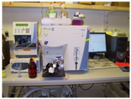
Targeted Method Refinement
Build Method
Refine:
Abundance
Measurability
Differentiation
Degradation
Digestion
Scheduling
Optimization
etc.
Run Method
Evaluate Results

Slide 6
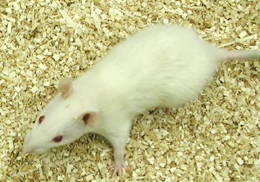
Identifying Plasma Proteins with Altered Levels in a Dahl Salt Sensitive Rat Model
7 Rats on a Low Salt Diet
7 Rats on a High Salt Diet
109 proteins reported in literature as related to heart disease

Slide 7
Phases of Refinement: Detection

Slide 8
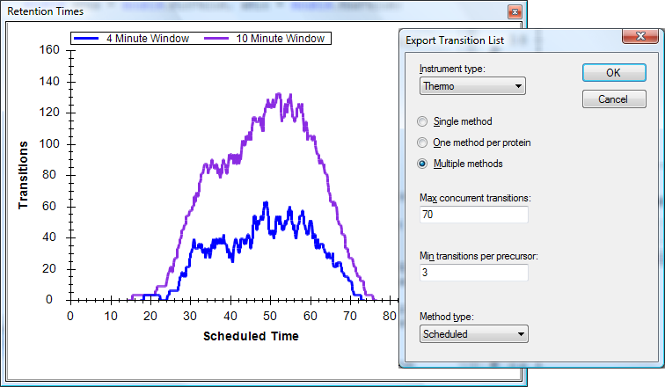
Scheduling Multi-Replicate Assays
49
Proteins
135
Peptides
780
Transitions
6
Unscheduled Injections

Slide 9
Prior Knowledge and Consistency
Based on empirical measurement
Powerful enough to be used cross-lab / cross experiment
More powerful run-to-run
Relative ion abundance
  Spectral and chromatogram libraries
Retention time
  iRT
Optimal collision energy
Ion mobility
  Collisional cross-section
Notes:
Confidence in what is being measured

Slide 10
Haptoglobin
LQTEGDGIYTLNSEK
Diseased
Healthy

Slide 11
Haptoglobin
LQTEGDGIYTLNSEK
SVVDIGLIK
Diseased
Healthy

Slide 12
Mitochondrial 39S ribosomal protein L9
CSSLLWAGAAWLR

Slide 13
Mitochondrial 39S ribosomal protein L9
CSSLLWAGAAWLR
SVVDIGLIK

Slide 14
CSSLLWAGAAWLR
H_159_REP1
D_138_REP3

Slide 15
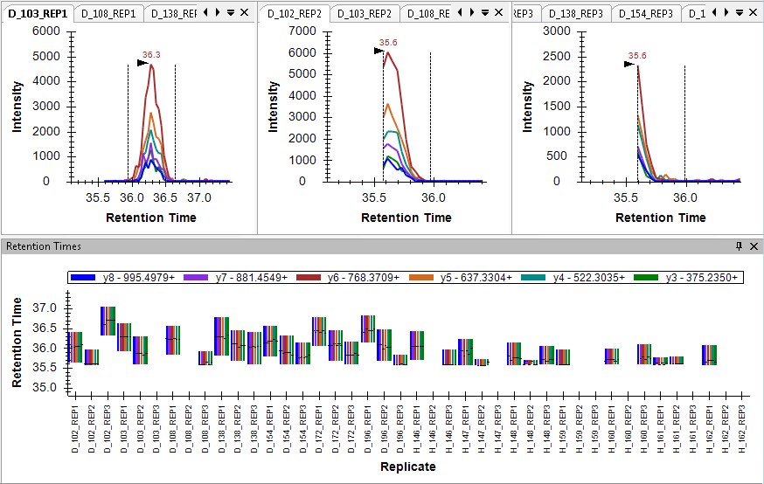
Truncated and Missing Peaks
TGTNLMDFLSR

Slide 16
Tutorial
Effective Data Processing and Interrogation with Skyline

Slide 17
Learn More
NEW! Grouped Studies Tutorial
Webinar #7: iRT or Isotope Labeled Standards
  Tuesday, May 12
Workshop and ASMS
Skyline User Group Meeting at ASMS
  May 31 at Old Post Office, St. Louis, MO
Workshop in Rio de Janiero, August 31-September 2
Workshop in Puerto Vallarta, November
Weeklong Course at PRBB, Barcelona,
  November 15-20

Slide 18
Questions?
Ask any questions you have on this month’s topic, Effective Data Processing, at the following form:
http://tinyurl.com/QA4Skyline
Take the post-webinar survey
http://tinyurl.com/Survey4Webinar

Slide 19
Tutorial Webinar #6
This ends this Skyline Tutorial Webinar.
Please give us feedback on the webinar at the following survey:
http://tinyurl.com/Survey4Webinar
A recording of today’s meeting will be available shortly at the Skyline website.
We look forward to seeing you at a future Skyline Tutorial Webinar.

