Slide 1

Multiplexing Clinical Protein Diagnostics in Dried Blood Spots
Skyline Webinar – March 10, 2015
James Bollinger - MacCoss Lab
Department of Genome Sciences
University of Washington

Slide 2
Outline
Selection of candidate proteins for the multiplex analysis of DBS via targeted proteomics
The currently employed strategies for the selection of candidate peptides for targeted proteomics
An empirical refinement process for the selection of optimal peptides and their respective MS/MS transitions

Slide 3
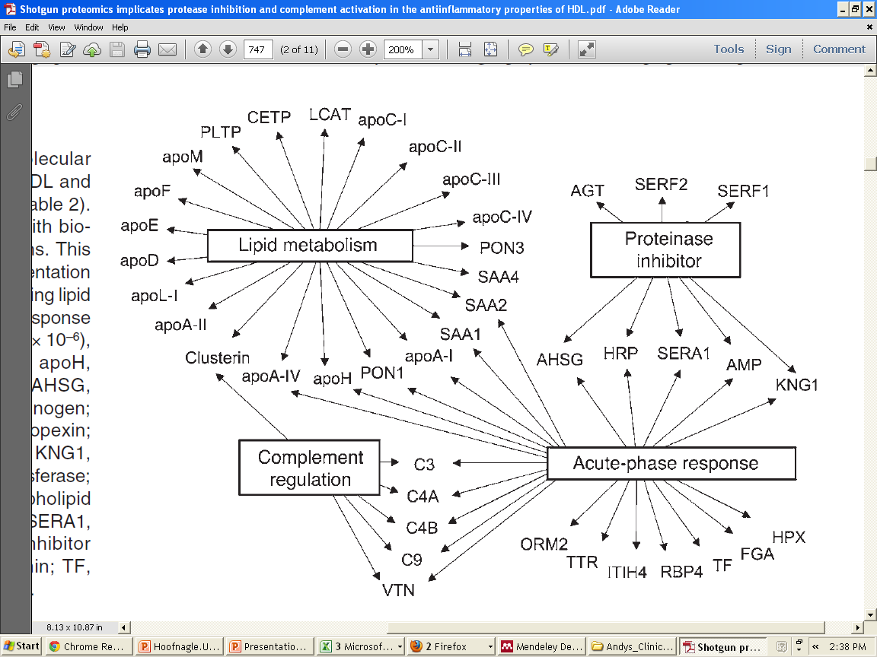
Selection of Protein Targets for DBS Wellness Assay
TALDO
ALDOA
KAD1
ZA2G
MDHC
TTHY
VTDB
IgG
CRP
APOB
CP
CFAB
C1R
FIBα/β
FINC
HBB/A1c
LDHB
SYUA
Adapted from: Vaisar, T. et al., J. Clin. Inves. 2007 117(3); 746–756

Slide 4
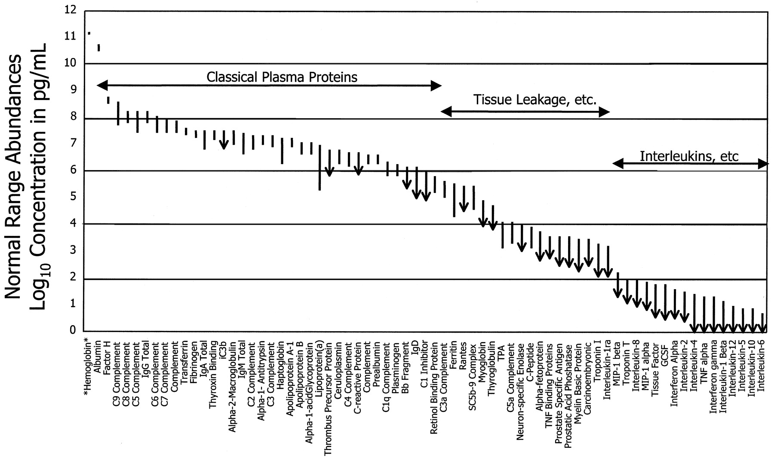
Selection of Protein Targets for DBS Wellness Assay
N. Leigh Anderson & Norman G. Anderson Mol Cell Proteomics (2002), 1, 845-867
N. Leigh Anderson. Clin. Chem. (2010), 56, 177-185
Notes:
Reference intervals for 70 protein analytes in plasma. Abundance is plotted on a log scale spanning 12 orders of magnitude. Where only an upper limit is quoted, the lower end of the interval line shows an arrowhead. The classical plasma proteins are clustered to the left (high abundance), the tissue leakage markers (e.g. enzymes and troponins) are clustered in the center, and cytokines are clustered to the right (low abundance). Hemoglobin is included (far left) for comparison. Data were obtained from the Specialty Laboratories publications (154). TPA, tissue plasminogen activator; GCSF, granulocyte colony-stimulating factor; TNF, tumor necrosis factor.

Slide 5
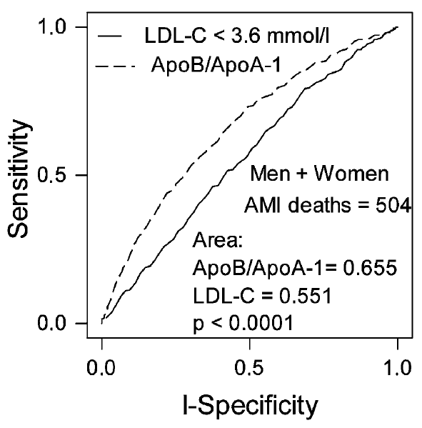
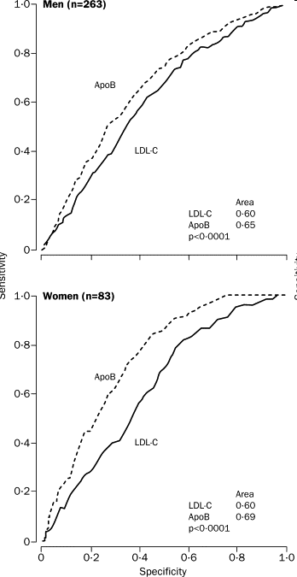
How Does One Select Optimal Peptides for the Quantitative Analysis of Each Respective Gene Product?
Should one use peptides identified in previous discovery experiments?
Should one use empirical refinement of analytical standards?
Apolipoprotein B (P04114) – 516 kDa, Serum reference range (~0.5-2 g/L)
Walldius, G. et al. J Intern Med. 2006, 259; 493-519
Walldius, G. et al. Lancet, 2001, 358(9298); 2026-33
Notes:
Receiver operating characteristic curve: increased discrimination between normal and diseased, i.e. means of distributions separate, using apoB versus LDL-C.
Increased true positive rate (TPR) using apoB instead of LDL-C
Unique to a given gene product, free of polymorphisms
Gas-phase properties that favor a sensitive ESI response
Fragmentation patterns with salient features for accurate detection and quantification
Stable during/after digestion
Reproducible chromatographic profiles

Slide 6
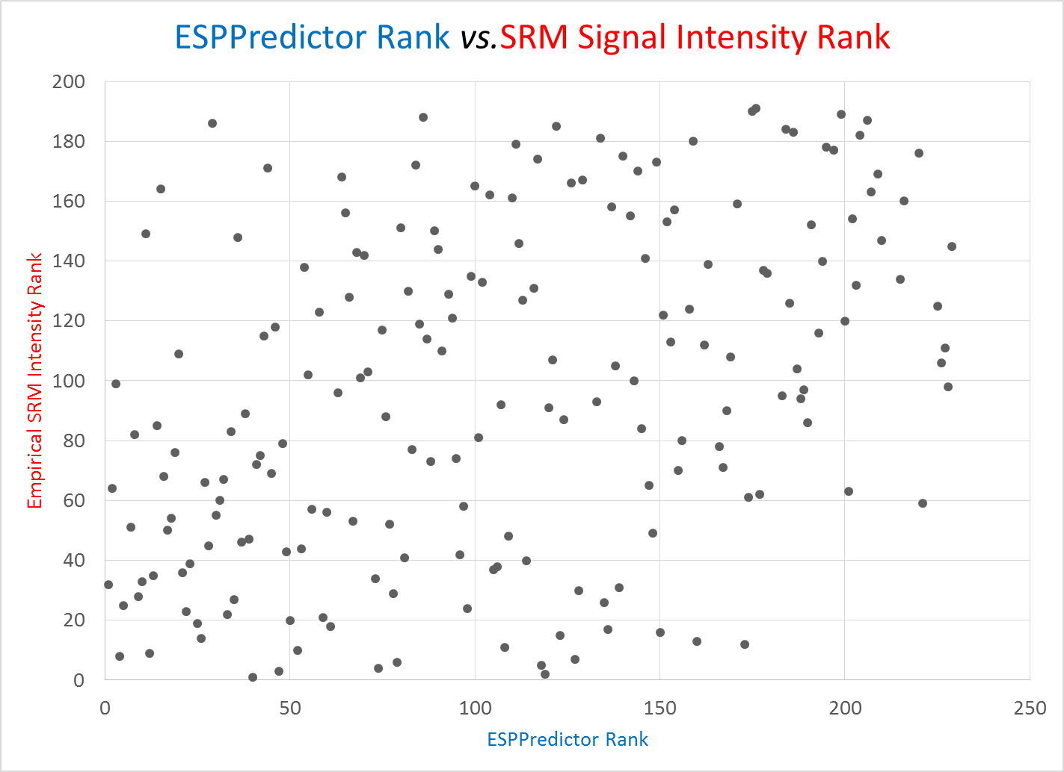
ESPPredictor Score vs. SRM Signal Intensity: Apolipoprotein B100
Mallick, P. & Aebersold, R. et al. Nature Biotechnology(2007) 25 (1): 125-131
Fusaro, V.A. & Carr, S.A. et al. Nature Biotechnology (2009) 27:190-198.

Slide 7
Spectrum Counts vs. SRM Signal Intensity: Apolipoprotein B100
Prakash, A. et al. J Proteome Res. 2009 8(6): 2733–2739.
Notes:
Although these approaches are better than selecting proteotypic peptides at random, our results suggest that current predictor algorithms and spectral counting approaches provide imperfect ranking and identification of optimal proteotypic peptides, potentially limiting the utility of large-scale peptide-synthesis efforts that rely on such approaches as a first-round filter.

Slide 8
Our Approach…………..

Slide 9
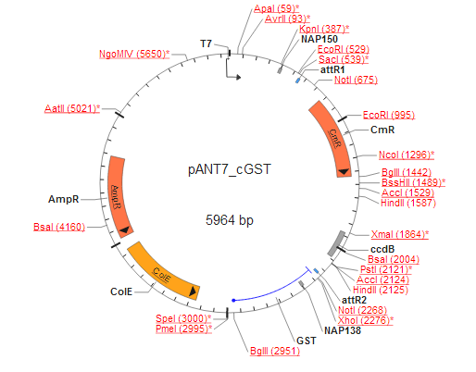
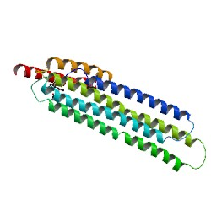
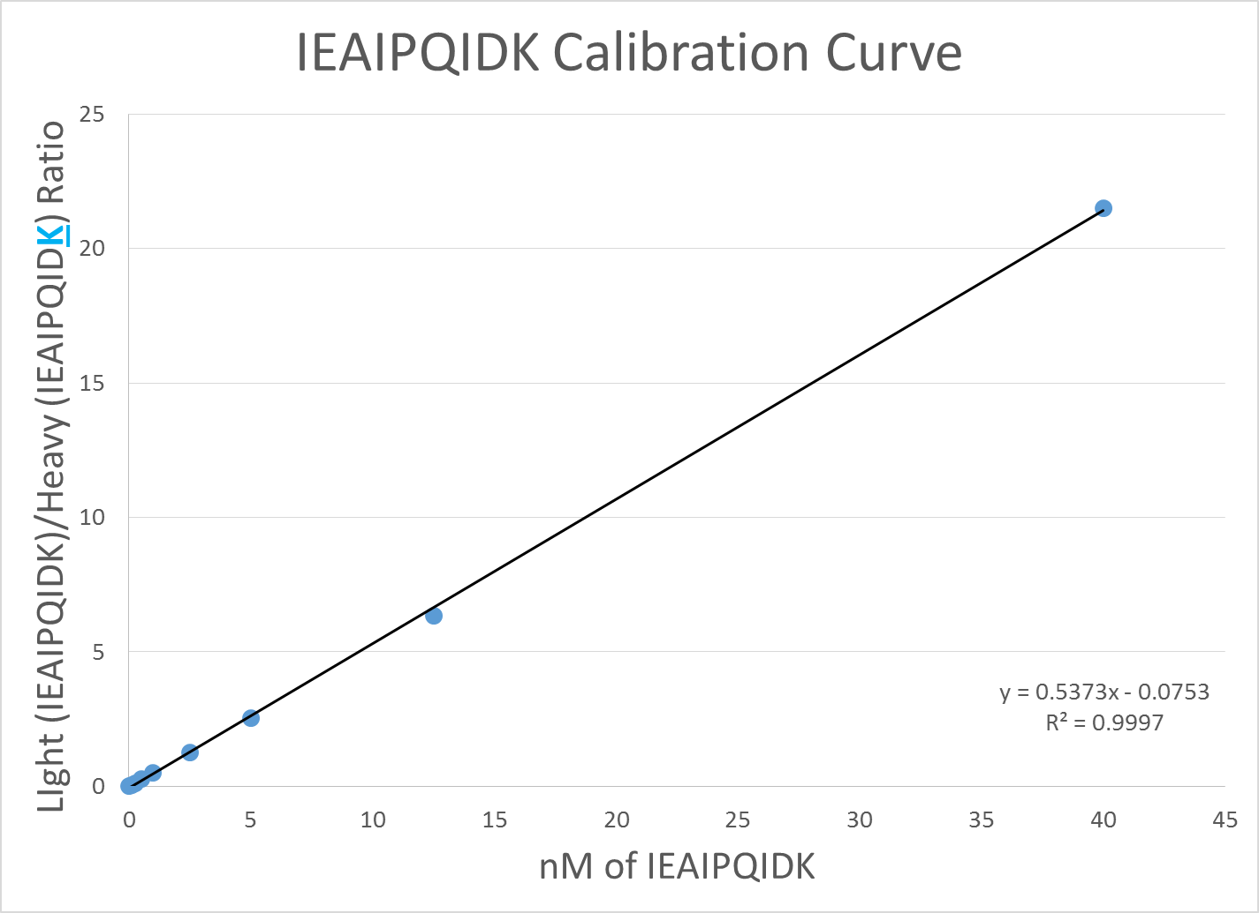
Workup of Recombinant/Native Protein Standard
Expand, Purify, & Sequence cDNA clone
In Vitro Transcription and Translation
Enrichment via Glutathione-Sepharose Resin
http://dnasu.org
GST
Gene Product of Interest
IEAIPQIDK
+
IEAIPQIDK
~25-500 femtomoles/25uL IVT
< $20.00/Protein
Notes:
The 1-Step Human IVT System uses HeLa cell lysates to perform cell-free protein expression. Using a human-based system yields proteins that mirror natural proteins with respect to post-translational modifications and results in proteins that exhibit natural protein function and structure.

Slide 10

Round 1 nanoLC MS/MS: SRM Signal Intensity Rank and Fragmentation Fingerprint
Peptide Filter #1: The y-ion series (y₃ to y_{n-1}) for all fully tryptic peptides 7 to 25 amino acids in length (+2 charge state) with all cysteines monitored as carbamidomethyl cysteines.
In Silico digestion
Apolipoprotein B100
Peptides
Export transition list parameters
(m/z Precursors, m/z Products, & Collision Energies¹)
241
1) Maclean, B. et al. Anal Chem. 2010. 82(24):10116-24.
Notes:
Before

Slide 11
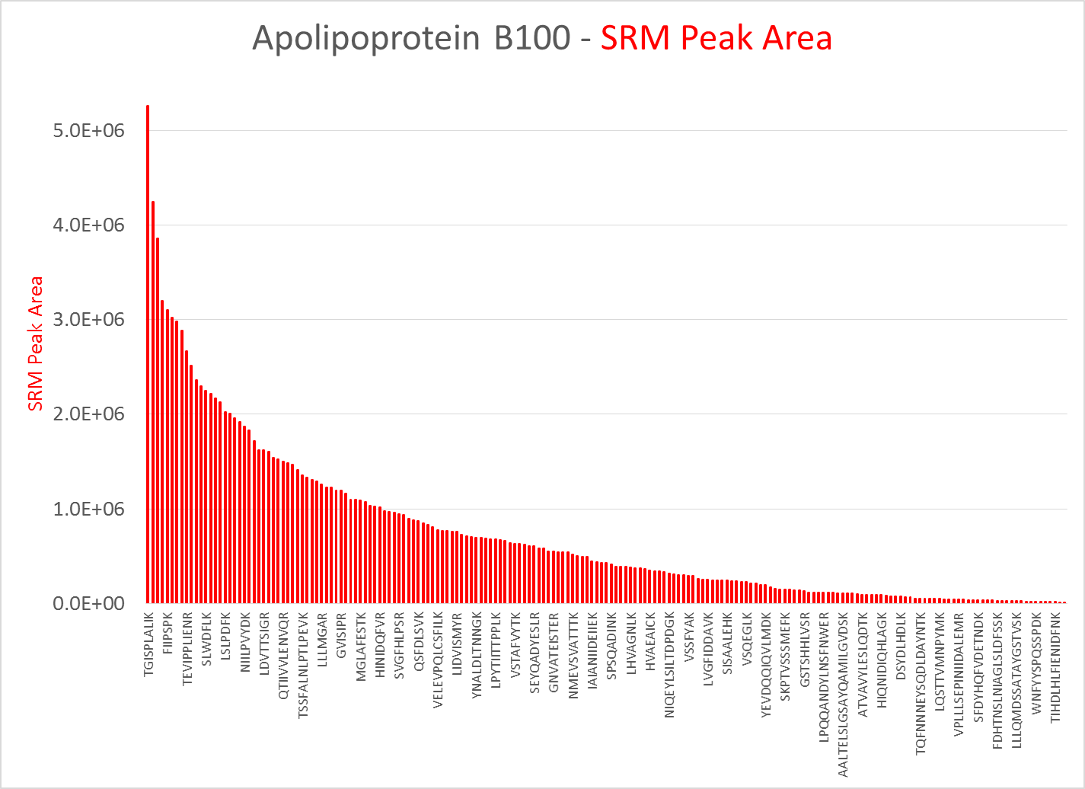
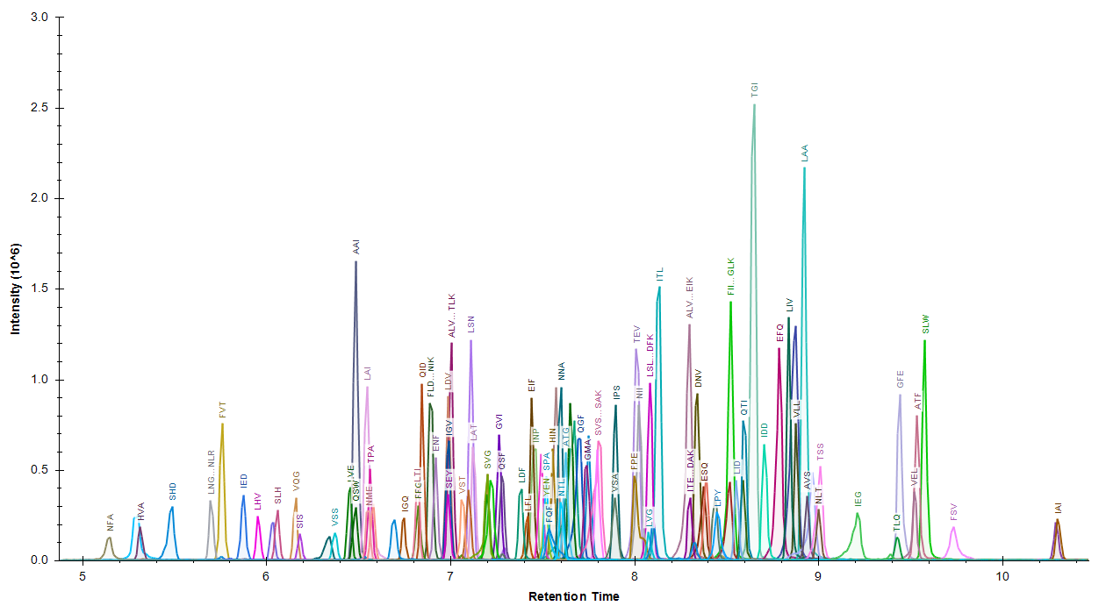
Round 1 nanoLC MS/MS:
SRM Signal Intensity Rank
Notes:
Feel for peak shape

Slide 12
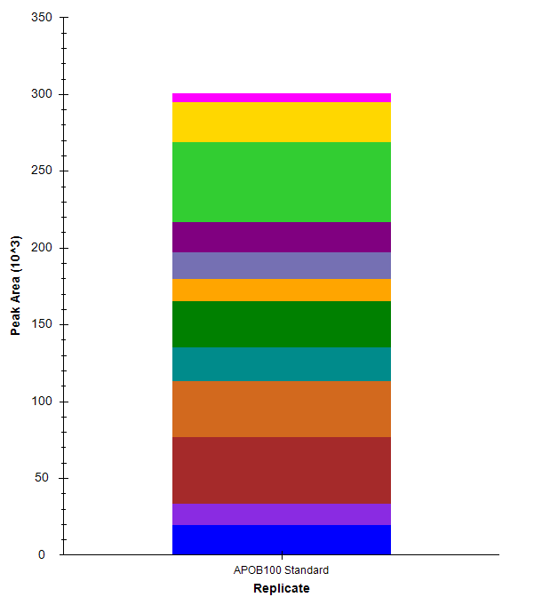
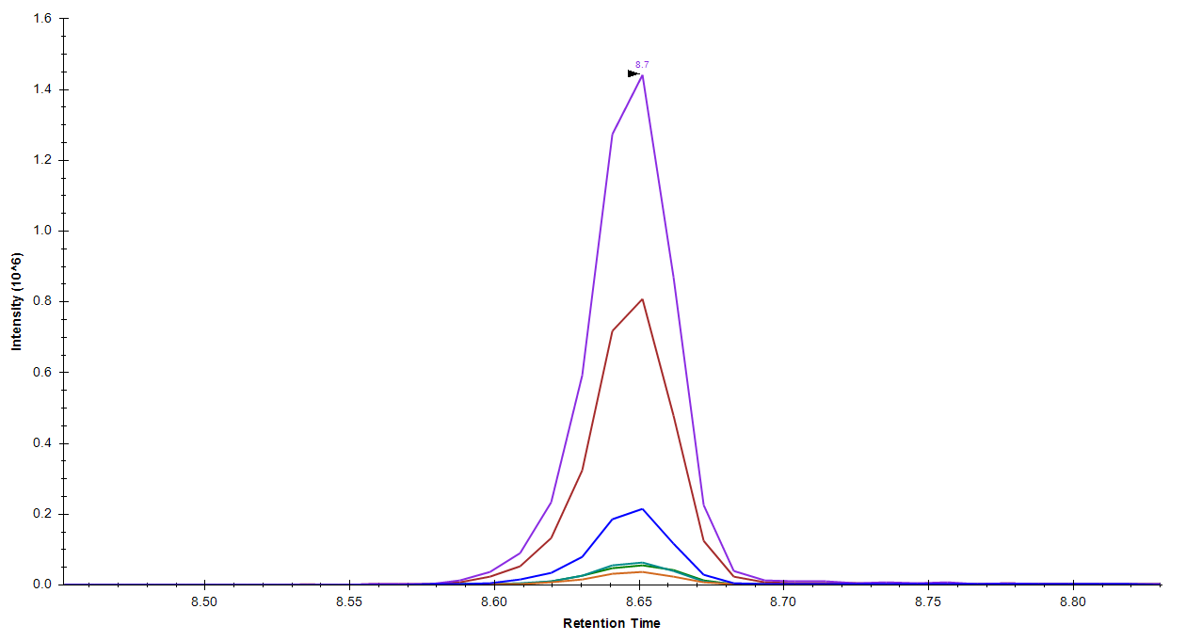
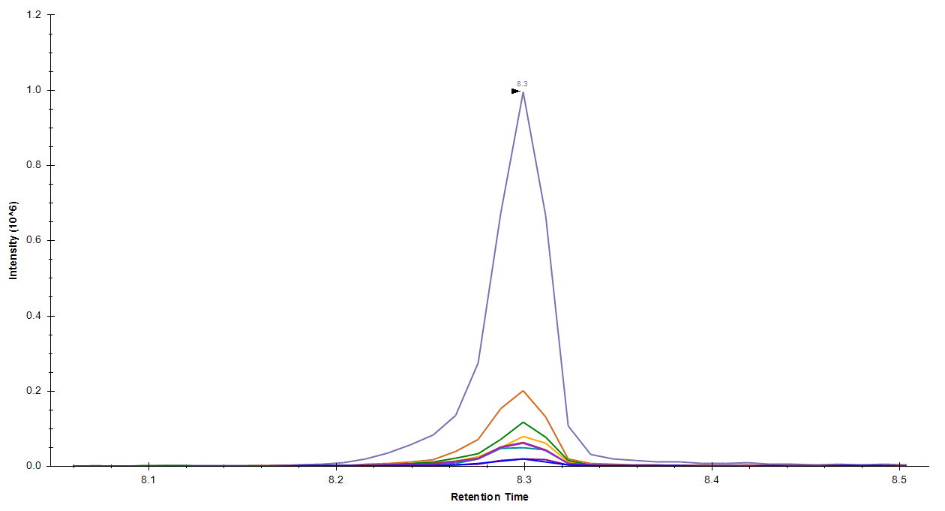
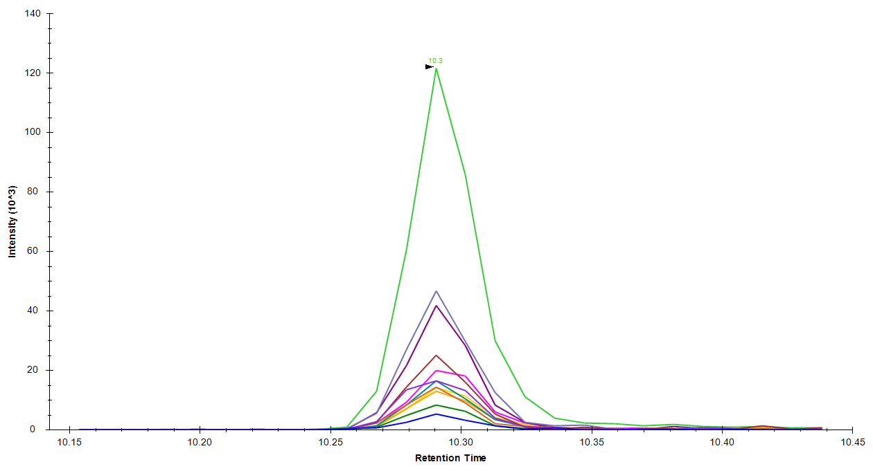
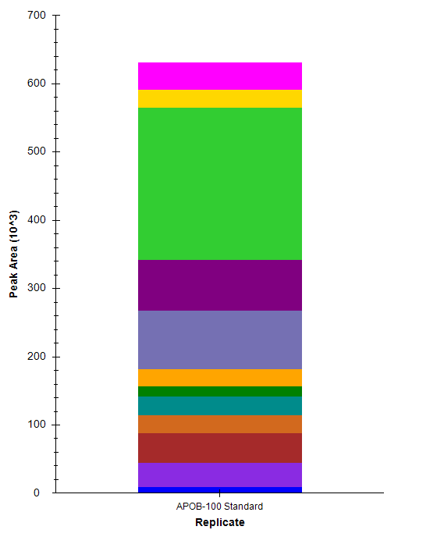
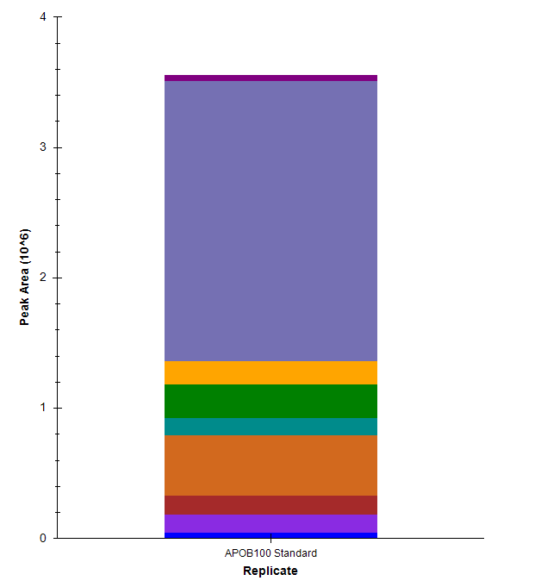
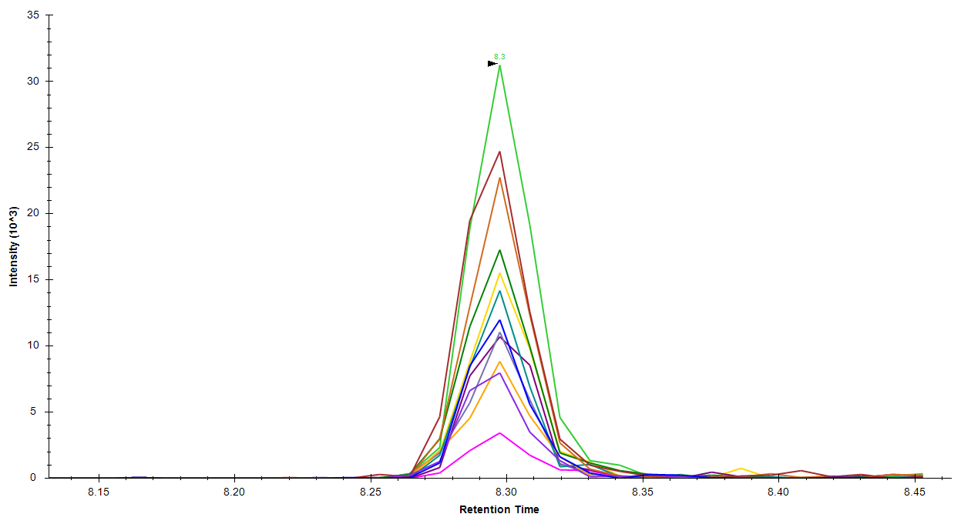
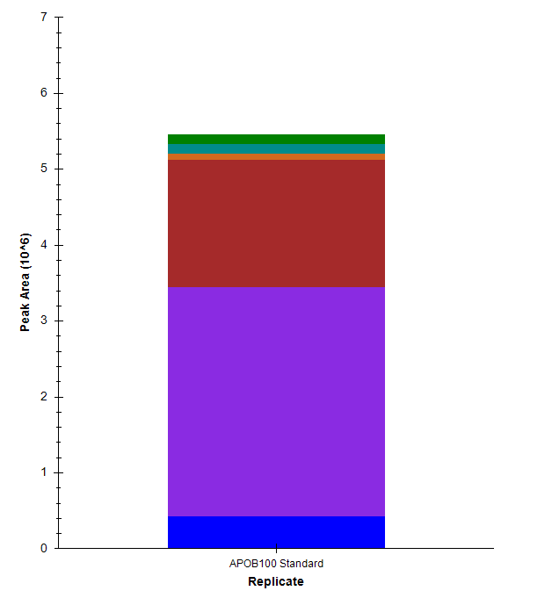
Round 1 nanoLC MS/MS:
Fragmentation Fingerprint
R.YEDGTLSLTSTSDLQSGIIK.N [1536, 1555]
K.TTLTAFGFASADLIEIGLEGK.G [674, 694]
K.ALVEQGFTVPEIK.T [2578, 2590]
R.TGISPLALIK.G [219, 228]

Slide 13

Round 2 nanoLC MS/MS:
iRT Calibration/Peptide Stability Analysis
Peptide Filter #2: Edit and annotate all peptides with non-existent or ambiguous chromatograms
Upload curated assay to Panorama for initial build of chromatogram library
Apolipoprotein B100
Peptides
191
241
Export methods with top 4 transitions from remaining peptides (Sensitivity and selectivity arguments) for retention time calibration and stability analysis
www.panorama.org
Notes:
Before

Slide 14
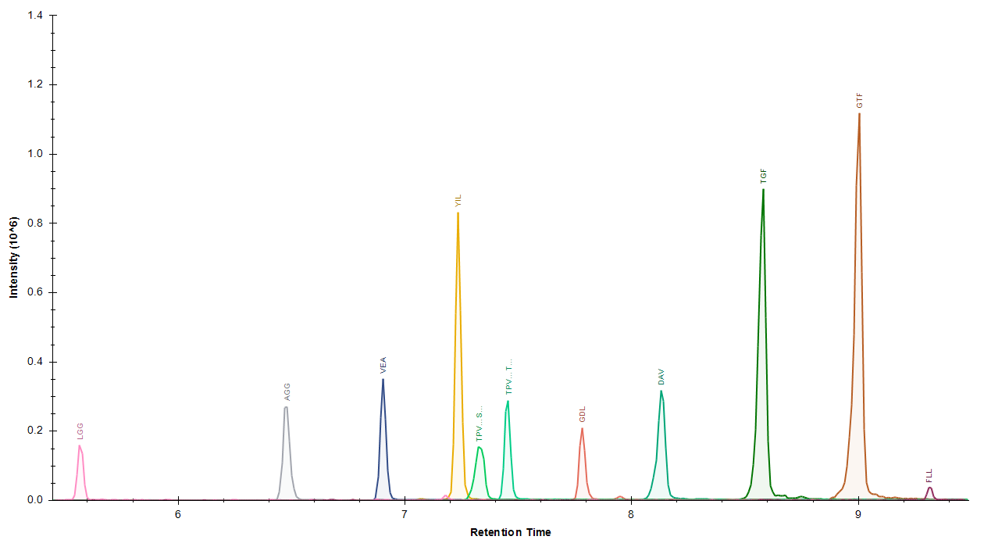
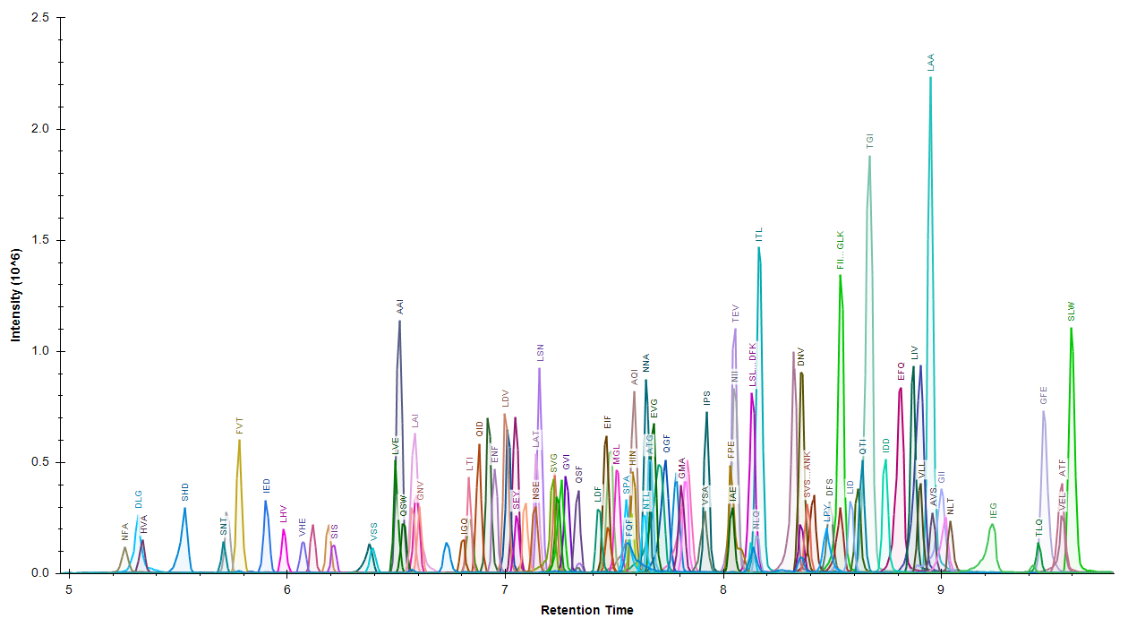
Round 2 nanoLC MS/MS:
iRT Calibration

Slide 15
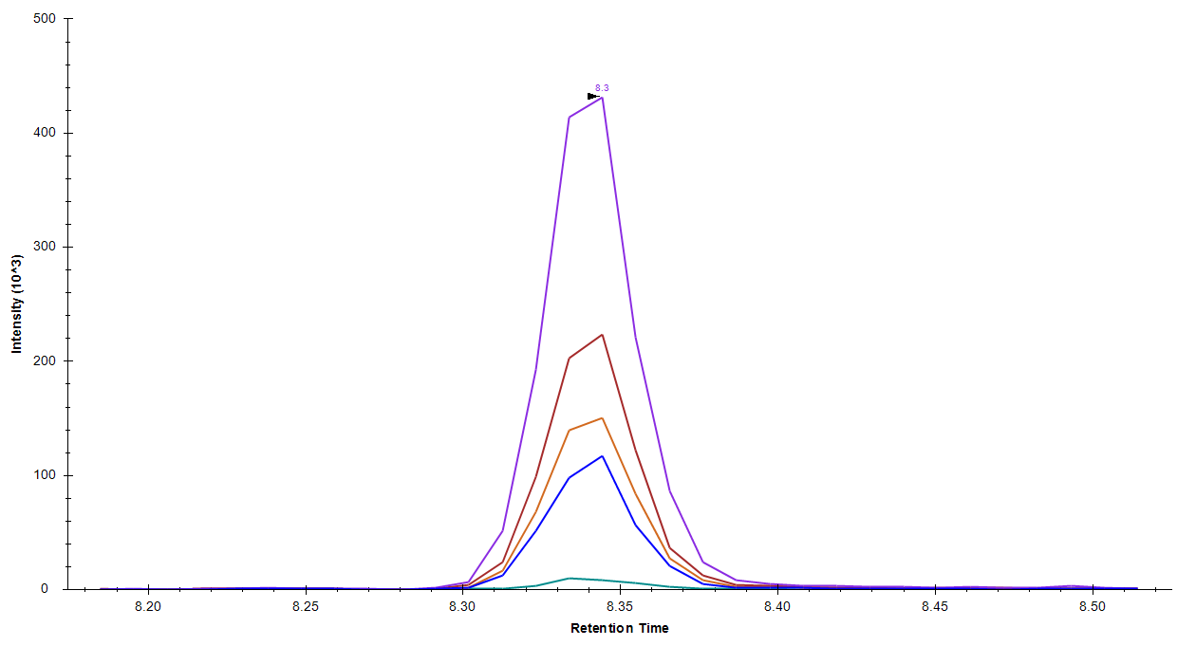
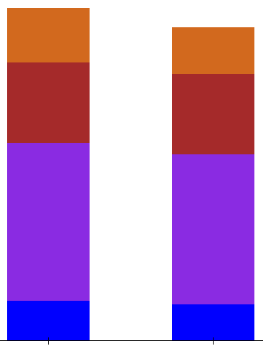
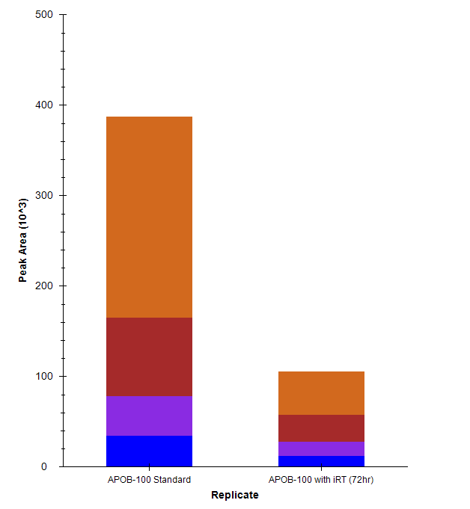
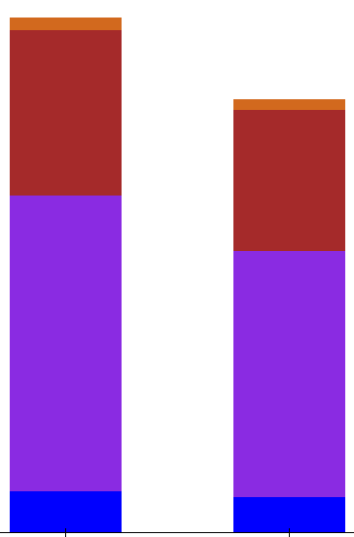
Round 2 nanoLC MS/MS:
Peptide Stability Analysis
K.DNVFDGLVR.V [4168, 4176]
K.TTLTAFGFASADLIEIGLEGK.G [674, 694]
R.TGISPLALIK.G [219, 228]
Standard
Standard
72hrs in A/S
Standard
Standard
72hrs in A/S
Standard
Standard
72hrs in A/S

Slide 16
Round 3 nanoLC MS/MS:
Validation of Peptides/Transitions in Matrix
Peptide Filter #3: Edit and annotate all peptides that fail to meet minimum stability requirements.
Update chromatogram library files with iRT values
Apolipoprotein B100
Peptides
191
55
241
Export scheduled methods with all transitions from all remaining peptides for the screening of a matrix of interest (DBS)

Slide 17
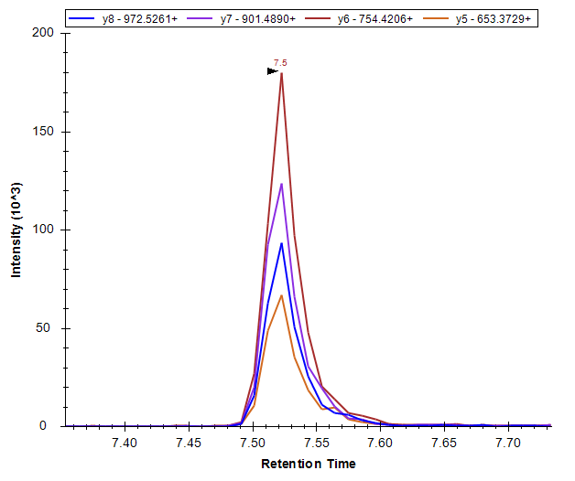
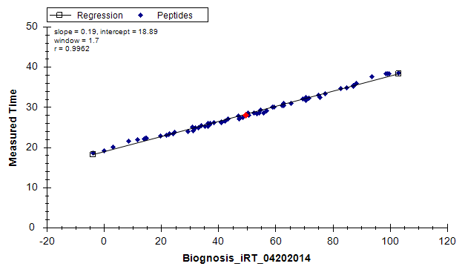
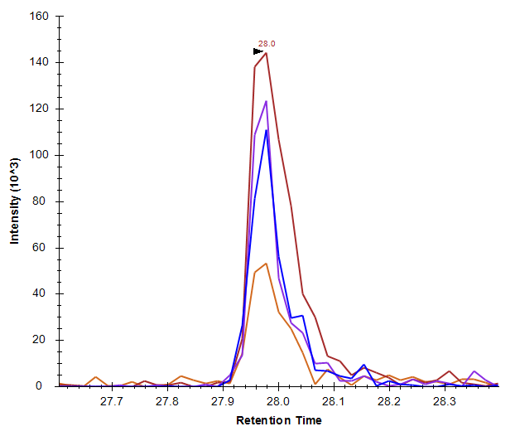
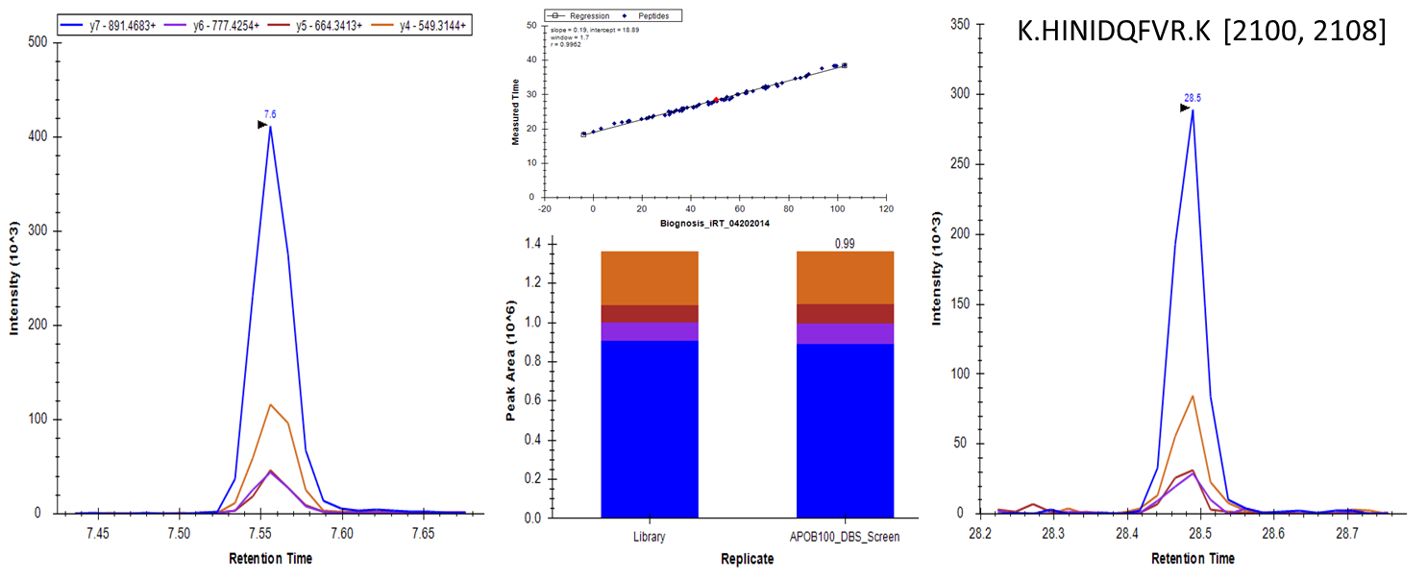
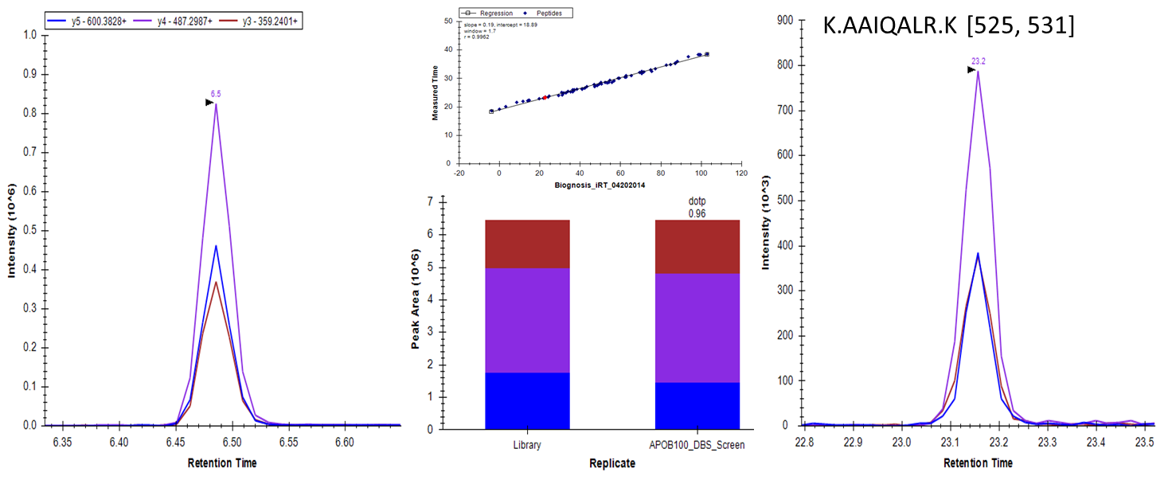
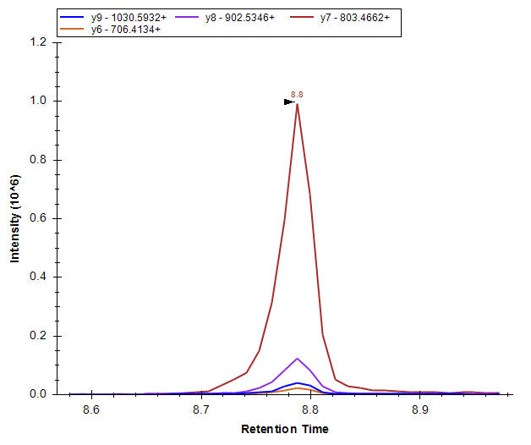
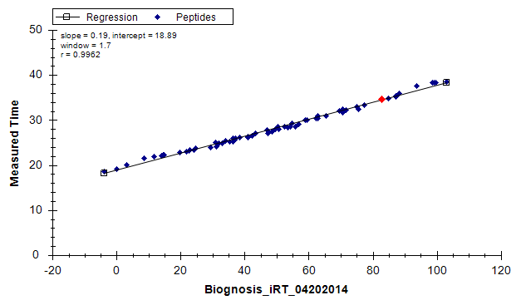
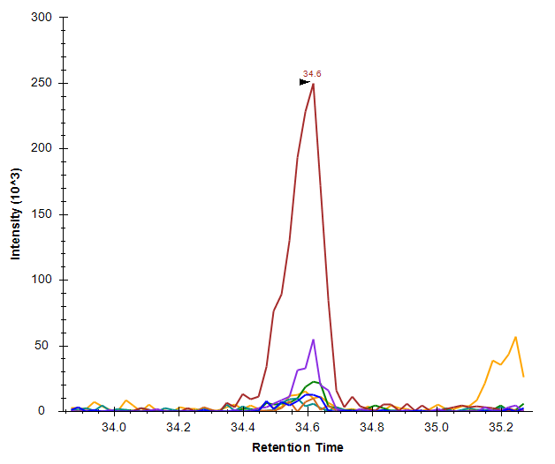
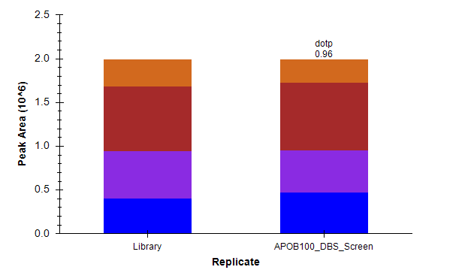
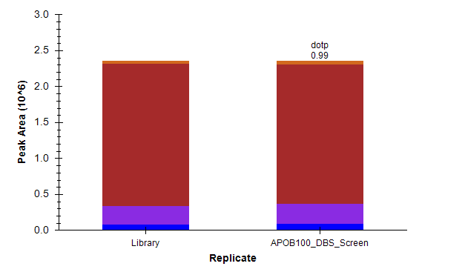
Round 3 nanoLC MS/MS:
Validation of Peptides/Transitions in Matrix
K.SPAFTDLHLR.Y [3979, 3988]
R.EFQVPTFTIPK.L [1333, 1343]

Slide 18

Round 4 nanoLC MS/MS:
Digestion Time Course
Peptide Filter #4: Edit and annotate all peptides that were not reliably identified in the matrix of interest
Combine and export scheduled methods for all remaining peptides for digestion time course analysis
Apolipoprotein B100
Peptides
191
55
241
32

Slide 19
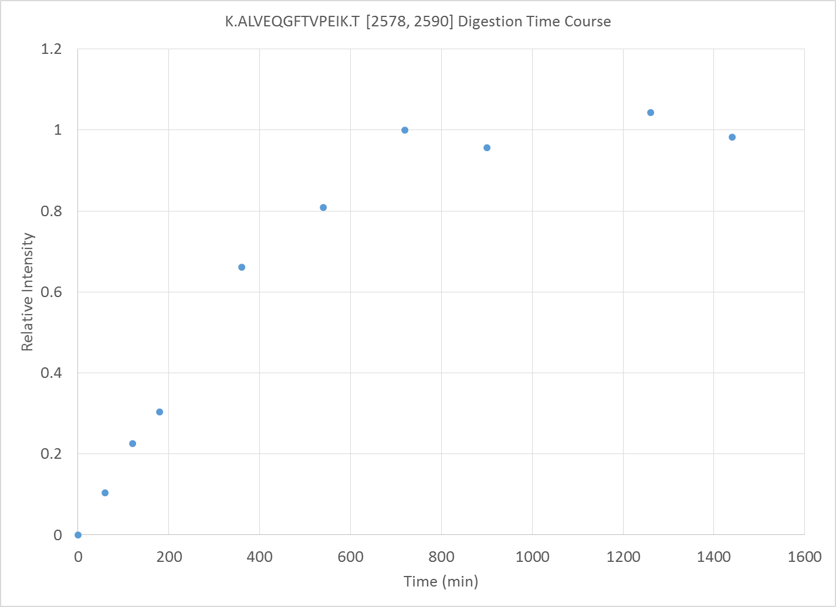
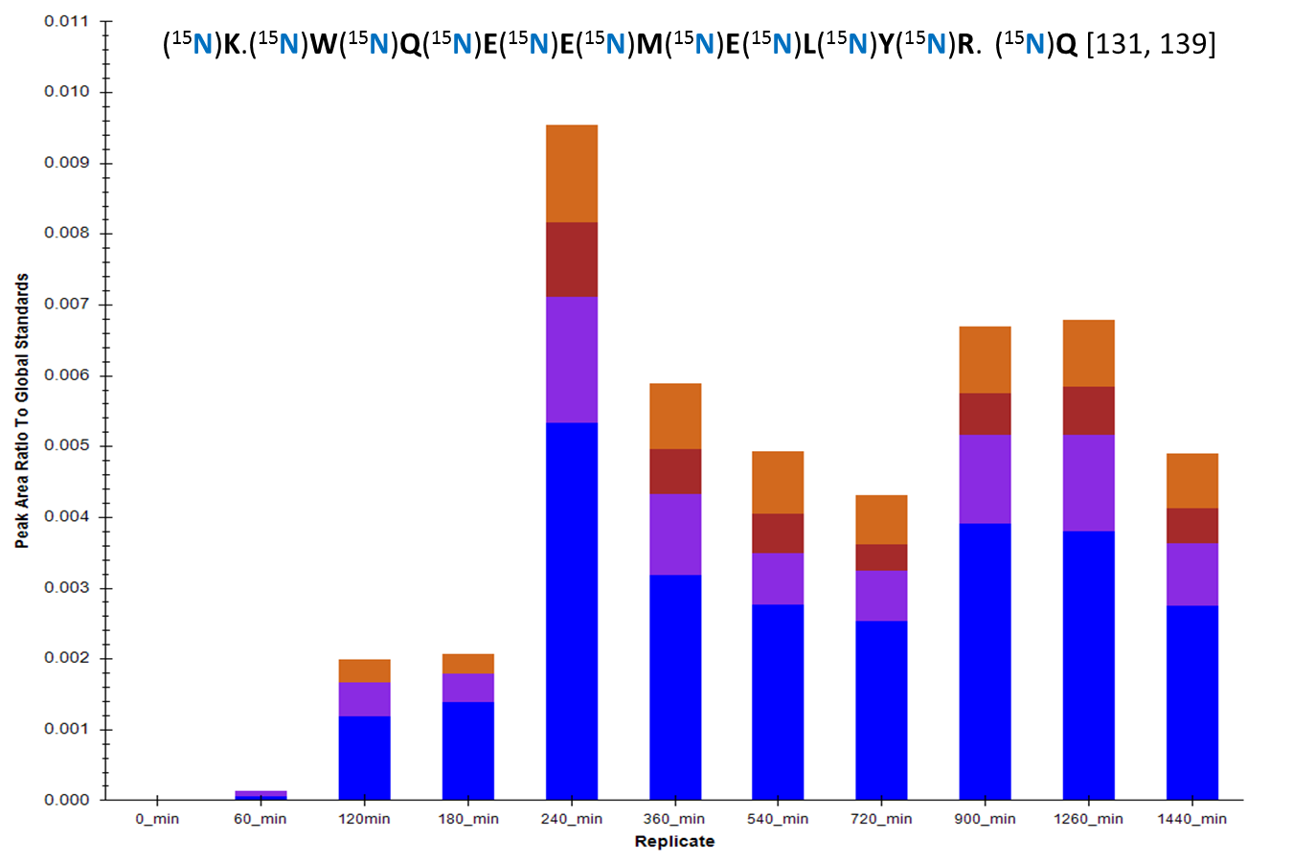
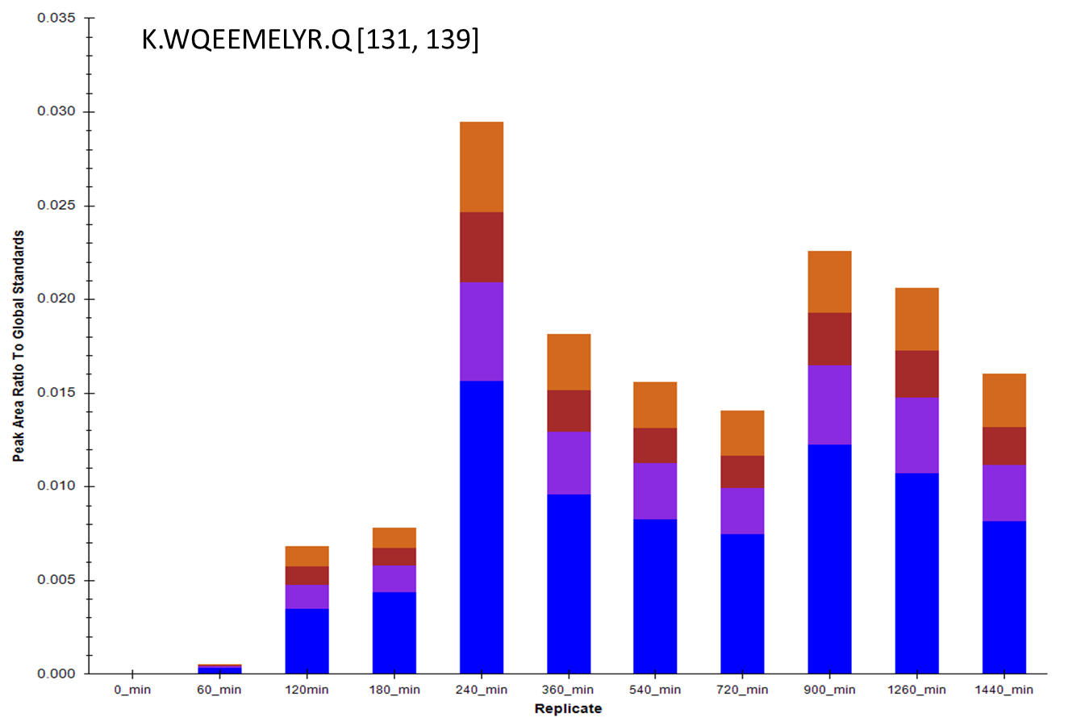
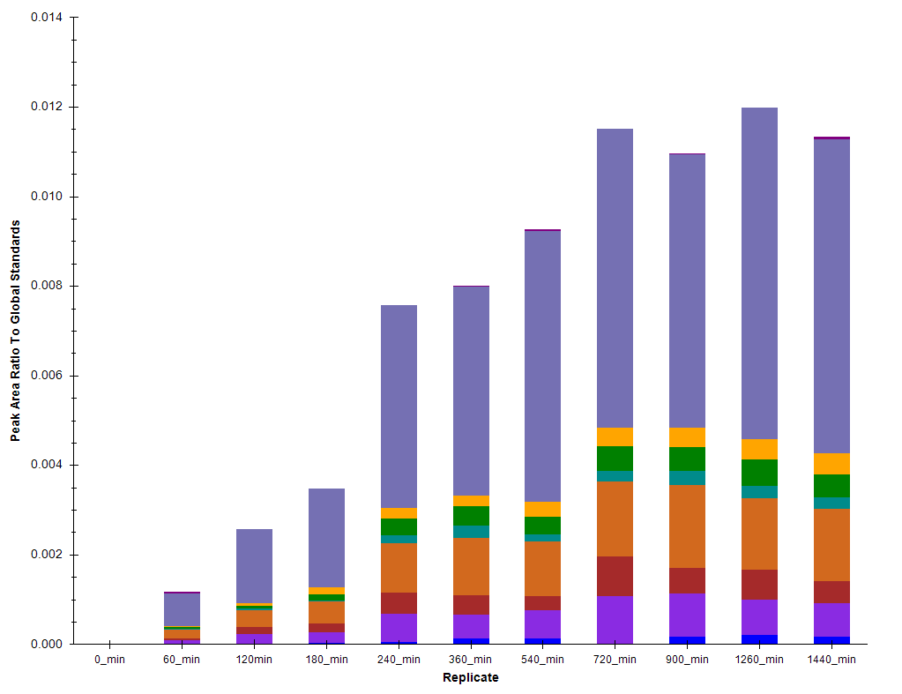
Round 4 nanoLC MS/MS:
Digestion Time Course
K.ALVEQGFTVPEIK.T [2578, 2590]

Slide 20
Final Method Refinement
Peptide Filter #5: Edit and annotate all peptides that gave a sub-optimal digestion characteristics
Combine and export scheduled methods for all remaining peptides from all target proteins for DBS correlation studies
55 Proteins, 1406 transitions, 281 Peptides
Normalization?
Apolipoprotein B100
Peptides
APOA1 Global Internal Standard (¹⁵N Protein)¹
Calibration?
191
57
19
241
32
Single Point Calibrator²
Assign concentration with clinical immunoassay
Measure in triplicate in each batch
Hoofnagle, A.N. et al. Clin. Chem. 2012, 58(4); 777-781.
Cox, B. et al. Clin. Chem. 2014, 60(3); 541-8.

Slide 21
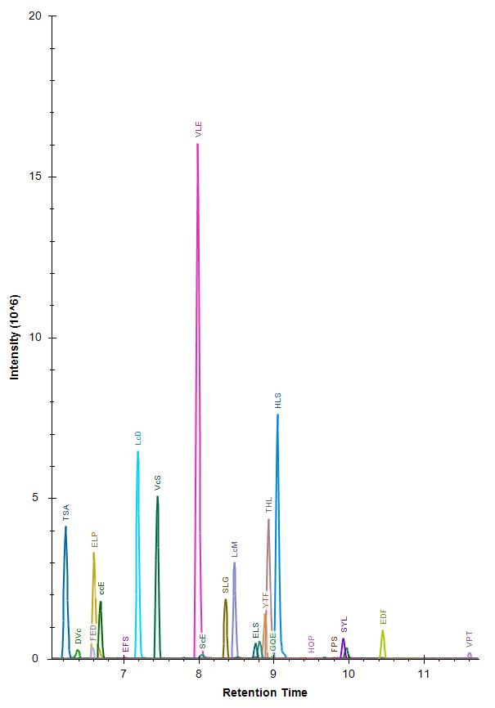
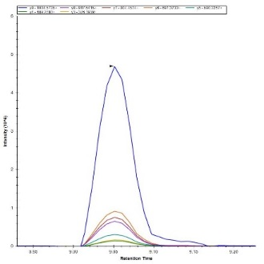
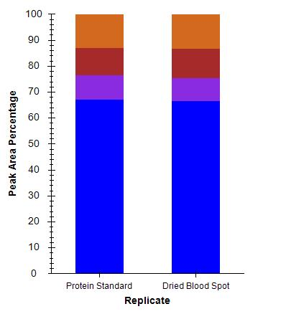
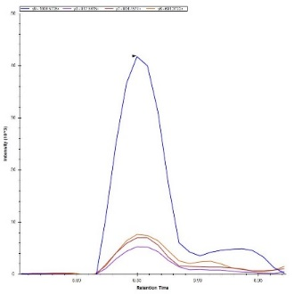

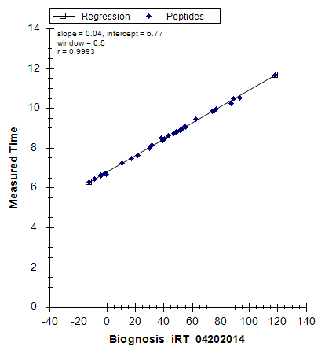
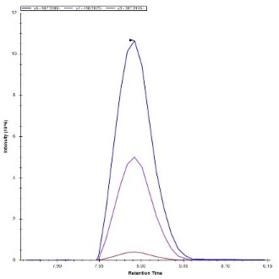
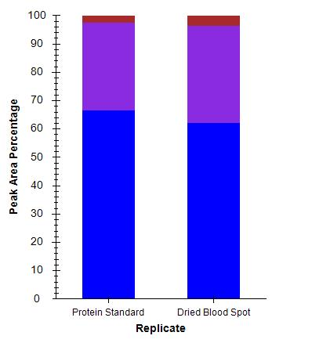
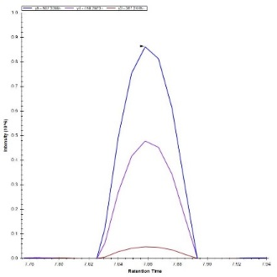

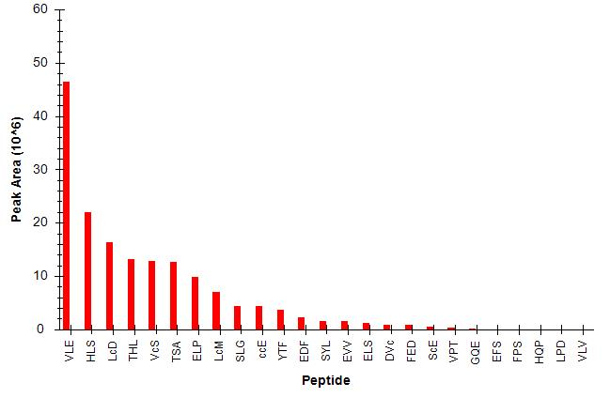
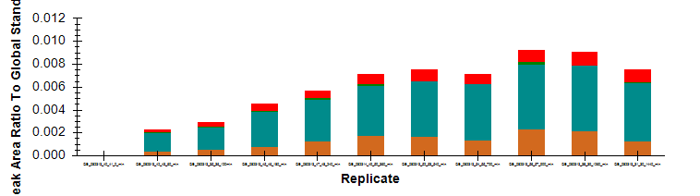
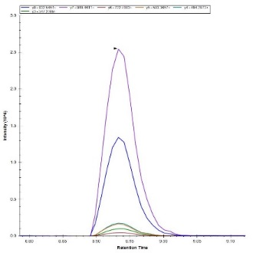
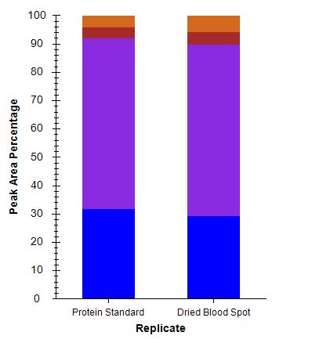


Summary of Empirical Derivation
with Vitamin D Binding Protein (P02774)
Protein Standard
DBS
K.HLSLLTTLSNR.V [207, 217]
K.VLEPTLK.S [363, 369]
R.THLPEVFLSK.V [353, 362]

