Slide 1

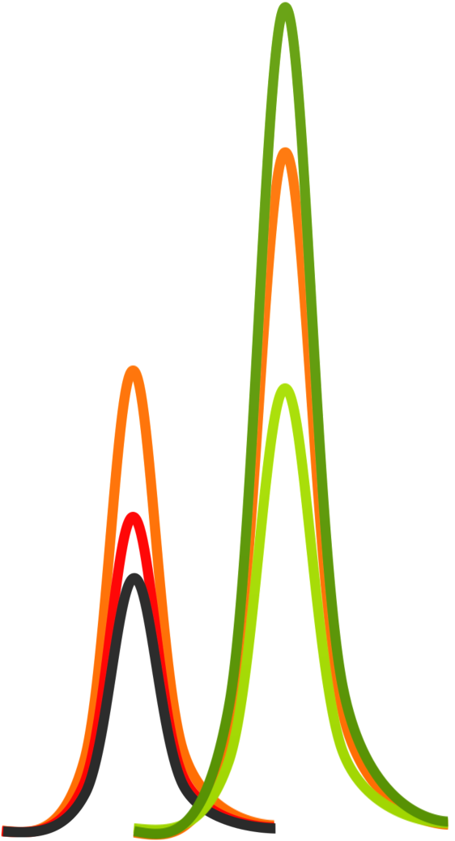


Lecture:
Isotope Labeled Standards in Skyline
Webinar , 1 December 2015
Christina Ludwig Ariel Bensimon
TU Munich ETH Zürich
Germany Switzerland

Slide 2

Motivation – why use isotope labeled standards ?
Outline
Outline
Introduction - Ariel
Improve confident peptide identification - Ariel
Improve quantitative precision and accuracy - Tina
How to get stable-isotope labeled information into a Skyline ?
Generating a reference for identification
Using a reference for peak selection
Using a reference for optimal quantification
Label-free versus label-based quantification
Metabolic, chemical, enzymatic and spike-in labeling
Relative versus absolute quantification
Single and multiple point calibration

Slide 3
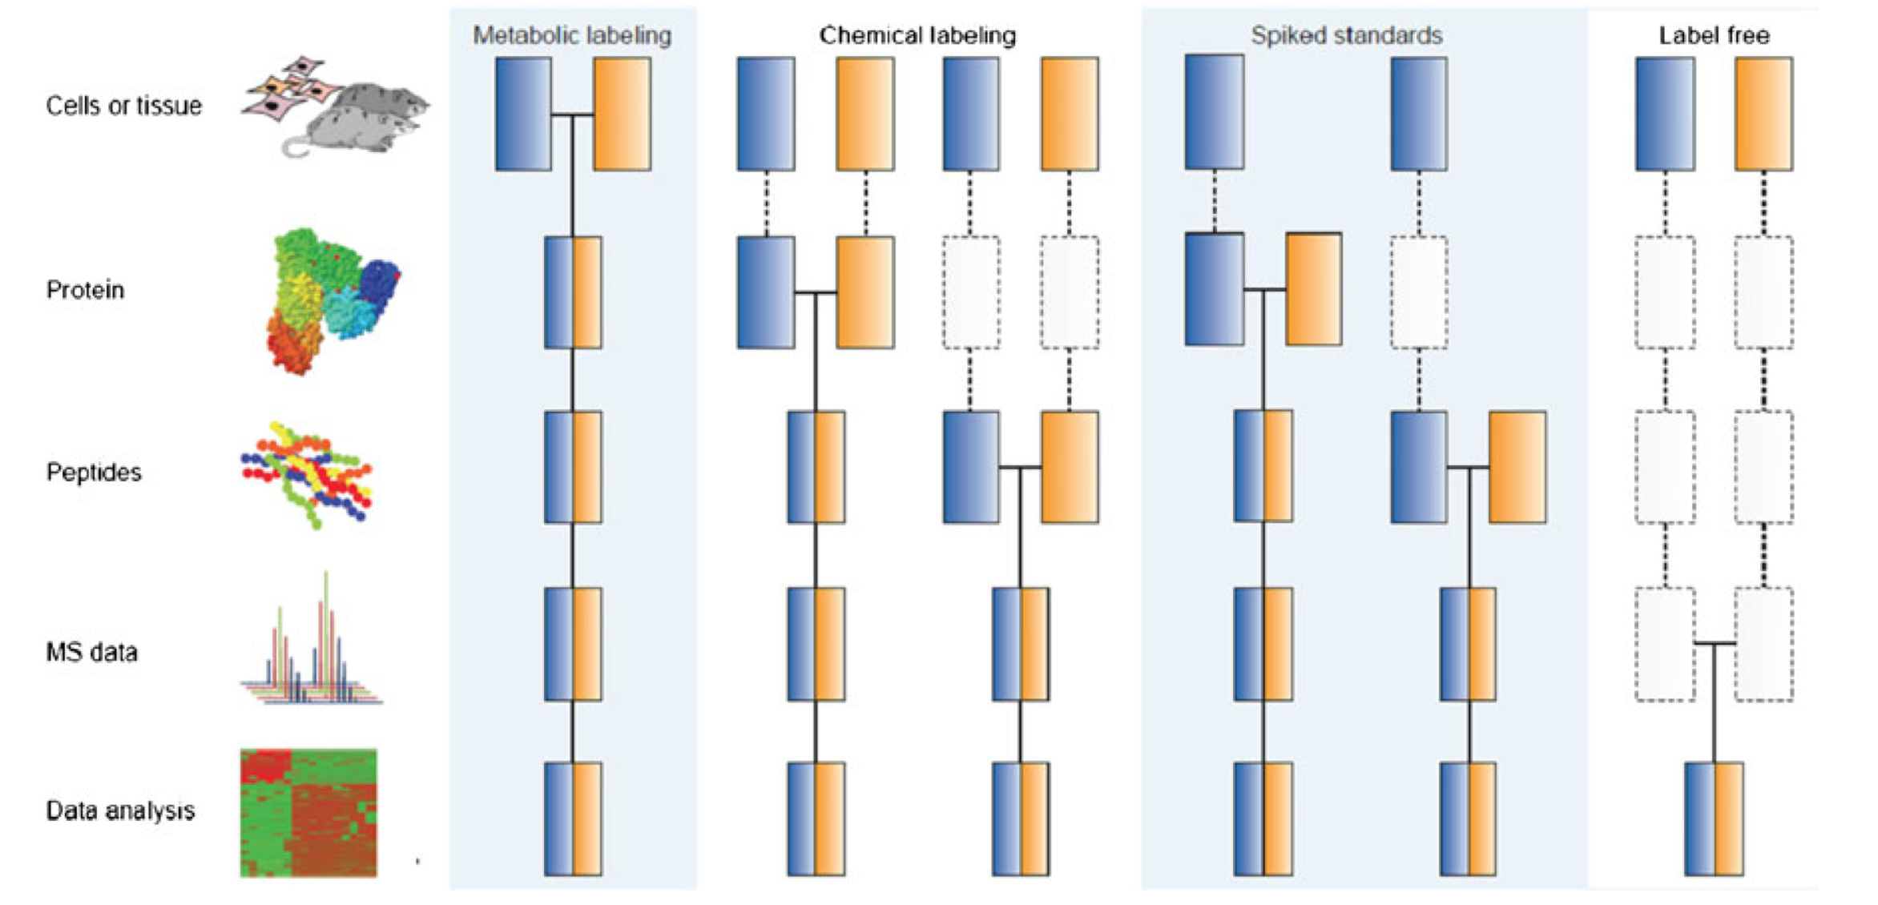
Motivation – why use isotope labeled standards ?
Motivation – why use isotope labeled standards ?
For the accurate quantification of a peptide: accounting for sources of variation
cells or tissue
Protein extraction
protein
Digestion & C18
The earlier an isotope-labeled standard is added into the samples during sample preparation, the more precise and accurate the results!
peptides
Separation &acquisition
MS data
Signal processing
data analysis
Bantscheff, M., Lemeer, S., Savitski, M. M. & Kuster, B., Anal Bioanal Chem 404, 939–965 (2012).

Slide 4
The multitude of quantitative MS-applications
SpikeTides
¹⁸O-labeling
SILAC
emPAI
iTRAQ
IBAQ
PSAQ
ICAT
APEX
PAI
QconCAT
¹⁵N-labeling
Dimethyl-labeling
mTRAQ
pREST
Super-SILAC
ICPL
NSAF
AQUA
ALF
TMT
Label-free

Slide 5

The multitude of quantitative MS-applications
SpikeTides
¹⁸O-labeling
SILAC
emPAI
iTRAQ
IBAQ
PSAQ
ICAT
APEX
PAI
QconCAT
¹⁵N-labeling
Dimethyl-labeling
mTRAQ
pREST
Super-SILAC
ICPL
NSAF
AQUA
ALF
TMT
Label-free

Slide 6



Label-free versus label-based quantification
label-free
label-based
SpikeTides
QconCAT
IBAQ
SILAC
APEX
ALF
pREST
TMT
Label-free
ICAT
Super-SILAC
emPAI
Dimethyl-labeling
ICPL
NSAF
¹⁸O-labeling
¹⁵N-labeling
PSAQ
iTRAQ
mTRAQ
AQUA

Slide 7

Label-free versus label-based quantification
label-free
label-based
Major advantages label-free:
Major advantages label-based:
Cost- and work-effective (at least
in terms of sample preparation)
applicable to all identified/quantified
proteins – proteome-wide
no increase in sample complexity -
high sensitivity
Can account for preparative and
analytical variabilities
Improved quantitative precision and
accuracy compared to label-free quant.
Improved confidence in peak
identification

Slide 8
Label-free versus label-based quantification
label-free
label-based
SpikeTides
QconCAT
IBAQ
SILAC
APEX
ALF
pREST
TMT
Label-free
ICAT
Super-SILAC
emPAI
Dimethyl-labeling
ICPL
NSAF
¹⁸O-labeling
¹⁵N-labeling
PSAQ
iTRAQ
mTRAQ
AQUA

Slide 9


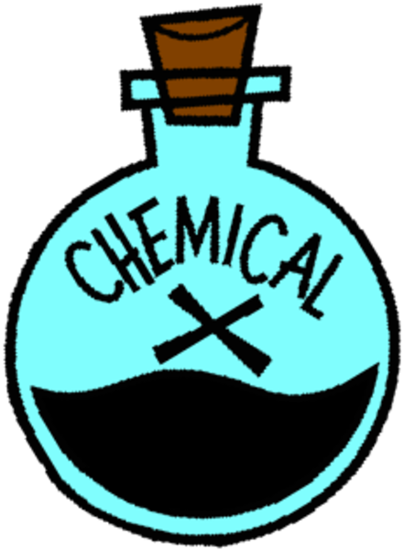
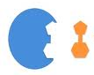
Strategies for incorporating stable-isotopes
Stable-isotope labeling
1. Metabolic labeling
4. Spike-in of isotope-labeled standards
label-based
For example:
For example:
SILAC
synthetic peptides
¹⁵N-labeling
protein standards
2. Chemical labeling
3. Enzymatic labeling
For example:
For example:
Dimethyl-labeling
¹⁸O-labeling
iTRAQ
TMT

Slide 10
Pros and Cons of stable-isotope labeling strategies
Stable-isotope labeling
1. Metabolic labeling
4. Spike-in of isotope-labeled standards
Strengths
+ eliminates best preparative and analytical variabilities (combination of light and heavy very early, on cell level)
Strengths
+ Compatible with any sample type
+ Maximal confidence in correct peak identification
+ Minimal increase in sample complexity
label-based
Weaknesses
- compatible with growing cells only
- significantly increased sample complexity
Weaknesses
- expansive
- applicable to limited number of proteins
2. Chemical labeling
3. Enzymatic labeling
Strengths
+ Compatible with any protein source
+ Multiplexing possible
Strengths
+ Compatible with any protein source
+ protein digestion and labeling one step
Weaknesses
- Potential for side reactions
- incomplete reactions
- Typically carried out on the peptide level
Weaknesses
- variable incorporation of ¹⁸O atoms
- Small mass shifts of 2 to 4 Da

Slide 11
Strategies for incorporating stable-isotopes
Stable-isotope labeling
1. Metabolic labeling
4. Spike-in of isotope-labeled standards
label-based
For example:
For example:
SILAC
synthetic peptides
¹⁵N-labeling
protein standards
2. Chemical labeling
3. Enzymatic labeling
For example:
For example:
Dimethyl-labeling
¹⁸O-labeling
iTRAQ
TMT

Slide 12
Strategies for incorporating stable-isotopes
Stable-isotope labeling
1. Metabolic labeling
4. Spike-in of isotope-labeled standards
label-based
For example:
For example:
SILAC
synthetic peptides
¹⁵N-labeling
protein standards
2. Chemical labeling
3. Enzymatic labeling
For example:
For example:
Dimethyl-labeling
¹⁸O-labeling
iTRAQ
TMT

Slide 13
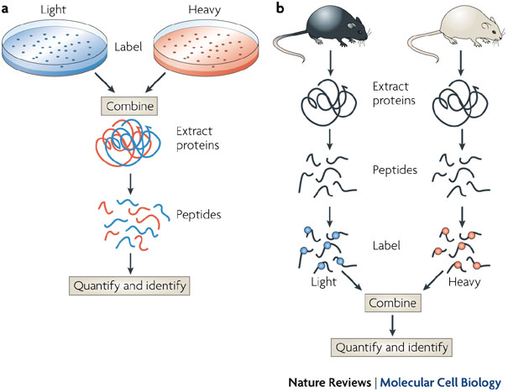
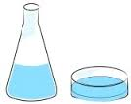
Skyline supports metabolic labeling
1. Metabolic labeling
Stable-isotope labeling
SILAC
¹⁵N labeling
Condition A
light (¹²C ¹⁴N)
arginine and lysine
Condition B
heavy (¹³C ¹⁵N)
arginine and lysine
Condition A
light ¹⁴N
Condition B
heavy ¹⁵N
(¹⁵N-labeled (NH₄)₂SO₄)
Intensity
Intensity
m/z
m/z
constant mass shift
8 Da (lysine) or 10 Da (arginine)
→ variable mass shift depending on the number of N-atoms in the peptide/fragment

Slide 14
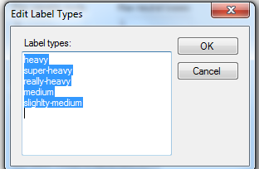
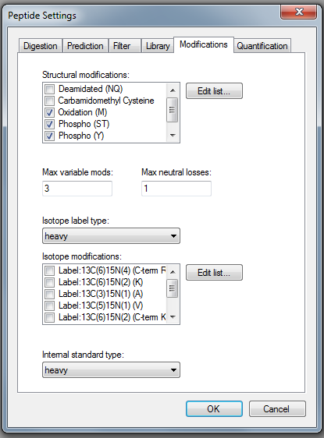
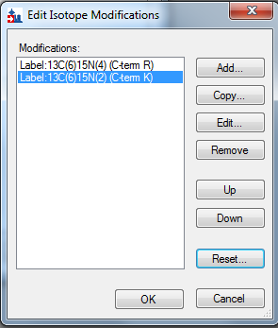
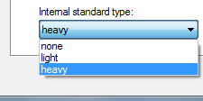
Modifications tab
1. Metabolic labeling
Skyline supports metabolic labeling
  You can define and name labels ; select those relevant for your experiment.
  You can select a set of possible isotope modifications; enable those relevant for the label.
  You can select which (if any) label is the internal standard

Slide 15
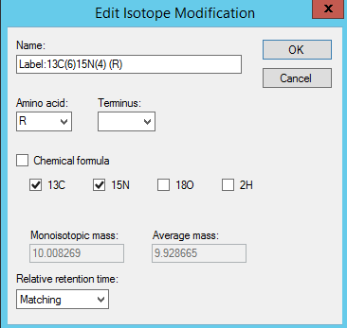
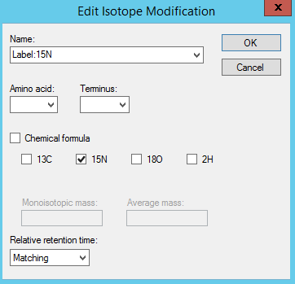
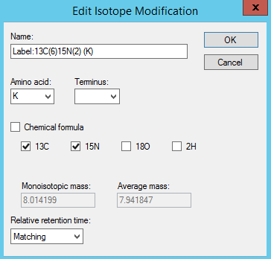
Skyline supports metabolic labeling
1. Metabolic labeling
Stable-isotope labeling
1. Define isotope modifications
→ Peptide Settings → Modifications → Isotope Modification
SILAC
¹⁵N labeling

Slide 16
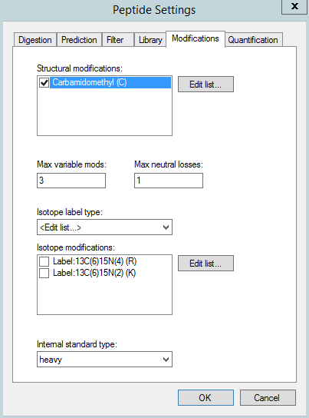
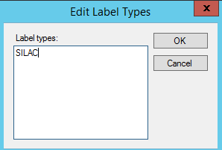
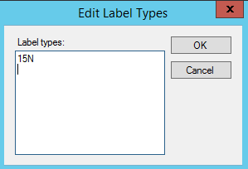
Skyline supports metabolic labeling
1. Metabolic labeling
Stable-isotope labeling
2. Create additional label type
SILAC
¹⁵N labeling

Slide 17
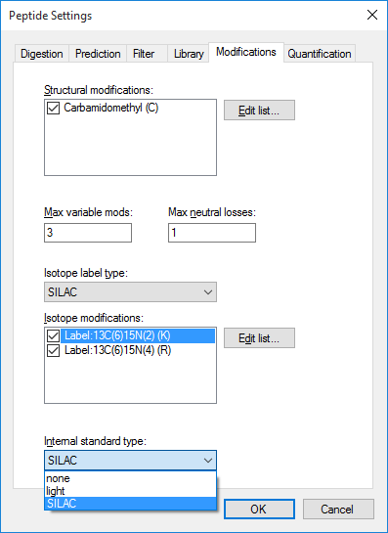

Skyline supports metabolic labeling
1. Metabolic labeling
Stable-isotope labeling
3. Define Label Types
SILAC
¹⁵N labeling

Slide 18
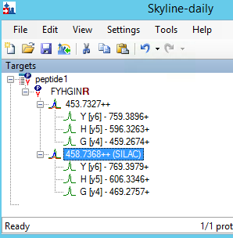
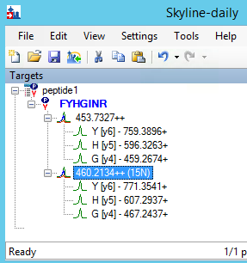
Skyline supports metabolic labeling
1. Metabolic labeling
Stable-isotope labeling
4. Isotope labeled variants will appear in peptide list
SILAC
¹⁵N labeling
Δ 5 Da
Δ 6.5 Da
Δ 12 Da
Δ 10 Da
Δ 11 Da
Δ 8 Da

Slide 19
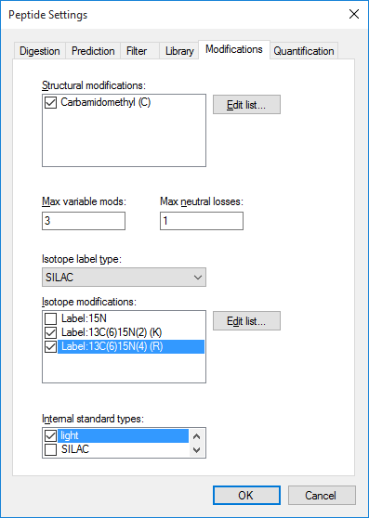
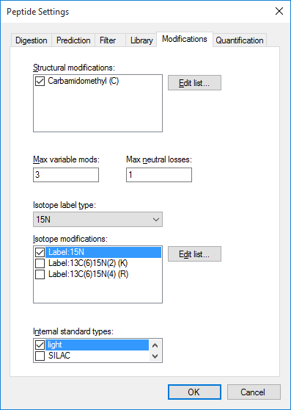
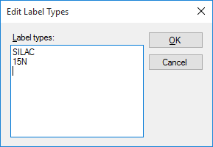
Skyline supports metabolic labeling
1. Metabolic labeling
Stable-isotope labeling
Combination of several
isotope modification types in a single Skyline document is possible!!!!
light AND SILAC and ¹⁵N labeling

Slide 20
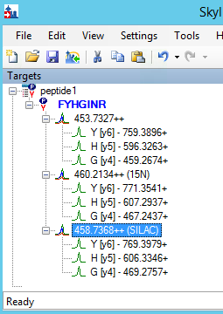
Skyline supports metabolic labeling
1. Metabolic labeling
Stable-isotope labeling
Combination of several
isotope modification types in a single Skyline document is possible!!!!

Slide 21
Strategies for incorporating stable-isotopes
Stable-isotope labeling
1. Metabolic labeling
4. Spike-in of isotope-labeled standards
label-based
For example:
For example:
SILAC
synthetic peptides
¹⁵N-labeling
protein standards
2. Chemical labeling
3. Enzymatic labeling
For example:
For example:
Dimethyl-labeling
¹⁸O-labeling
iTRAQ
TMT

Slide 22
Spike-in of isotope-labeled standards
4. Spike-ins
Stable-isotope labeling
synthetic peptides
concatenated
peptides
full-length
recombinant proteins
NH₂
COOH
plasmid
plasmid
¹³C- ¹⁵N-labeled C-terminal
amino acid (lysine/arginine)
Different purity forms available from various companies:
Crude peptides = cheap
→ Library generation and relative quant.
Highly purified peptides (AQUA/SIS) = expansive
→ Absolute quant.
cloning of concatenated
peptides (possibly from
different proteins) QconCAT
overexpression in
labeled medium
purification and concentration determination
co-digestion with endogenous proteins
cloning of the complete protein
overexpression of the target protein in labeled medium
purification and concentration determination
co-digestion with endogenous protein

Slide 23
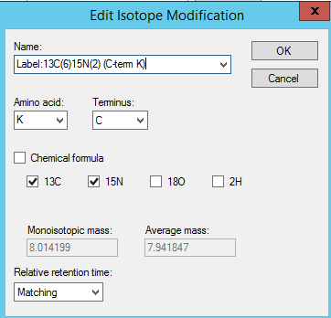
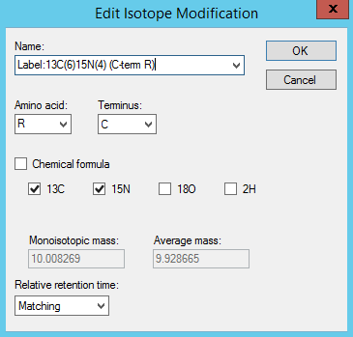
Skyline supports spike-in labeling
4. Spike-in
1. Define isotope modifications
synthetic peptides
NH₂
COOH
Different to SILAC modification!!!
¹³C- ¹⁵N-labeled C-terminal
amino acid (lysine/arginine)
Different purity forms available from various companies:
Crude peptides = cheap
→ Library generation and relative quant
Highly purified peptides (AQUA/SIS) = expansive
→ Absolute quant.

Slide 24
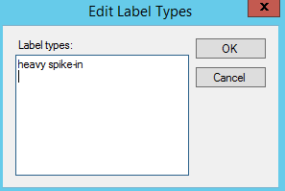
Skyline supports spike-in labeling
4. Spike-in
1. Define isotope modifications
synthetic peptides
2. Create additional label type
NH₂
COOH
¹³C- ¹⁵N-labeled C-terminal
amino acid (lysine/arginine)
Different purity forms available from various companies:
Crude peptides = cheap
→ Library generation and relative quant
Highly purified peptides (AQUA/SIS) = expansive
→ Absolute quant.

Slide 25
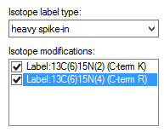
Skyline supports spike-in labeling
4. Spike-in
1. Define isotope modifications
synthetic peptides
2. Create additional label type
3. Define Label Types
NH₂
COOH
¹³C- ¹⁵N-labeled C-terminal
amino acid (lysine/arginine)
Different purity forms available from various companies:
Crude peptides = cheap
→ Library generation and relative quant
Highly purified peptides (AQUA/SIS) = expansive
→ Absolute quant.

Slide 26
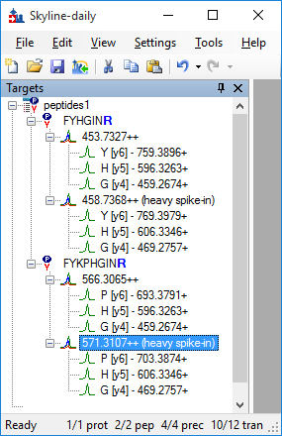
Skyline supports spike-in labeling
4. Spike-in
1. Define isotope modifications
synthetic peptides
2. Create additional label type
3. Define Label Types
NH₂
COOH
4. Isotope labeled variants will appear in peptide list
¹³C- ¹⁵N-labeled C-terminal
amino acid (lysine/arginine)
Different purity forms available from various companies:
Crude peptides = cheap
→ Library generation and relative quant
Highly purified peptides (AQUA/SIS) = expansive
→ Absolute quant.
Δ 5 Da
Δ 5 Da

Slide 27
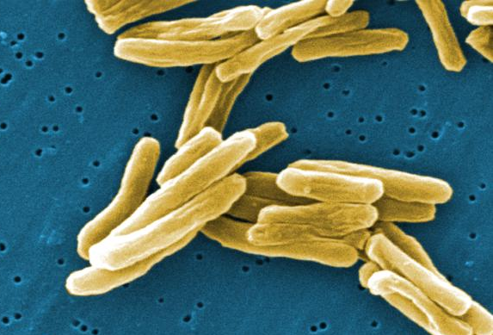
Tutorial-6 “Manual SRM data analysis in Skyline” Zürich course
Stable-isotope labeling
http://targetedproteomics.ethz.ch/downloads.html
http://targetedproteomics.ethz.ch/tutorials2014/Tutorial-6_ManualAnalysis.pdf
Mycobacterium tuberculosis (Mtb) total cell extracts
  Three different time points of hypoxia: 0h, 6h, and 48h
10 target proteins represented by 3 peptides each
→ total of 30 peptides
30 isotopically labelled crude synthetic reference peptides available and spiked into each sample at the same concentration
Task:
Analyze the data twice: Once label-free, once label-based!
Investigate the quantitative differences.
heavy reference peptides
SRM
Intensity
Protein Extraction
Tryptic Digest
LC Retention Time

Slide 28
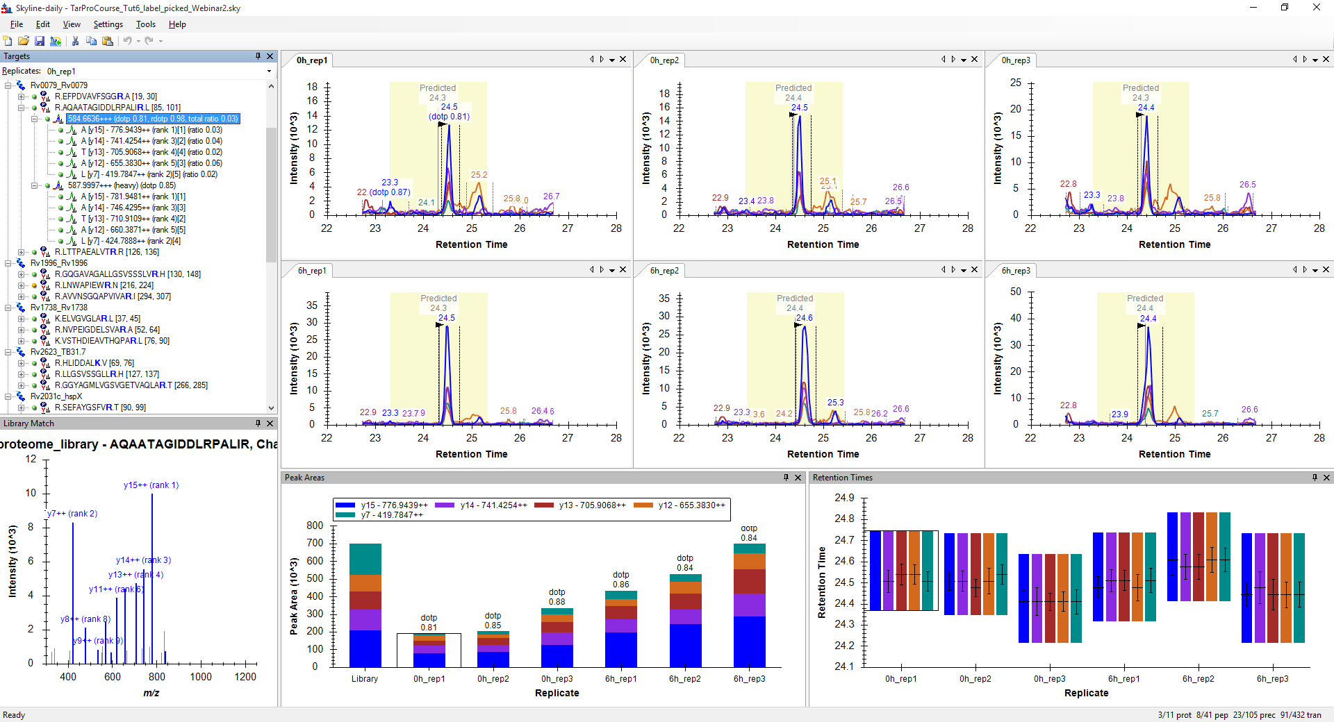
Tutorial-6 “Manual SRM data analysis in Skyline” Zürich course
Stable-isotope labeling
http://targetedproteomics.ethz.ch/tutorials2014/Tutorial-6_ManualAnalysis.pdf
0h
6h
0h
6h

Slide 29
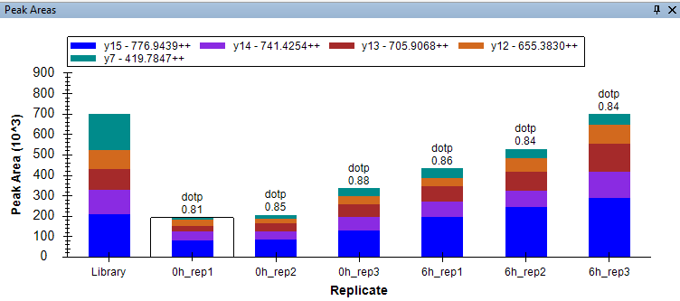
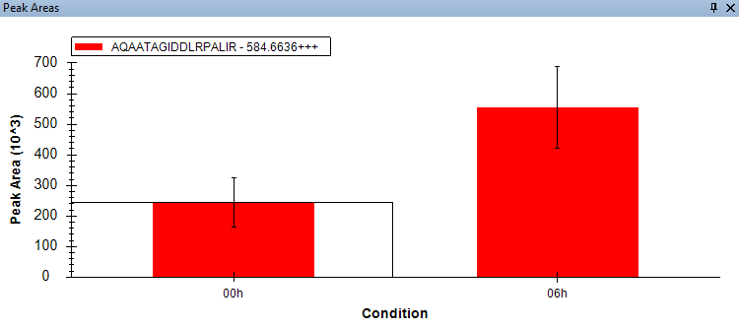
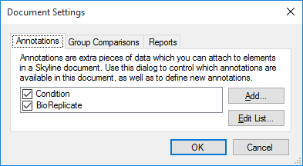
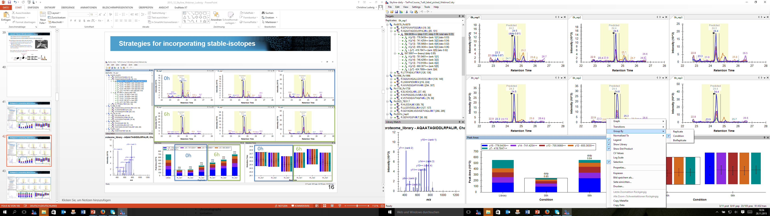
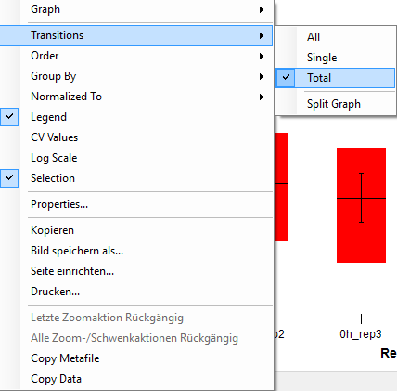
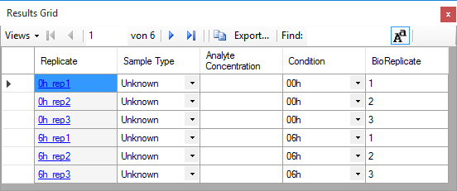
“Peak Area” viewing options in Skyline
Stable-isotope labeling
1. Settings → Document Settings
3. right mouse click on „Peak Areas“ window
2. View → Results Grid

Slide 30
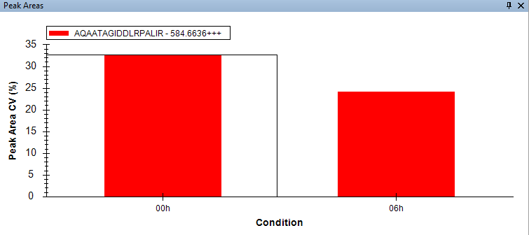
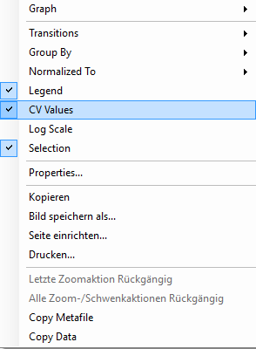
“Peak Area” viewing options in Skyline
Stable-isotope labeling
right mouse click on „Peak Areas“ window
Coefficient of variation in %
Is the detected fold-change of peptide AQAATAGIDDLRPALIR between condition 0h and 6h statistical significant?

Slide 31
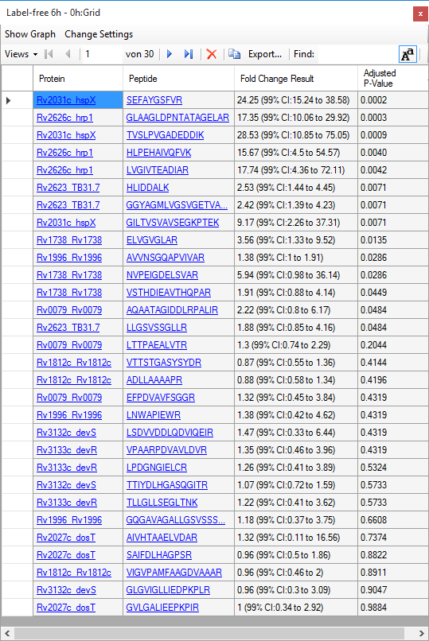
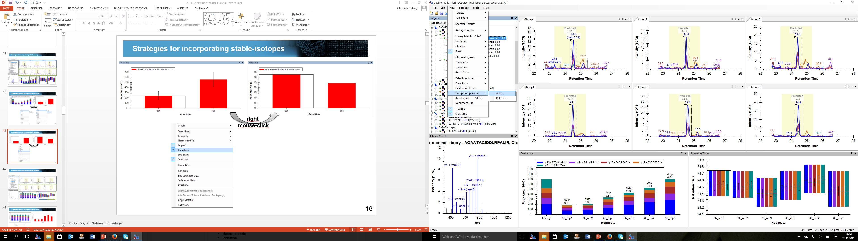
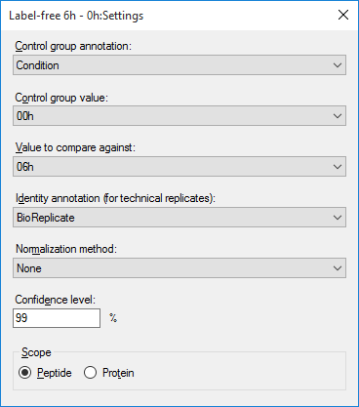
Simple group comparison within Skyline
Stable-isotope labeling
Tutorial „Processing Grouped Study data“: https://skyline.gs.washington.edu/labkey/tutorial_grouped.url

Slide 32
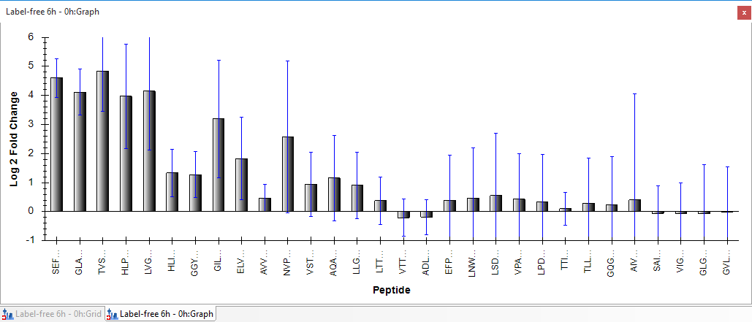
Simple group comparison within Skyline
Stable-isotope labeling
Tutorial „Processing Grouped Study data“: https://skyline.gs.washington.edu/labkey/tutorial_grouped.url
Confidence interval whiskers
With a confidence of 99% (adj. p-value < 0.01) peptide AQAATAGIDDLRPALIR does
not change significant between 0h and 6h!

Slide 33
Tutorial-6 “Manual SRM data analysis in Skyline”
Stable-isotope labeling
http://targetedproteomics.ethz.ch/tutorials2014/Tutorial-6_ManualAnalysis.pdf
0h
6h
0h
6h
0h
6h

Slide 34
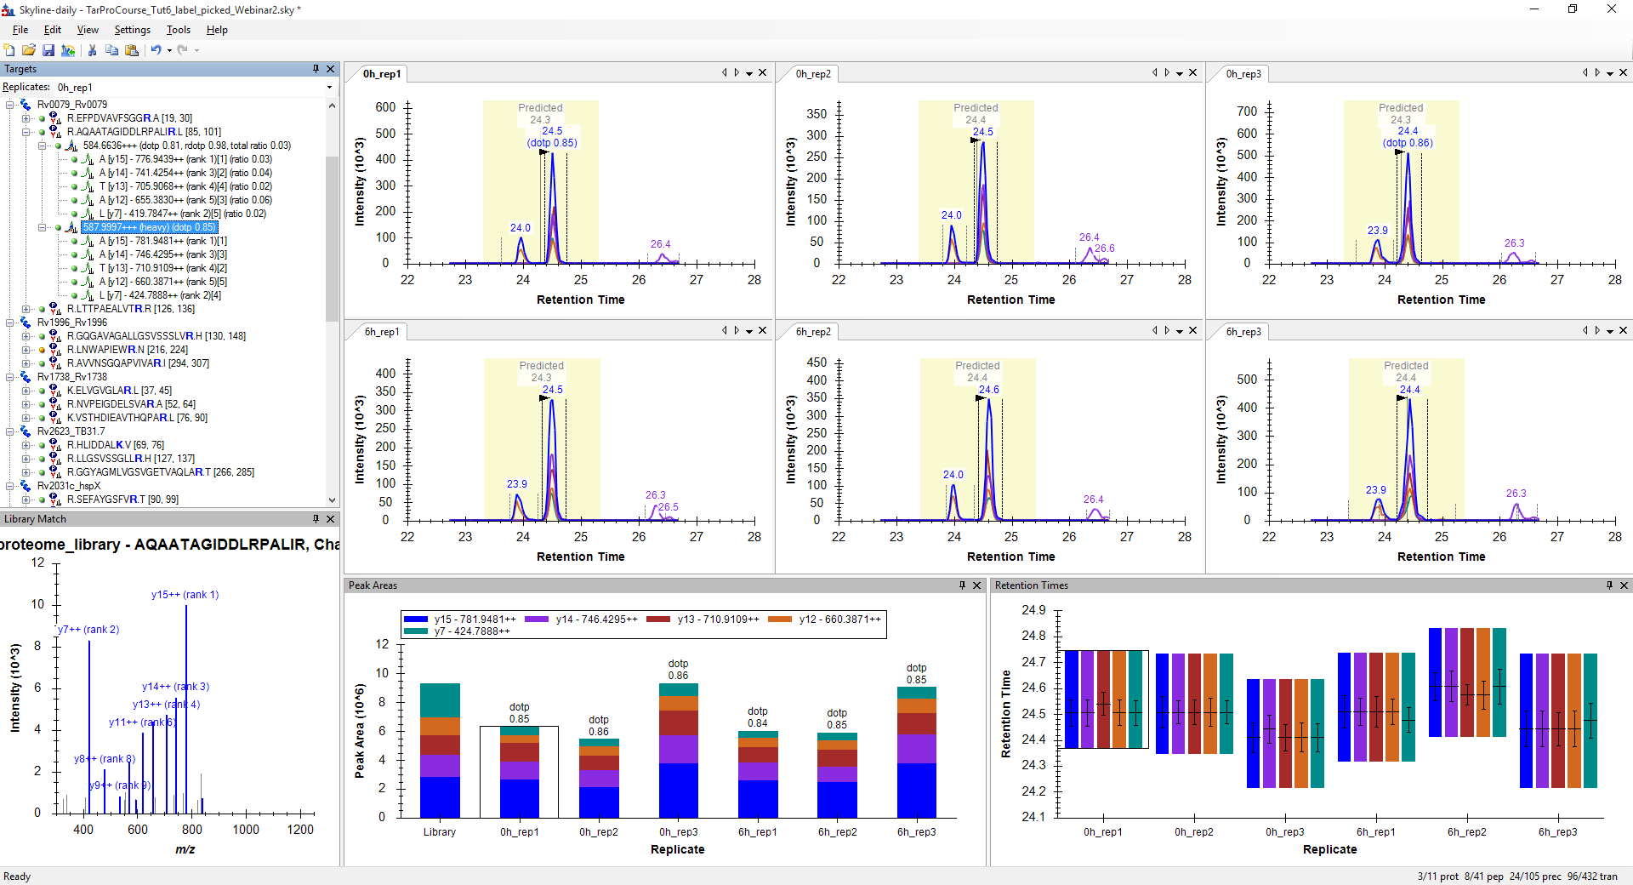
Tutorial-6 “Manual SRM data analysis in Skyline”
Stable-isotope labeling
http://targetedproteomics.ethz.ch/tutorials2014/Tutorial-6_ManualAnalysis.pdf
0h
6h
0h
6h
0h
6h

Slide 35
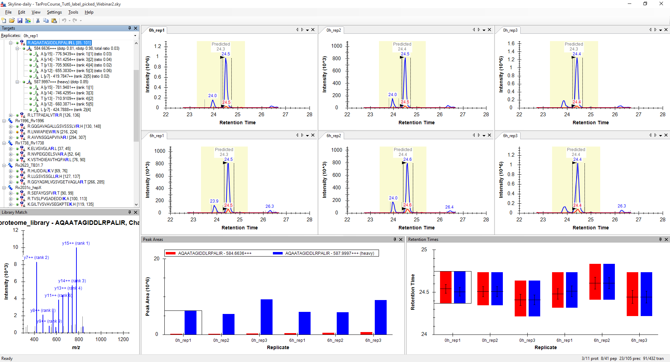
Tutorial-6 “Manual SRM data analysis in Skyline”
Stable-isotope labeling
http://targetedproteomics.ethz.ch/tutorials2014/Tutorial-6_ManualAnalysis.pdf
0h
6h
0h
6h
0h
6h

Slide 36
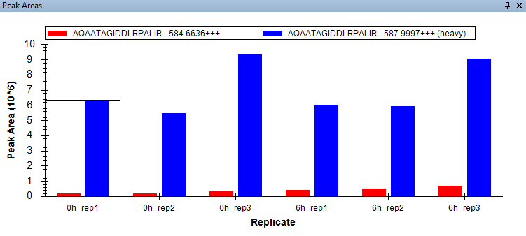
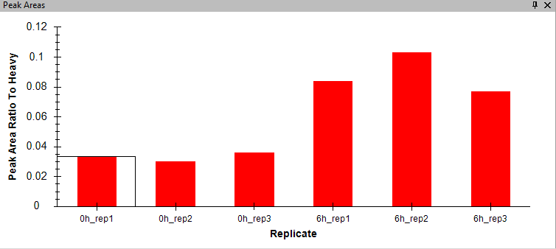
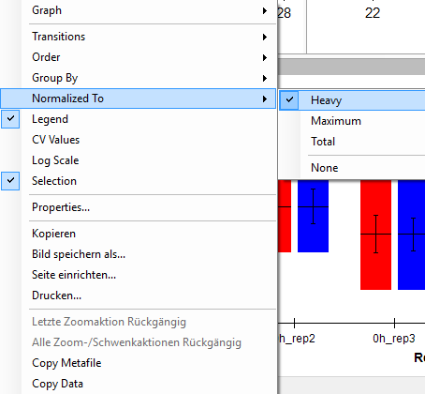
“Peak Area” viewing options in Skyline
Stable-isotope labeling
right mouse click on „Peak Areas“ window

Slide 37
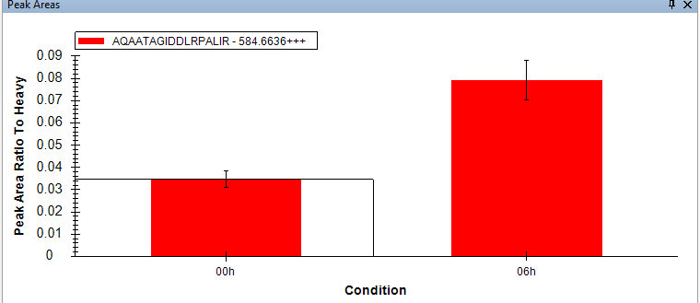
“Peak Area” viewing options in Skyline
Stable-isotope labeling
right mouse click on „Peak Areas“ window

Slide 38
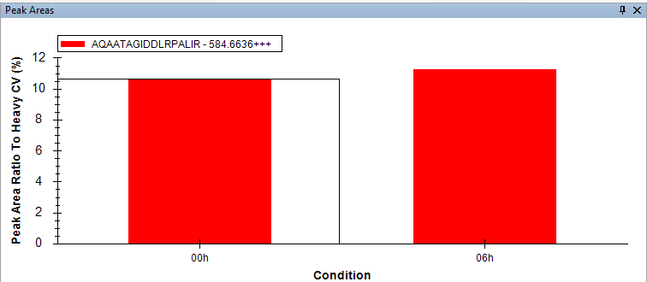
“Peak Area” viewing options in Skyline
Stable-isotope labeling
right mouse click on „Peak Areas“ window
Coefficient of variation in %

Slide 39
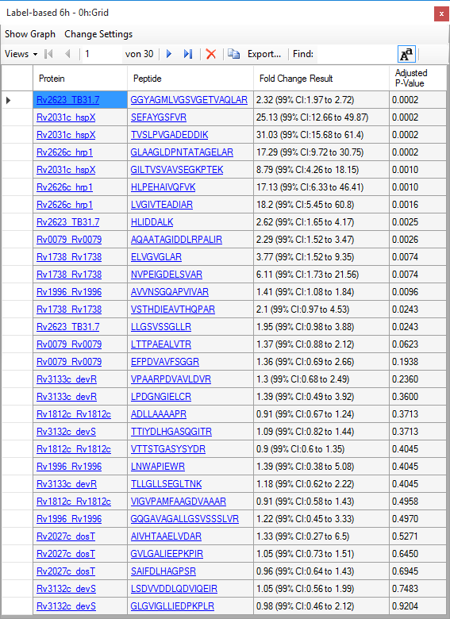

Simple group comparison within Skyline
Stable-isotope labeling
Tutorial „Processing Grouped Study data“: https://skyline.gs.washington.edu/labkey/tutorial_grouped.url

Slide 40

Simple group comparison within Skyline
Stable-isotope labeling
Label-free
Conclusion: Spike-in of isotope labeled peptides helps to account for sample preparation variabilites from the spike-in moment on
(no protein extraction or digestion variabilities!!!).
Thereby quantitative precision and accuracy get improved!
Label-based

Slide 41
The multitude of quantitative MS-applications
SpikeTides
¹⁸O-labeling
SILAC
emPAI
iTRAQ
IBAQ
PSAQ
ICAT
APEX
PAI
QconCAT
¹⁵N-labeling
Dimethyl-labeling
mTRAQ
pREST
Super-SILAC
ICPL
NSAF
AQUA
ALF
TMT
Label-free

Slide 42


Relative versus absolute protein quantification
relative
absolute
¹⁵N-labeling
¹⁸O-labeling
PSAQ
IBAQ
mTRAQ
NSAF
SILAC
APEX
QconCAT
APEX
emPAI
SpikeTides
AQUA
ICPL
iTRAQ
ALF
emPAI
pREST
TMT
ICAT
IBAQ
Dimethyl-labeling
QconCAT
AQUA
Label-free
PSAQ
ALF

Slide 43


Definition of absolute versus relative protein quantification
Relative quantification
Absolute quantification
samples
≥ 2 samples
≥ 1 samples
healthy
disease
1 : 2
2-fold upregulated
protein
concentration
copies/cell
fmol/µg extract
ng/ml body fluid
output
protein ratio
relative comparison of the
same protein between samples
comparison of the same protein
between samples +
comparison of different proteins
within the same sample

Slide 44
MS-based absolute protein quantification strategies
absolute
label-based
absolute
label-free
gold-standard -
more precise !!!!

Slide 45
Label-based absolute protein quantification
absolute label-based quantification
quantification
value:
ratio to a reference with
known absolute concentration

Slide 46
Strategies for incorporating stable-isotopes
Stable-isotope labeling
1. Metabolic labeling
4. Spike-in of isotope-labeled standards
label-based
2. Chemical labeling
3. Enzymatic labeling

Slide 47
Label-based absolute protein quantification
absolute label-based quantification
quantification
value:
ratio to a reference with
known absolute concentration
quantification
approach:
synthetic
peptides
concatenated
peptides
labeled
proteins
AQUA
QconCAT
PSAQ
plasmid
plasmid

Slide 48



Absolute quantification – internal single point calibration
endogenous peptide (light)
reference peptide (heavy)
ratio light/heavy
= 1.37
Absolute quantification requires comparison to a reference molecule at a known concentration.
Single point calibration
spike-in concentration
50 fmol
68.5 fmol
50 fmol
1.37
fold
Assumptions of internal single point calibration:
Measurements are carried out within the linear dynamic range of the mass spectrometer
Linear correlation between MS signal intensity and absolute concentration with a
slope of 1 and an axis intercept of 0.

Slide 49
Absolute quantification – multiple point calibration curve
Work with dilution series of isotope-labeled reference peptides/proteins
linear equation:
y = 2.2E⁶x – 1.4E⁵
intensity
concentration, fmol/µl
Advantages of multiple point calibration:
You can account for linear peptide responses which do NOT have slope = 1 and axis intercept = 0
Limitations of multiple point calibration:
Requires multiple injections (time and sample investment)
Best → Generate an external calibration curve once and use the obtained linear equation for absolute quantification

Slide 50

Isotope-labeled absolute quantification supported within Skyline
Current Skyline Tutorial online available:
https://skyline.gs.washington.edu/labkey/tutorial_absolute_quant.url
New implementations for internal single point and multiple point calibration curves
are already available in Skyline-daily and are coming soon in Skyline public….

Slide 51
Internal single-point absolute quantification supported within Skyline
Published data set:
Schubert O. T. & Ludwig C., et al. Cell host & microbe 18, 96-108, doi:10.1016/j.chom.2015.06.001 (2015).
Panorama link: https://panoramaweb.org/labkey/Mtb_anchors.url
Motivation of the data set:
Absolutely quantify 30 proteins in Mycobacterium Tuberculosis over 24 samples using
1-2 AQUA peptides per protein.
Points to consider regarding sample preparation:
Spike-in AQUA peptides into all samples.
Keep the concentration for a given AQUA peptide over all samples constant
Try to select a spike-in AQUA concentration close to 1:1 light : heavy
→ If a peptide is strongly regulated over the samples of interest a 1:1 ratio is of course
not possible, try to select a spike-in concentration between highest and lowest sample

Slide 52

Internal single-point absolute quantification supported within Skyline

Slide 53


Internal single-point absolute quantification supported within Skyline
Peptide Settings → Quantification
View → Document Grid → Views → Peptide Quantification
Copy paste spike-in concentrations of each AQUA peptide in fmol/µg

Slide 54

Internal single-point absolute quantification supported within Skyline
View → Document Grid → Views → Peptide Ratio Results

Slide 55


Multiple-point absolute quantification supported within Skyline
Peptide Settings → Quantification
View → Document Grid → Views → Replicates

Slide 56



Multiple-point absolute quantification supported within Skyline
View → Document Grid → Views → Peptide Quantification

Slide 57

Take-home messages - Quantification
Isotope-labeling helps to account for various types of variabilities (during sample preparation and LC-MS) and thereby to improve quantitative precision and accuracy!
For every research project the optimal quantitative approach must be selected accordingly (label-free or label-based, relative or absolute)
→ Skyline supports label-free as well as all 4 different subtypes of label-based quantification approaches (metabolic, enzymatic, chemical, spike-in)
→ Skyline supports internal single-point as well as multiple point absolute quantification

Slide 58

Acknowledgements
Targeted Proteomics Course Zürich – Team:
Prof. Ruedi Aebersold (ETH Zürich)
Brendan MacLean (University of Washington)
Prof. Mike MacCoss (University of Washington)
The whole Skyline Team
Prof. Olga Vitek (Northeastern University)
Prof. Bruno Domon (Luxembourg Institute of Health)
Olga Schubert (UCLA)
Ben Collins (ETH Zürich)
Betty Friedrich (ETH Zürich)
Ludovic Gillet (ETH Zürich)
Meena Choi (Purdue University)
Lukas Reiter (Biognosys)
Claudio Escher (Biognosys)
Oliver Rinner (Biognosys)
Eduard Sabido (CRG Barcelona)
Dario Amodei (Google)
Jarrett Egertson (University of Washington)
Ralph Schiess (ProteoMedix)
Paola Picotti (ETH Zürich)

Slide 59
Learn More
Webinar #13: in January
Weeklong Course at IIT-Bombay
  December 10-14 - Full
Weeklong Courses 2016
  ETH, Zurich – February 8-12 - Full
  Buck Institute, San Francisco – March 7-11 – Register now!
  Northeastern University, Boston – May 2-6
  University of Washington, Seattle – July 18-22
  PRBB, Barcelona – November 13-18
Workshops 2016
  US HUPO, Boston – March 13

Slide 60
Questions?
Ask any questions you have on modifications in Skyline at the following form:
http://tinyurl.com/QA4Skyline
Take the post-webinar survey:
http://tinyurl.com/Survey4Webinar

Slide 61
Tutorial Webinar #12
This ends this Skyline Tutorial Webinar.
Please give us feedback on the webinar at the following survey:
http://tinyurl.com/Survey4Webinar
A recording of today’s meeting will be available shortly at the Skyline website.
We look forward to seeing you at a future Skyline Tutorial Webinar.

Slide 62
Additional slide material Christina Ludwig

Slide 63



Tips and tricks: Isotope impurity!
Isotope-labeled synthetic peptides can be “polluted” with the light form.
→ Make sure what you are measuring in the light channel is not a “pollution” coming form the synthetic peptide (ratios close to 1:1 help!)

Slide 64


Tips and tricks: Isobaric transition interferences
Isobaric transition interferences between heavy and light form of a peptide can make exclusions of such transitions necessary!
→ Investigate your data!
Δ 0.93 m/z
Δ . 0.06 m/z

Slide 65

Tips and tricks: Different isotopic envelopes between light and heavy
The isotopic pattern of the light and heavy peptide form is not perfectly equal!
→ Hence, high resolution accurate mass data (PRM, DIA), where quantification gets based on the monoisotopic peak (as performed in Skyline!), must get corrected for the different theoretical isotopic pattern.
7% increase for 75 C-atom peptide
Standard peptide
(15 aa 75 C-atoms)
1.1% ¹³C in
75 C-atoms
1.1% ¹³C in
69 (75-6) C-atoms
Figure adapted from Mike MacCoss
Mass Spectrometry Signal Calibration for Protein Quantitation, technical note, Cambridge Isotope Laboratories

Slide 66
Tips and tricks: Handling AQUA peptides
Issue when handling AQUA peptides (highly purified peptide solutions with precisely determined concentration):
Significant Losses of AQUA peptides due to attachment to surfaces, degradation, freezing-thawing cycles, etc.
Tips:
→ work with low-binding vessels and low-binding pipetting tips
→ whenever possible use glass ware
→ whenever possible use a complex sample background or a BSA solution as blocking reagent
→ aliquote your standard stock solution upon arrival to avoid freezing-thawing cycles
→ only purchase standards with known concentration in solution (not lyophilized to avoid any resuspension step)

Slide 67
Strategies for incorporating stable-isotopes
Stable-isotope labeling
1. Metabolic labeling
4. Spike-in of isotope-labeled standards
label-based
For example:
For example:
SILAC
synthetic peptides
¹⁵N-labeling
protein standards
2. Chemical labeling
3. Enzymatic labeling
For example:
For example:
Dimethyl-labeling
¹⁸O-labeling
iTRAQ
TMT

Slide 68

Skyline supports chemical labeling
2. Chemical labeling
Dimethyl labeling
reactivity for primary amines
(N-terminus and Lysine residues)
+ 28 Da light
+ 4 Da
+ 32 Da medium
+ 8 Da
+ 36 Da heavy
Boersema, P. J. et al., Nature Protocols, 4, 484-494 (2009).

Slide 69
Modifications tab
2. Chemical labeling
Skyline supports chemical labeling
  You can define and name labels ; select those relevant for your experiment.
  Additionally needed
  You can select a set of possible isotope modifications; enable those relevant for the label.
  You can select which (if any) label is the internal standard

Slide 70


Skyline supports chemical labeling
2. Chemical labeling
Dimethyl labeling
reactivity for primary amines
(N-terminus and Lysine residues)
1. Define structural modification
+ 28 Da light
+ 4 Da
+ 32 Da medium
+ 8 Da
+ 36 Da heavy
Boersema, P. J. et al., Nature Protocols, 4, 484-494 (2009).

Slide 71


Skyline supports chemical labeling
2. Chemical labeling
Dimethyl labeling
reactivity for primary amines
(N-terminus and Lysine residues)
2. Define isotope modification
+ 28 Da light
+ 4 Da
+ 32 Da medium
+ 8 Da
+ 36 Da heavy
Boersema, P. J. et al., Nature Protocols, 4, 484-494 (2009).

Slide 72


Skyline supports chemical labeling
2. Chemical labeling
Dimethyl labeling
reactivity for primary amines
(N-terminus and Lysine residues)
2. Define isotope modification
+ 28 Da light
+ 4 Da
+ 32 Da medium
+ 8 Da
+ 36 Da heavy
Boersema, P. J. et al., Nature Protocols, 4, 484-494 (2009).

Slide 73



Skyline supports chemical labeling
2. Chemical labeling
Dimethyl labeling
reactivity for primary amines
(N-terminus and Lysine residues)
3. Create additional label type
+ 28 Da light
+ 4 Da
+ 32 Da medium
4. Define Label Types
+ 8 Da
+ 36 Da heavy
Boersema, P. J. et al., Nature Protocols, 4, 484-494 (2009).

Slide 74

Skyline supports chemical labeling
2. Chemical labeling
Dimethyl labeling
reactivity for primary amines
(N-terminus and Lysine residues)
5. Isotope labeled variants will appear in peptide list
+ 28 Da light
+ 4 Da
Δ 2 Da
+ 32 Da medium
Δ 2 Da
+ 8 Da
Δ 4 Da
Δ 4 Da
+ 36 Da heavy
Boersema, P. J. et al., Nature Protocols, 4, 484-494 (2009).

Slide 75


Skyline supports chemical labeling
2. Chemical labeling
iTRAQ/TMT
(isobaric tags for relative and absolute quantification / tandem mass tags)
→ reactivity for primary amines
(N-terminus and Lysine residues)
1. Define structural modification
Reporter
Balance
Reactive group
Amine specific
114
31
115
30
Mix all samples
for one
MS/MS analysis
116
29
117
28
MReporter + MBalance = Constant

Slide 76

Skyline supports chemical labeling
2. Chemical labeling
iTRAQ/TMT
(isobaric tags for relative and absolute quantification / tandem mass tags)
→ reactivity for primary amines
(N-terminus and Lysine residues)
2. Define reporter ions
Reporter
Balance
Reactive group
Amine specific
114
31
115
30
Mix all samples
for one
MS/MS analysis
116
29
117
28
MReporter + MBalance = Constant

Slide 77

Skyline supports chemical labeling
2. Chemical labeling
iTRAQ/TMT
(isobaric tags for relative and absolute quantification / tandem mass tags)
→ reactivity for primary amines
(N-terminus and Lysine residues)
3. Labeled variants will appear in peptide list
Reporter
Balance
Reactive group
Amine specific
114
31
115
30
Mix all samples
for one
MS/MS analysis
116
29
117
28
MReporter + MBalance = Constant

Slide 78
Strategies for incorporating stable-isotopes
Stable-isotope labeling
1. Metabolic labeling
4. Spike-in of isotope-labeled standards
label-based
For example:
For example:
SILAC
synthetic peptides
¹⁵N-labeling
protein standards
2. Chemical labeling
3. Enzymatic labeling
For example:
For example:
Dimethyl-labeling
¹⁸O-labeling
iTRAQ
TMT

Slide 79



Skyline supports enzymatic labeling
3. Enzymatic labeling
Proteolytic ¹⁸O labeling
Reaction 1 (peptide bond cleavage):
+2 Da
Reaction 2 (carboxyl oxygen exchange):
+4 Da
+4 Da
Miyagi, M. & Rao, K. C. S., Mass Spectrom Rev 26, 121–136 (2007).

Slide 80


Skyline supports enzymatic labeling
3. Enzymatic labeling
Proteolytic ¹⁸O labeling
Reaction 1 (peptide bond cleavage):
1. Define isotope modifications
+2 Da
Reaction 2 (carboxyl oxygen exchange):
+4 Da

Slide 81

Skyline supports enzymatic labeling
3. Enzymatic labeling
Proteolytic ¹⁸O labeling
Reaction 1 (peptide bond cleavage):
1. Define isotope modifications
+2 Da
2. Create additional label type
Reaction 2 (carboxyl oxygen exchange):
+4 Da

Slide 82


Skyline supports enzymatic labeling
3. Enzymatic labeling
Proteolytic ¹⁸O labeling
Reaction 1 (peptide bond cleavage):
1. Define isotope modifications
+2 Da
2. Create additional label type
Reaction 2 (carboxyl oxygen exchange):
3. Define Label Types
+4 Da

Slide 83

Skyline supports enzymatic labeling
3. Enzymatic labeling
Proteolytic ¹⁸O labeling
Reaction 1 (peptide bond cleavage):
1. Define isotope modifications
+2 Da
2. Create additional label type
Reaction 2 (carboxyl oxygen exchange):
3. Define Label Types
+4 Da
4. Isotope labeled variants will appear in peptide list
Δ 1 Da
Δ 1 Da

Slide 84




protein complex stoichiometries
mathematical
modeling
For which projects does absolute
protein quantification really matter?
rate constants
kinetic fluxes
energy budget
etc.
3 : 2 : 1
data cross-comparison
pharmaceutical and biomedical industry
absolute
protein
concentration
inter-experimental
inter-laboratory
Inter-MS platform
inter-organism
quality control
therapeutic analysis
food safety
sports drug testing
etc.
protein biomarker development

Slide 85
The time-point of heavy-light sample combination matters!
Stable-isotope labeling
The more early an isotope-labeled standard is added into the samples during sample preparation, more accurate the results!
Metabolic
Chemical
Spike-in standards
label-free
cells or tissue
protein
peptides
MS data
data analysis
Bantscheff, M., Lemeer, S., Savitski, M. M. & Kuster, B., Anal Bioanal Chem 404, 939–965 (2012).

