Slide 1
Isotope Labeled Internal Standards in Skyline
Tutorial Webinar #12
With
Christina Ludwig (Proteomics Researcher)
Ariel Bensimon (Proteomics Researcher)

Slide 2
Agenda
Welcome from the Skyline team!
Isotope Labeled Standards in Skyline
Quick intro with Brendan MacLean
with Ariel Bensimon
with Tina Ludwig
Audience Q&A – submit questions to Google Form:
https://skyline.gs.washington.edu/labkey/qa4skyline.url

Slide 3
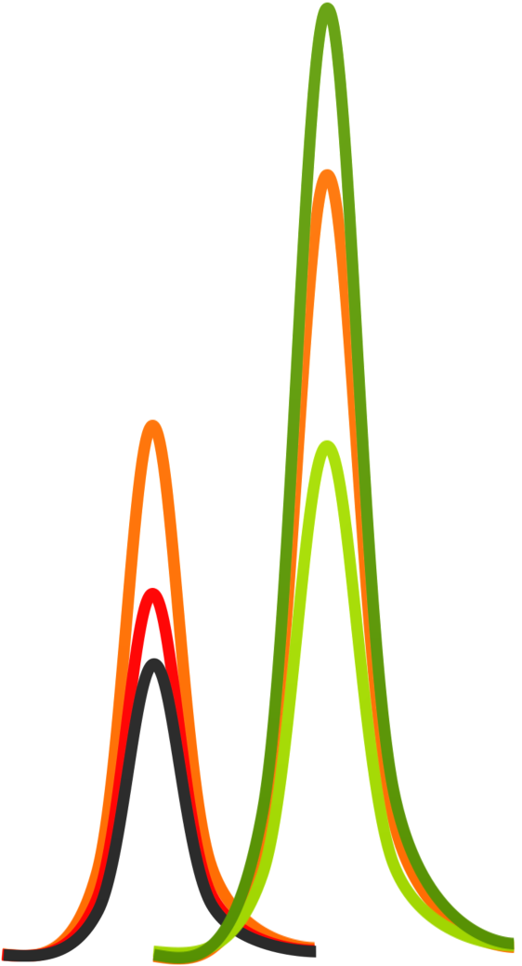


Lecture:
Isotope Labeled Standards in Skyline
Webinar , 1 December 2015
Christina Ludwig Ariel Bensimon
TU Munich ETH Zürich
Germany Switzerland

Slide 4
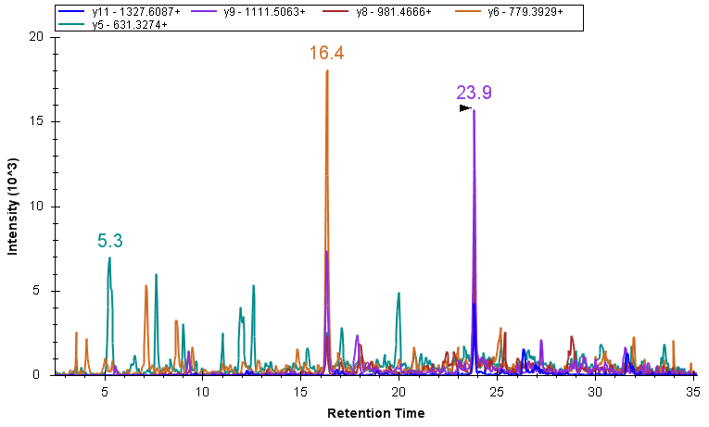
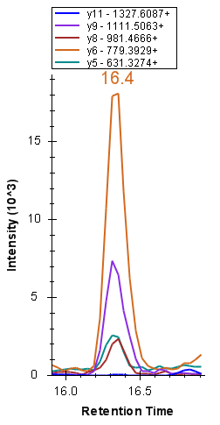
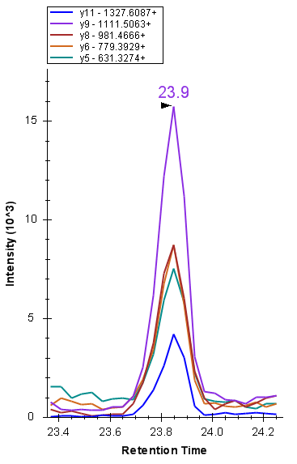
Motivation – why use isotope labeled standards ?
For the correct identification of a peptide: selecting the correct peak

Slide 5
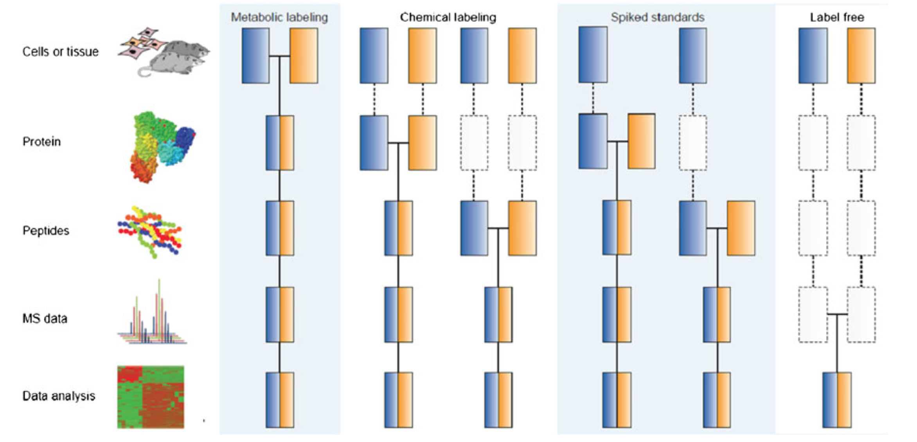
Motivation – why use isotope labeled standards ?
For the accurate quantification of a peptide: accounting for sources of variation
We assume that extra sample handling does not introduce extra variation
control
treated
cells or tissue
Biological variation
Protein extraction
protein
Technical variation: sample prep
Digestion & C18
peptides
Separation &acquisition
LC-MS variation
MS data
Signal processing
data analysis
Post-MS analysis variation
Bantscheff, M., Lemeer, S., Savitski, M. M. & Kuster, B., Anal Bioanal Chem 404, 939–965 (2012).

Slide 6

Outline
Introduction - Ariel
Improve confident peptide identification - Ariel
Improve quantitative precision and accuracy - Tina
How to get stable-isotope labeled information into a Skyline ?
Generating a reference for identification
Using a reference for peak selection
Using a reference for optimal quantification
Label-free versus label-based quantification
Metabolic, chemical, enzymatic and spike-in labeling
Relative versus absolute quantification
Single and multiple point calibration

Slide 7
Stable-isotope labeling
Heavy reference standards are generated such that they carry one or several isotope-labeled atoms.
  typically used isotope-labeled atoms: ¹³C, ¹⁵N, ¹⁸O
  most common amino acids: K, R but also A, L, I, F, P, V.
  use of ²H less favorable due to chromatographic elution differences
Be aware of the purity of isotope labeling.
These heavy references are chemically identical to the endogenous (light) targets and hence we assume they show the same behavior in terms of
  sample preparation biases
  Chromatography
  ionization
  fragmentation

Slide 8
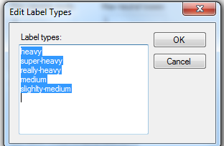
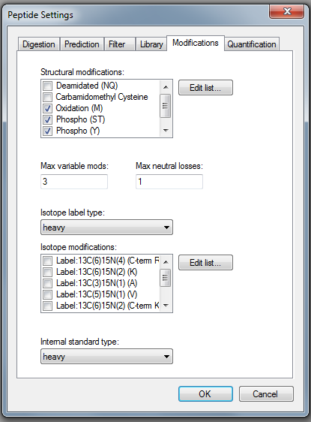
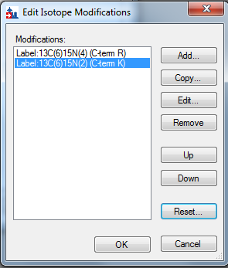
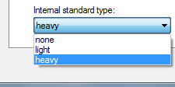

Modifications tab
Settings>>peptide senttings>>modifications (see also webinar 10)
  You can define and name labels ; select those relevant for your experiment. Some appear in default
  You edit a set of possible isotope modifications; select those relevant for each of the labels
  You can select which (if any) label is the internal standard
  You assume the standard is present;
  Reverse is possible

Slide 9
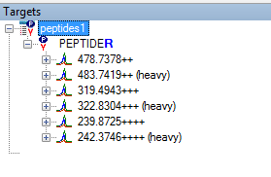
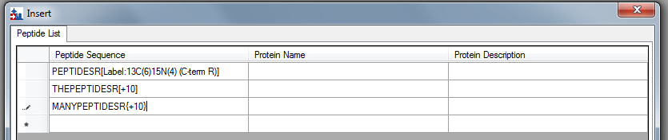
Insert peptides
Edit>>Insert>>peptides (see also webinar 10)
Insert a light peptide sequence
Insert a modified peptide sequence
Full name
Mass in []
Correct: Mass in {}

Slide 10
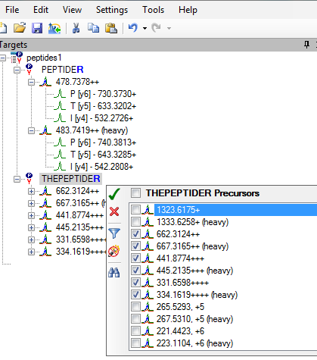
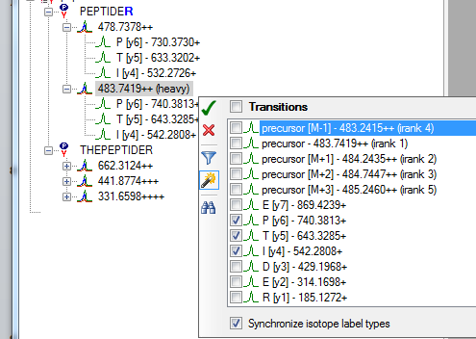
Select precursors & transitions

Slide 11
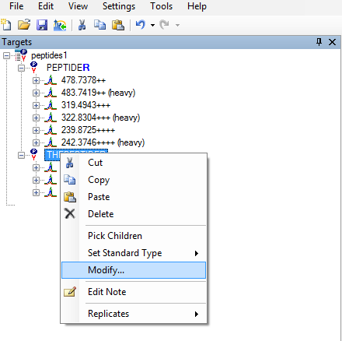
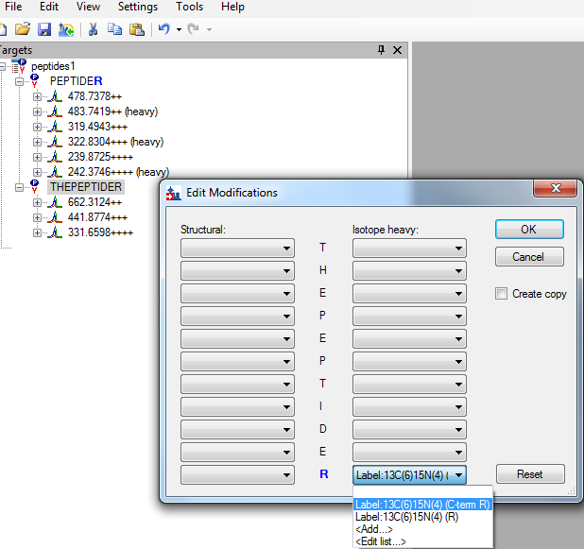
Modify peptides
Make sure these are first set in Modifications tab

Slide 12
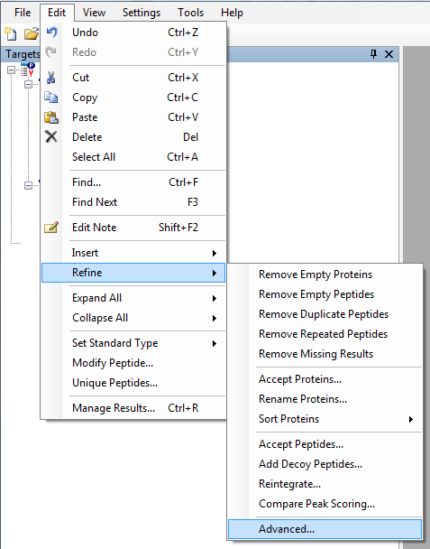
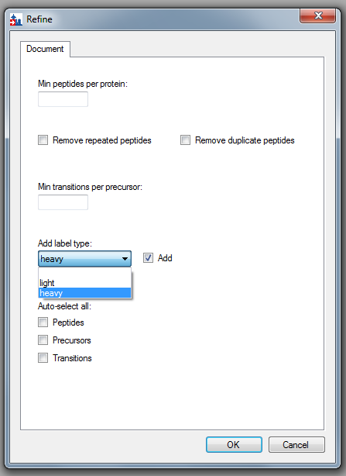
Add label

Slide 13
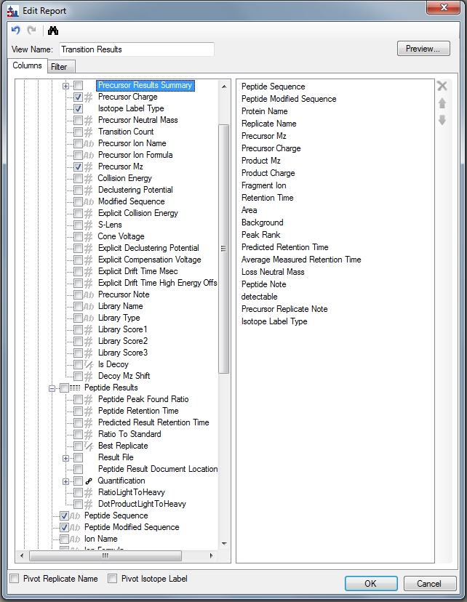
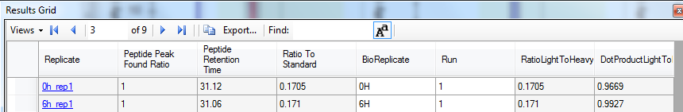
Export & Results
Isotope label information can be selected in any report exported:
Pivot based on the isotope label
In results grid:
Results tutorial : https://skyline.gs.washington.edu/labkey/_webdav/home/software/Skyline/@files/tutorials/CustomReports-1_2.pdf

Slide 14
Outline
Introduction - Ariel
Improve confident peptide identification - Ariel
Improve quantitative precision and accuracy - Tina
Take home messages
(General Tips and Tricks when working with isotope-labeled peptides - Tina)
How to get stable-isotope labeled information into a Skyline ?
Generating a reference for identification
Using a reference for peak selection
Using a reference for optimal quantification
Label-free versus label-based quantification
Relative versus absolute quantification

Slide 15
Motivation – why use isotope labeled standards ?
For the correct identification of a peptide: selecting the correct peak

Slide 16
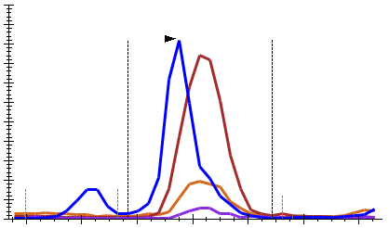
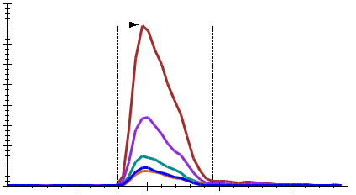
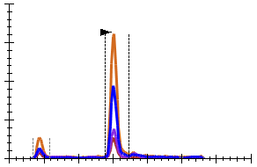
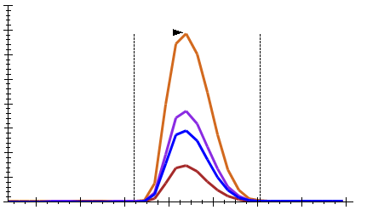
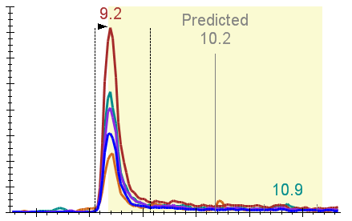
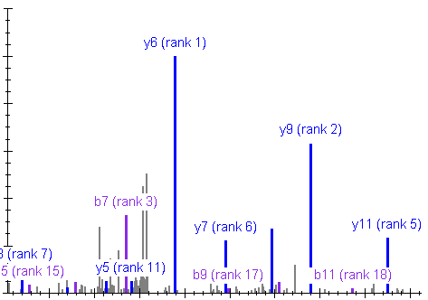
Criteria for reliable peak identification
1. Co-elution
2. Peak shape
3. Signal intensity
intensity
intensity
intensity
time (min)
time (min)
time (min)
4. Correlation peak
intensities to library spectrum
5. Correlation retention time
(empirical)
intensity
y6
intensity
y9
y7
y11
time (min)
m/z

Slide 17
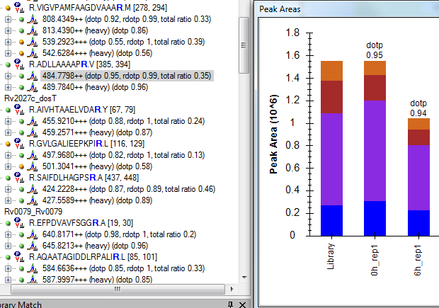
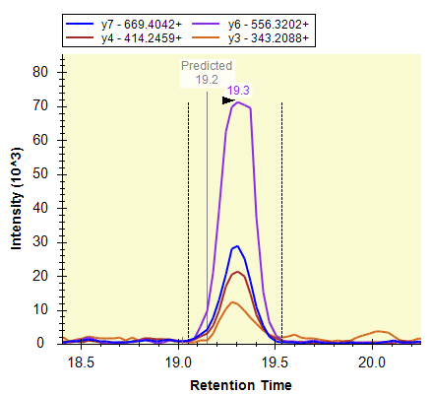
Generating a reference for identification
We can use a synthetic standard to generate :
  A reference spectrum for the spectral library (see also webinar 4, tutorials)
  A reference retention time value , for the RT library (see webinar 7, tutorials)
Shotgun data
Reference spectrum
PRM data
Data conversation
MS/MS search
Library building
Reference for retention time
SRM data
To read how is dotp calculated in Skyline:
https://skyline.gs.washington.edu/labkey/announcements/home/support/thread.view?rowId=20003

Slide 18
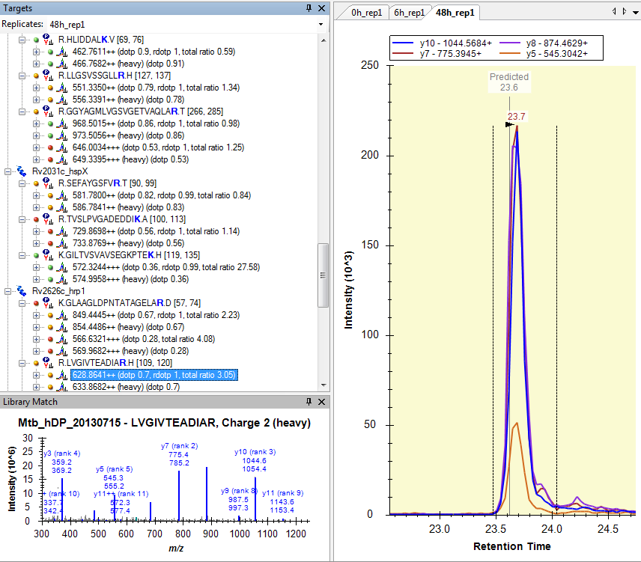
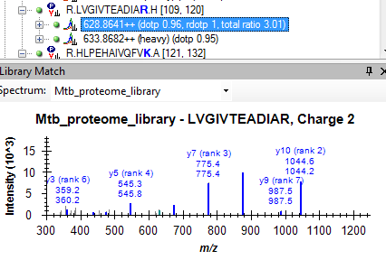
Generating a reference for identification
We can use a synthetic standard to generate a reference:
  peptide or protein standard.
  heavy or light standard (chemically identical).
  Skyline transfers information, if you activate the heavy label in Modifications.
To ensure a good dotp: Perform an identification experiment with the same MS setup (CE etc) , as in the targeted experiment.
Shotgun data
PRM data
SRM data

Slide 19
Generating a reference for identification
We can use a synthetic standard to generate a reference spectrum for the spectral library in SRM:
SRM triggered MS2 on QTRAP: if a product ion is monitored above a threshold, switch to Enhanced Product Ion (switch Q3 to LIT, acquire full fragment scan).
  For assay generation (using synthetic standards).
    http://targetedproteomics.ethz.ch/downloads.html (tutorials 2013)
  For validation (of any endogenous peptide peak).
Targeted MS2: SRM triggered MS2 as well as PRM. In both modes, one can view the peptide MS/MS events using Skyline.
SRM data ?
SRM triggered MS2
Data conversation
MS/MS search
Library building
Reference spectrum
Picotti, P., et al. (2010). High-throughput generation of selected reaction-monitoring assays for proteins and proteomes. Nat Methods 7, 43–46.

Slide 20
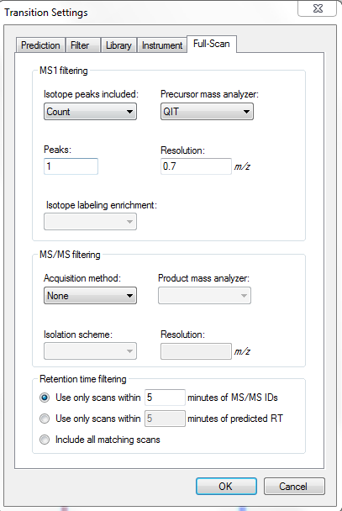
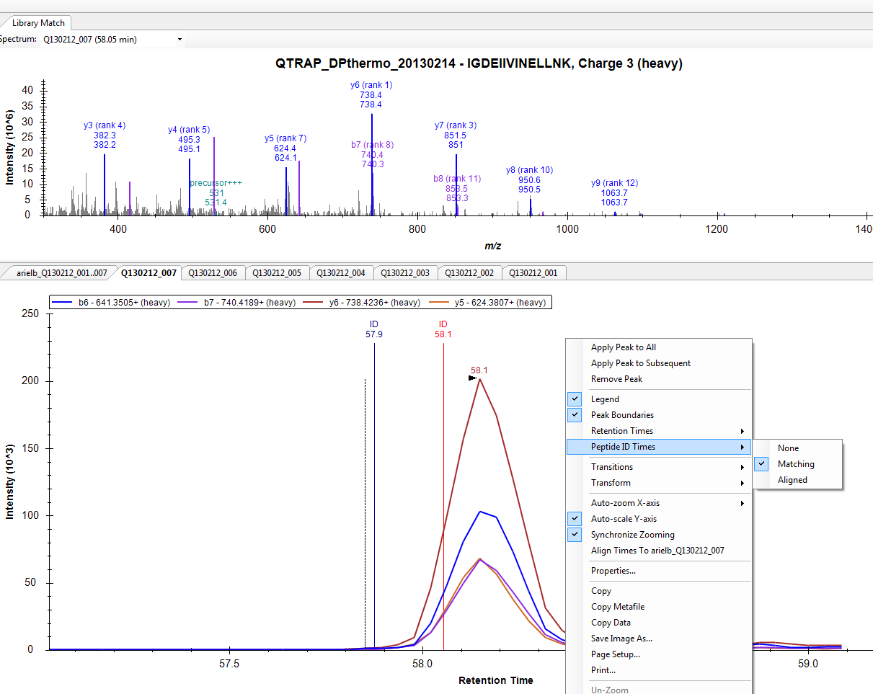
Targeted MS2 in Skyline
For SRM trig-MS2 files: Enable the Full-scan Enable ID matching in the view
Note: for PRM the parameters are different (webinar 3)

Slide 21
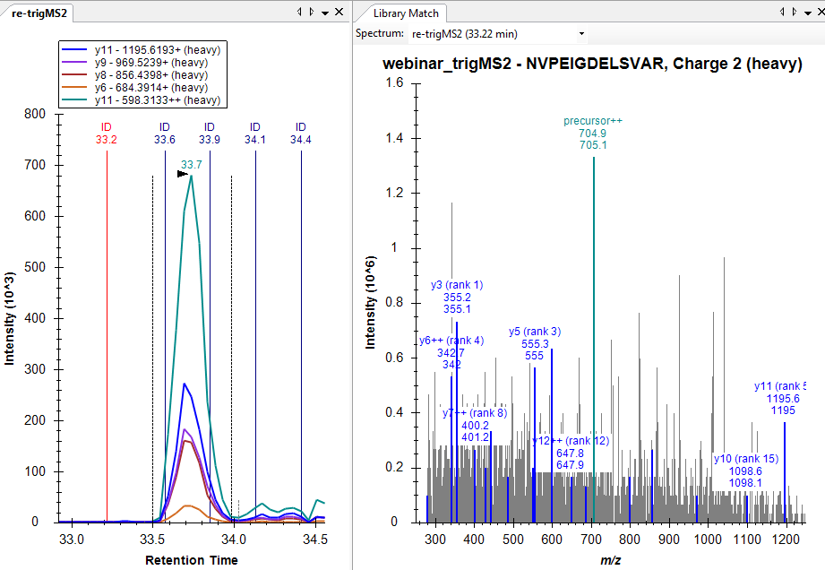
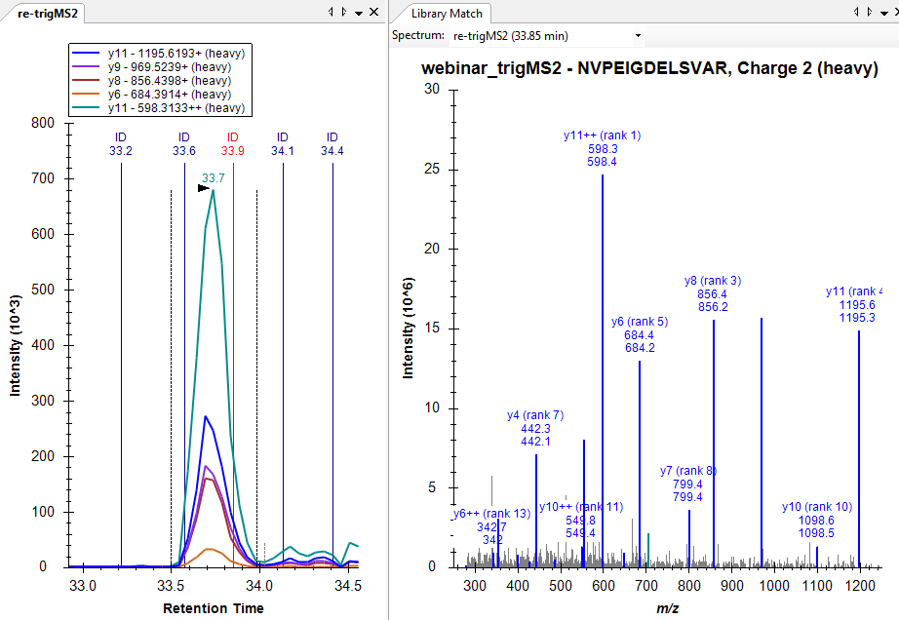
Targeted MS2 in Skyline
When working with with synthetic standards for assay generation : ensure the quality of your spectra
https://skyline.gs.washington.edu/labkey/tutorial_library_explorer.url

Slide 22
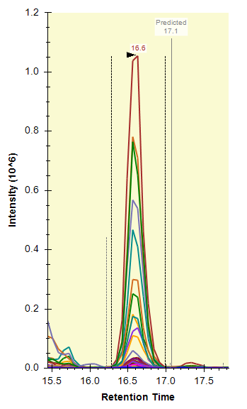

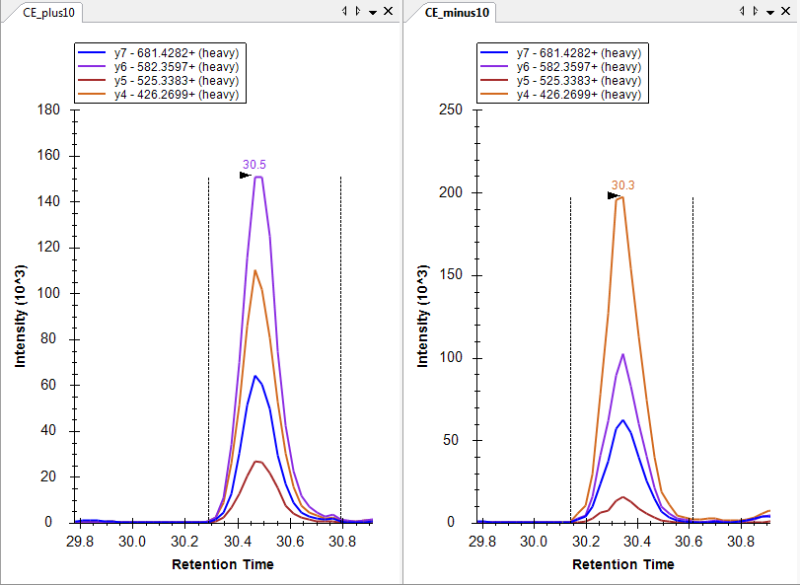
Generating a reference for identification
All b,y ions
We can use a synthetic standard to generate a reference for the chromatogram library: heavy or light standard; peptide or protein standard.
Notes:
  In SRM: you would need to measure all the desired transitions.
  You will still get a dotp from a chromatogram library.
  Ensure similarity in MS setup (CE etc).
PRM data
Library building
Reference chromatogram
SRM data
Webinar 11; Tutorial (chromatogram libraries)
Dotp: 0.95
Dotp: 0.85
Same peptide with different CEs

Slide 23
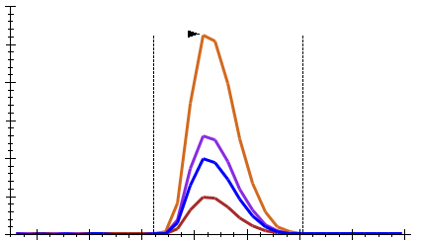
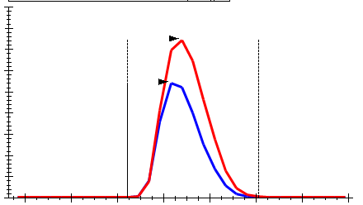
Criteria for reliable peak identification
1. Co-elution
2. Peak shape
3. Signal intensity
intensity
intensity
intensity
time (min)
time (min)
time (min)
4. Correlation peak
intensities to library spectrum
5. Correlation retention time
(empiric or predicted*)
6. Correlation with
heavy-labeled standard
light
heavy
intensity
y6
intensity
y9
intensity
light
y7
y11
heavy
time (min)
m/z
time (min)

Slide 24
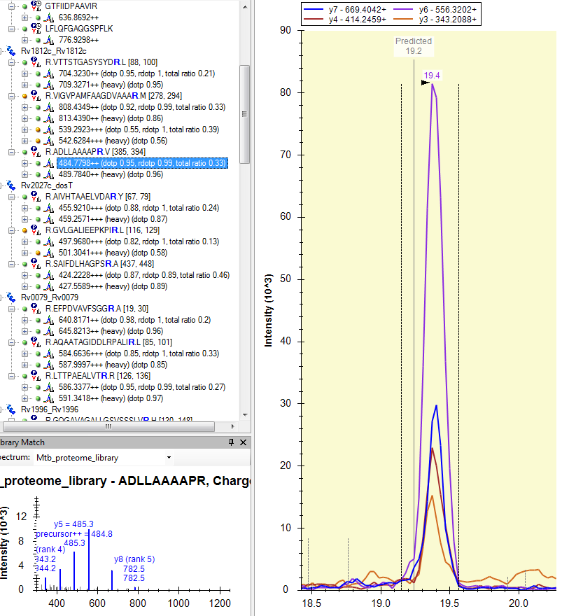
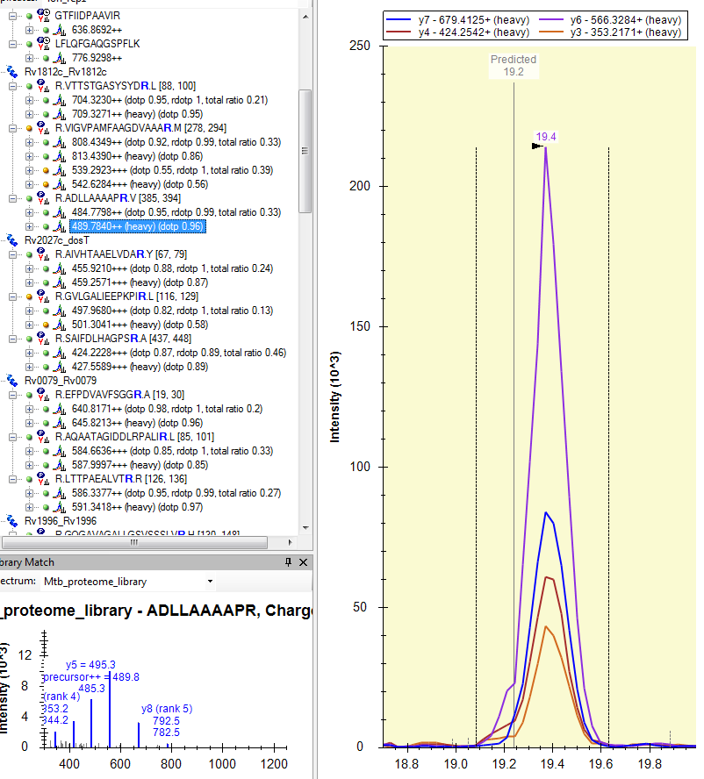
View individual precurosors
light
heavy

Slide 25
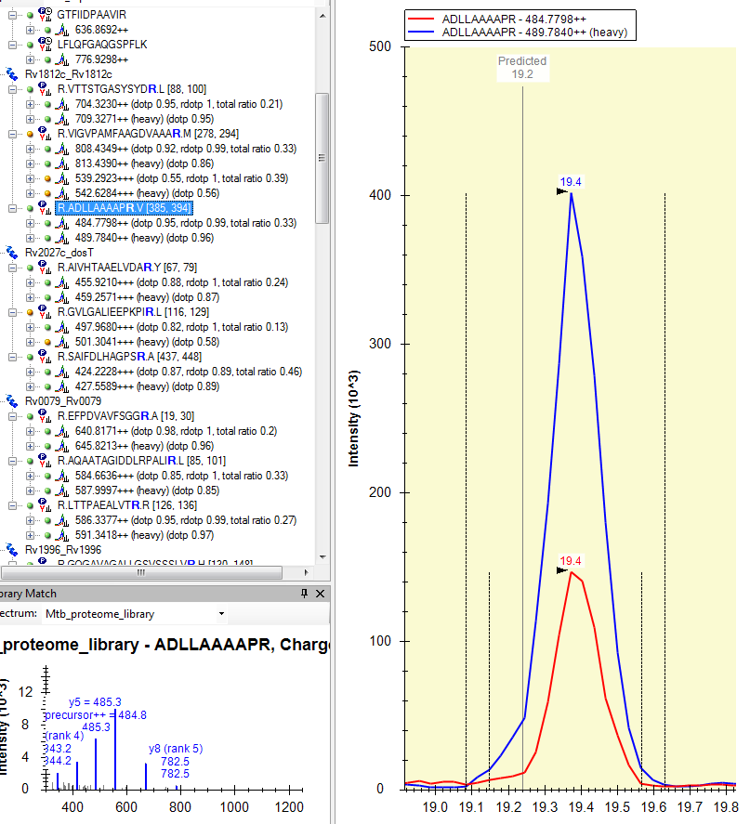
View pairs
View:
Total sum, no transition info
Same boundries
These heavy references are chemically identical to the endogenous (light) :
Co-elution
Same peak boundries

Slide 26
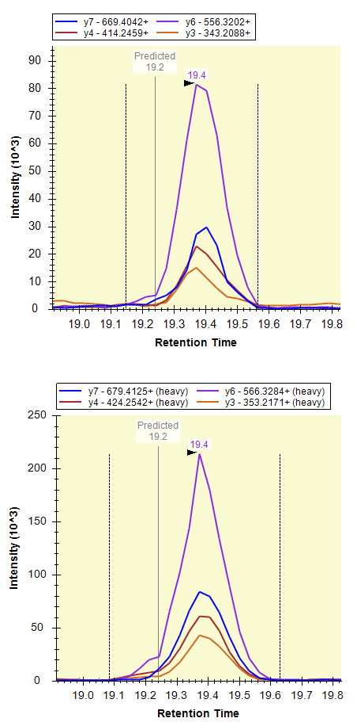
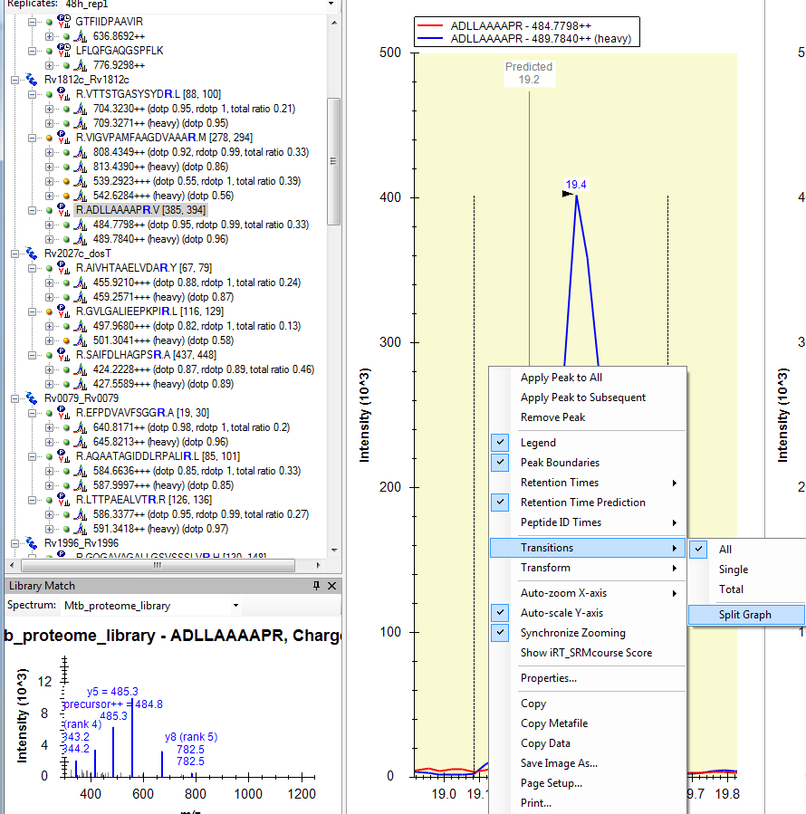
Split graph

Slide 27
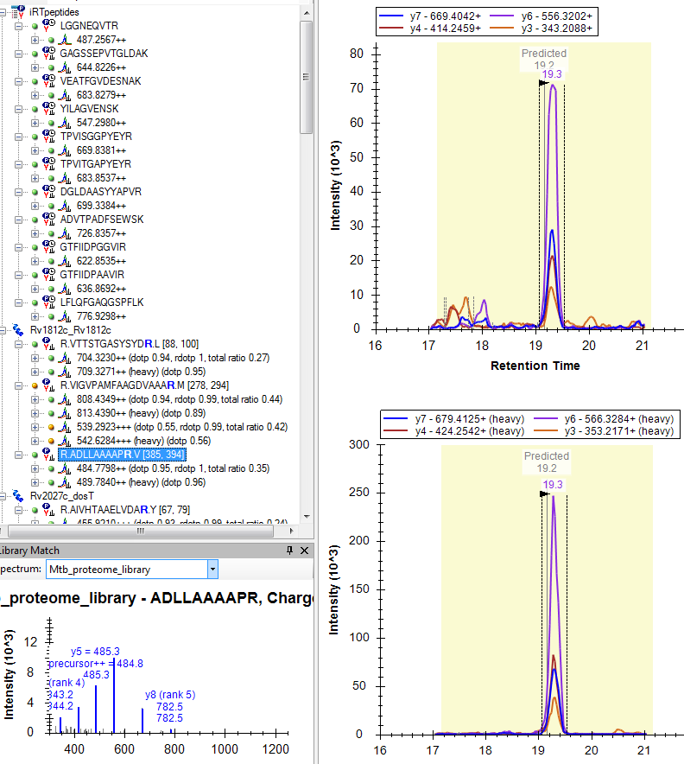
Dotp, rdotp with library
Dotp : 0.95
Rdotp: 1
Dotp: 0.96

Slide 28
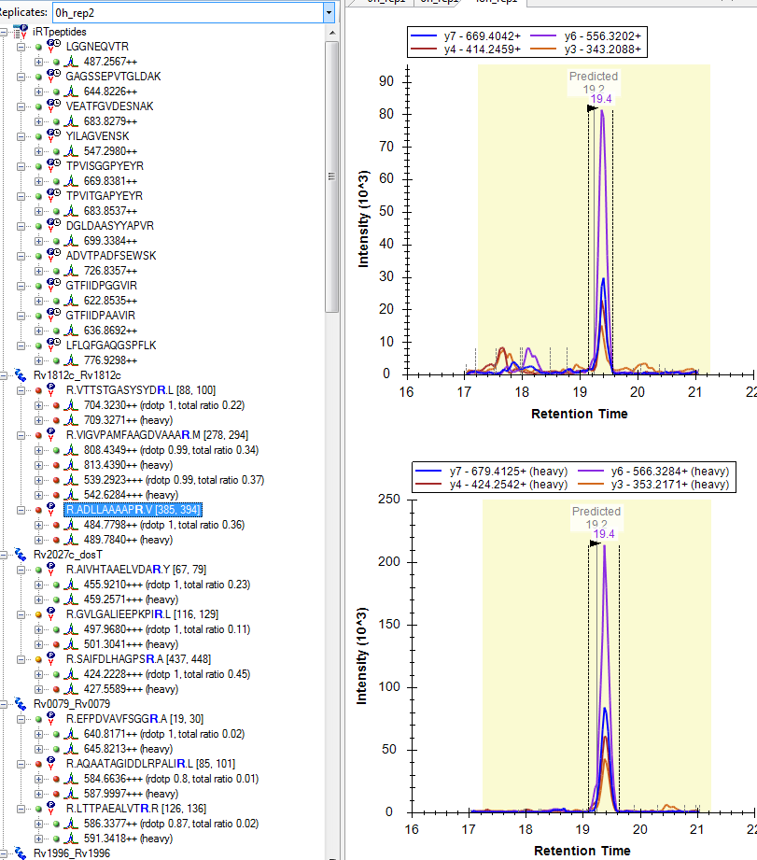
Dotp, rdotp without library
Dotp ?
Rdotp: 1
Dotp ?

Slide 29
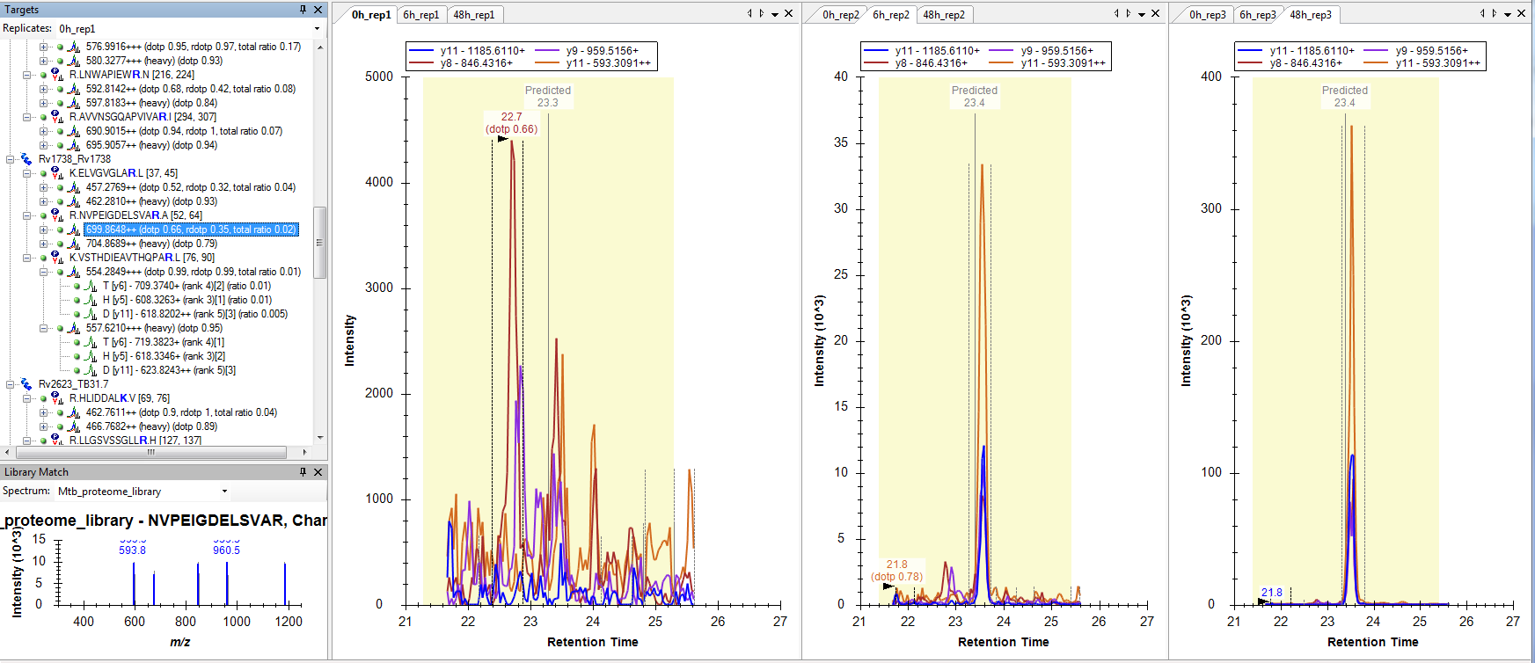
Using reference standards for peak selection
No clear peak, A low dotp
Which should we select ?

Slide 30
Using reference standards for peak selection
0 hours
6 hours
48 hours

Slide 31
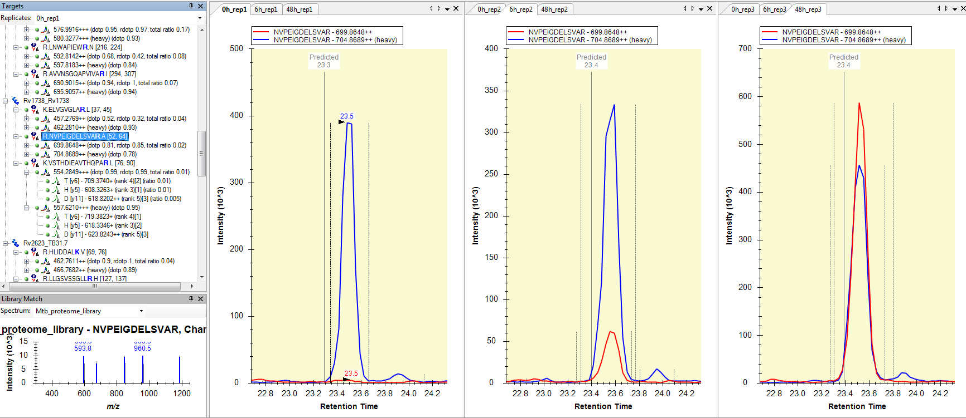
Using reference standards for peak selection
We can confidently state about absence :
the endogenous peptide is below detectability

Slide 32
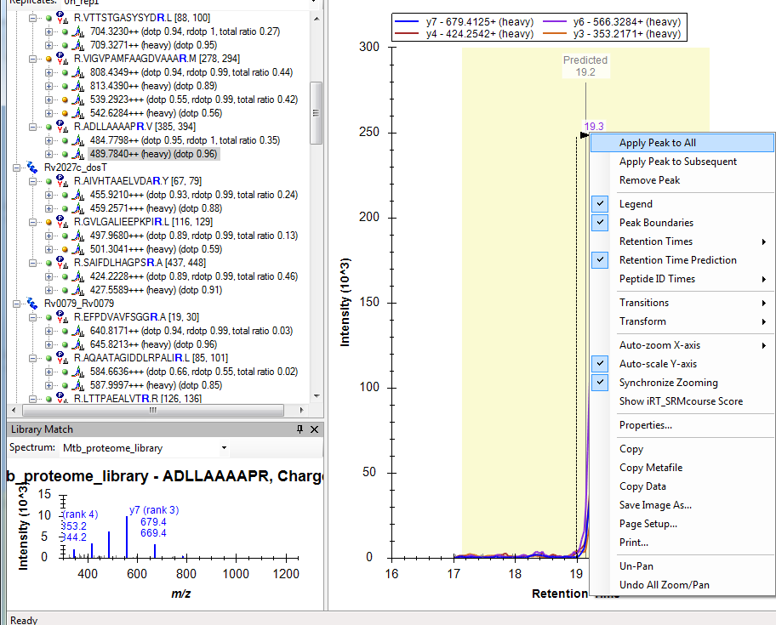
Using reference standards for peak selection

Slide 33
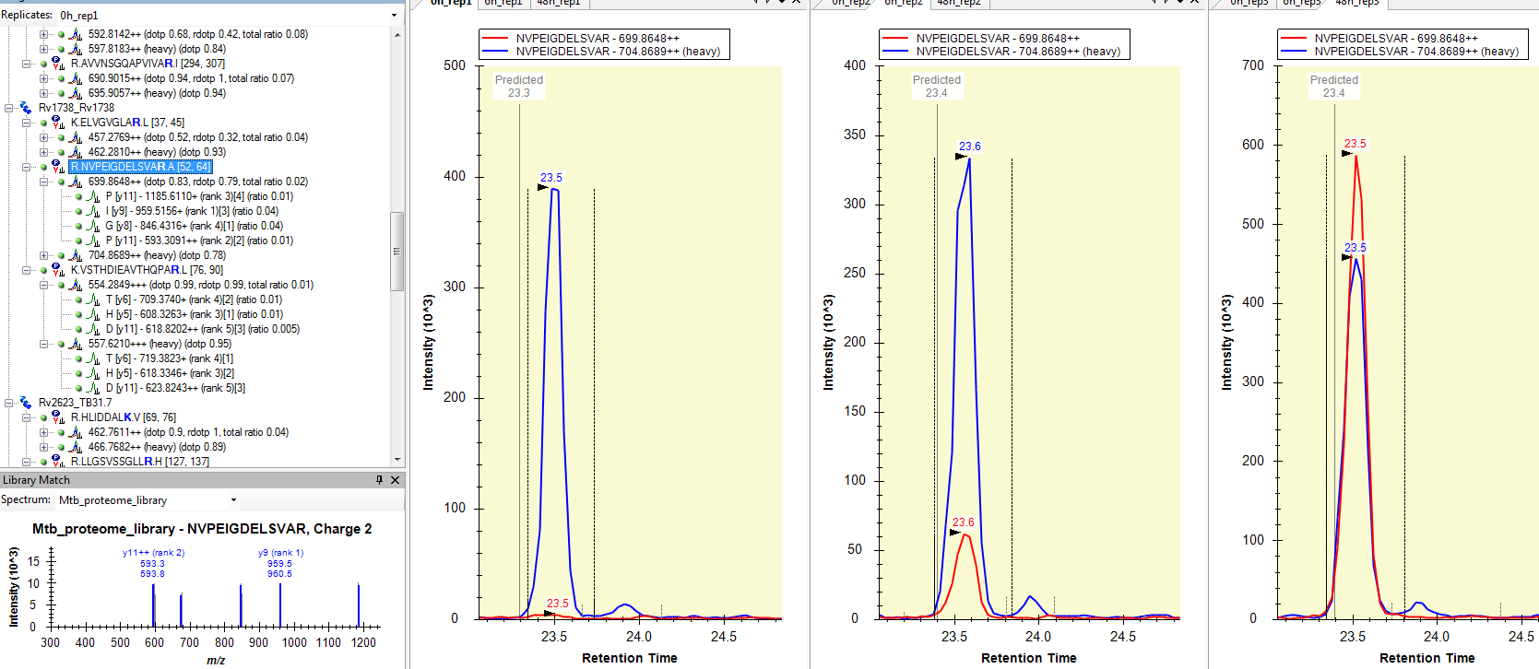
Using reference standards for peak selection
  If the standard is set to heavy, it will be used in peak picking

Slide 34
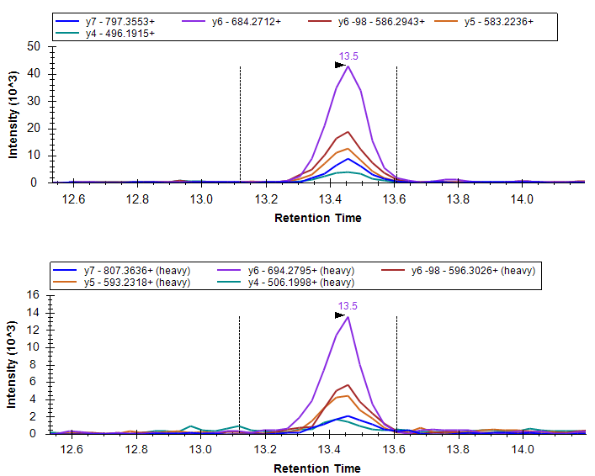
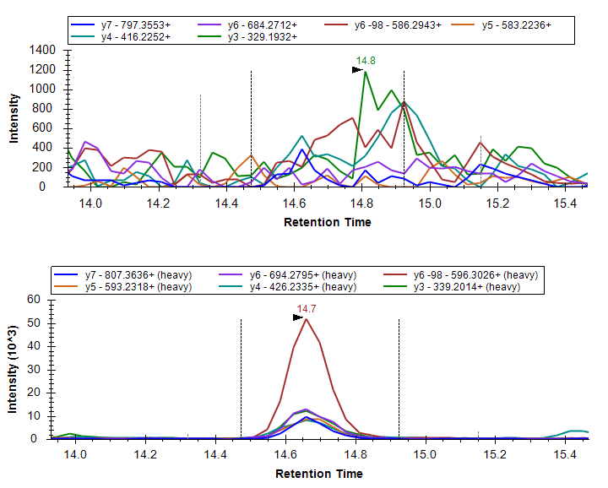
Using reference standards for peak selection
Modified peptides & localization: we can use synthetic standards to generate a reference for the identification and quantification of the correct modification site (an example with phosphorylation):
reference
reference
TDALTSS[Phos]PGR
TDALTS[Phos]SPGR
http://targetedproteomics.ethz.ch/videos.html

Slide 35
Using reference standards for peak selection
reference
reference
TDALTSS[Phos]PGR
TDALTS[Phos]SPGR

Slide 36

Using reference standards for peak selection
Modified peptides & localization: we can use synthetic standards to generate a reference for the identification and quantification of the correct modification site :
reference
reference
TDALTSS[Phos]PGR
TDALTS[Phos]SPGR

Slide 37


Generating a reference for quantification
We can use a synthetic standard to generate a reference for the best quantitative assay :
PRM data
Library building
Reference assay for maximal sensitivity
SRM data
for example collision energy optimization
https://skyline.gs.washington.edu/labkey/wiki/home/software/Skyline/page.view?name=tutorial_optimize_ce
http://targetedproteomics.ethz.ch/downloads.html

Slide 38
Using standards for peptide identification - summary
Generating a reference for identification
Using a reference for peak selection
Using a reference for optimal quantification
Reference for retention time
Reference chromatogram
Peak selection: RT, rdotp, transition selection
Peptide identification
In targeted proteomics
  Can be stored in Skyline, Panorama
Reference spectrum in library
Reference chromatogram
In library
Reference for parameters (CE)
  Per se, does not require isotope label standards
  Using isotope label standards

Slide 39
Improve confident peptide identification
Generating a reference for identification
Using a reference for peak selection
Using a reference for optimal quantification
Reference chromatogram
Peak selection: RT, rdotp, transition selection
Peptide identification
In targeted proteomics
Label-free versus label-based quantification
Relative versus absolute quantification
Improve quantitative precision and accuracy
Tina:
  Using isotope label standards

