Slide 1


Tutorial Webinar #10
Welcome to the tenth in a series of tutorial webinars designed to help you get the most out of Skyline proteomics software.
We’ll begin shortly …
Webinar Audio: Make sure you have audio during the webinar.
  Click the telephone icon in the upper left corner of JoinMe - circled here →
  You then have the choice to either:
  Call by phone (US and International numbers)
  Call via internet – a short, temporary software download is required.
Submit Skyline Questions: Use this form to submit Skyline questions to the team – we will try to answer as many as possible: http://tinyurl.com/QA4Skyline
The QA link will also be available in the chat window – to open your chat window click the bubble icon – circled here →

Slide 2
Working with Modifications in Skyline
Tutorial Webinar #10
With
Brendan MacLean (Principal Developer)

Slide 3
Agenda
Welcome from the Skyline team!
Working with Modifications in Skyline
Introduction and overview with Brendan MacLean
  Setting up and importing PTMs and neutral losses
  Adding peptides with isotope labeling
  Importing large assay libraries
Tutorial
Audience Q&A – submit questions to Google Form:
https://skyline.gs.washington.edu/labkey/qa4skyline.url

Slide 4
Overview
Control Center – Peptide Settings – Modifications tab
  Defining modifications and neutral losses
Modified sequence formats
Skyline guesses modifications
  Import > Peptide Search
  View > Spectral Libraries
  Insert > Peptides
  Insert > Transition List
Tips and tricks
  Filtering for modifications
  Targeting charged losses
  Accepting modified peptide states
  Modified sequences in reports

Slide 5
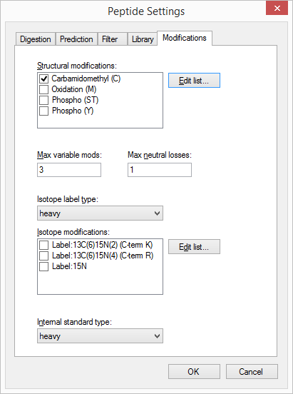
Peptide Settings - Modifications
Structural
Modifications
Isotope
Modifications

Slide 6
Modified Sequence Formats
Skyline Internal – delta-mass to 1 decimal place
  PEPC[+57.0]IDER
  Spectral libraries
  iRT calculators
  Optimization libraries
  Ion mobility libraries
Skyline Display – delta-mass short
  PEPC[+57]IDER
  P[+1]E[+1]P[+1]C[+58]I[+1]D[+1]E[+1]R[+4]
Explicit isotope labeling
  PEPC[+57]IDER{+10}

Slide 7
Modified Sequence Formats (continued)
Named
  PEPC[Carbomidomethyl (C)]IDER[Label:13C(6)15N(4) (C-term R)]
Short names (SCIEX)
  PEPC[CAM]IDER
  PES[Pho]T[Pho]IC[CAM]IDER
Unimod
  PEPC(unimod: 4)IDER
  PES(unimod: 21)T(unimod: 21)IC(unimod: 4)IDER

Slide 8
Tutorial

Slide 9
Learn More
Webinar #11: Panorama AutoQC and Panorama Public
  Tuesday, October 20th
Webinar #12: Isotope Labeled Standards in Skyline
  Tuesday, December 1st
Workshop in Tokyo, October 13
Workshop in Puerto Vallarta, November 8 & 9
Weeklong Course at IIT-Bombay
  December 10-14
Weeklong Courses 2016
  ETH, Zurich – February 8-12
  Buck Institute, San Francisco – March 7-11
  Northeastern, Boston – May 2-6
  University of Washington, Seattle – July 18-22

Slide 10
Questions?
Ask any questions you have on modifications in Skyline at the following form:
http://tinyurl.com/QA4Skyline
Take the post-webinar survey:
http://tinyurl.com/Survey4Webinar

Slide 11
Tutorial Webinar #10
This ends this Skyline Tutorial Webinar.
Please give us feedback on the webinar at the following survey:
http://tinyurl.com/Survey4Webinar
A recording of today’s meeting will be available shortly at the Skyline website.
We look forward to seeing you at a future Skyline Tutorial Webinar.

