Slide 1







Welcome!
Skyline Users Meeting 2012
Vancouver, BC

Slide 2
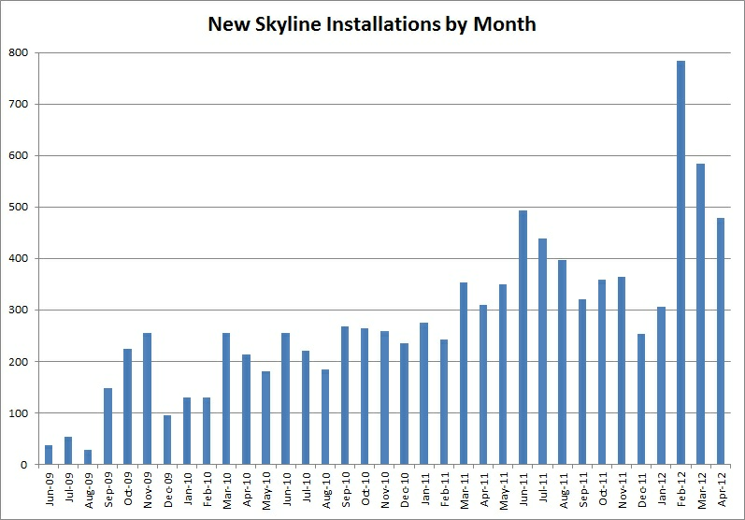
Skyline Adoption
>10,000 Installations since ASMS 2009

Slide 3
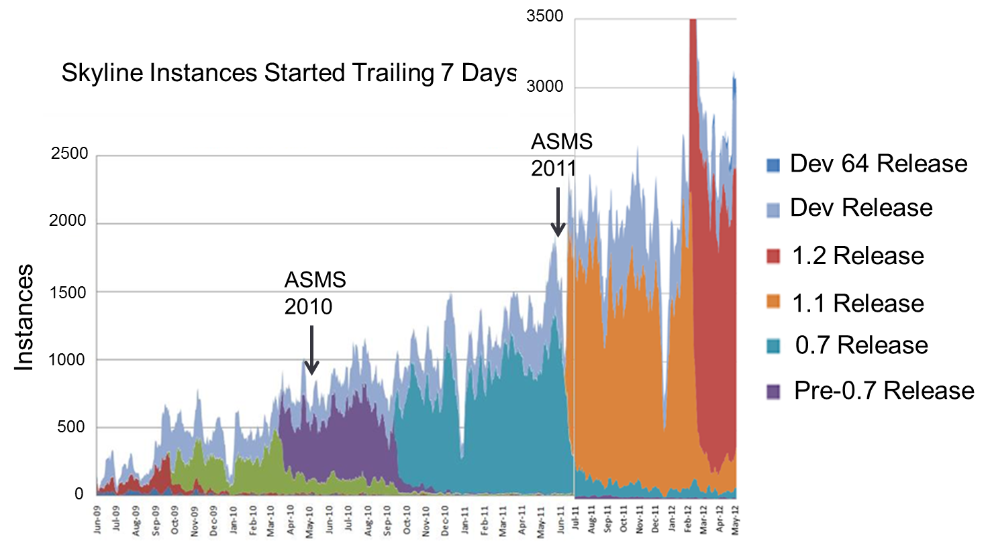
Skyline Adoption
Startups per Week (>10,000 installations)

Slide 4
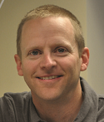
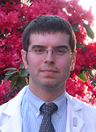
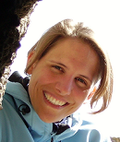
Agenda
Jeff Whiteaker, FHCRC
Andrew Stergachis, UW
Chrstina Ludwig, ETH

Slide 5
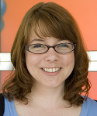
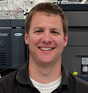
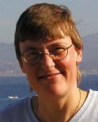
Agenda
Susan Abbatiello, The Broad
Will Thompson, Duke
Birgit Schilling, The Buck Research Institute

Slide 6
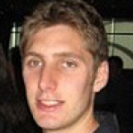
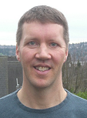
Agenda
Jarrett Egertson, UW
Brendan MacLean, UW

