Slide 1

Targeted Proteomics
Environment
Quantitative Proteomics with Bruker Q-TOF Instruments and Skyline
Brendan MacLean

Slide 2
Quantitative Proteomics
Spectrum-based
  Spectral counting
  Isobaric tags
Chromatography-based
  SRM
  MS1 chromatogram extraction
  Targeted MS/MS
  Data independent acquisition (DIA)

Slide 3

Quantitative Proteomics
Spectrum-based
  Spectral counting
  Isobaric tags
Chromatography-based
  SRM
  MS1 chromatogram extraction
  Targeted MS/MS
  Data independent acquisition (DIA)
micrOTOF-Q and maXis series

Slide 4
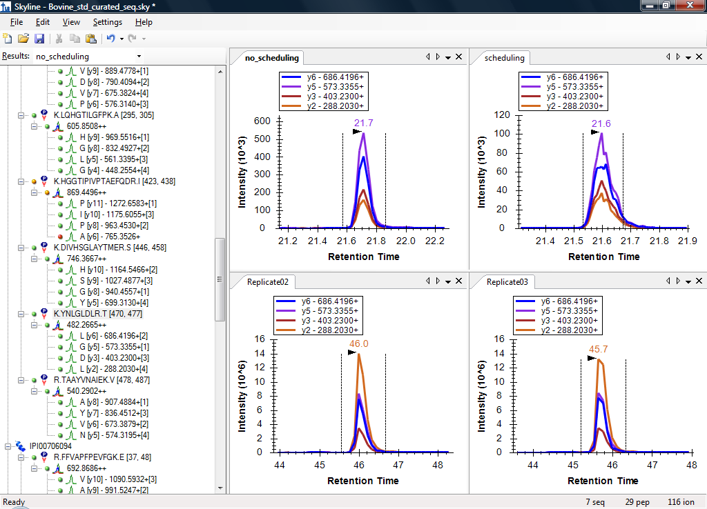
2010 Multi-Instrument SRM Tool for
NCI CPTAC Verification Working Group
AB SCIEX
4000 Q Trap
Thermo-
Scientific
TSQ Ultra
Kessner, D. et al. Bioinformatics. 2008.
Notes:
4000 Q Trap data from Jeff Whiteaker
TSQ data from MacCoss Lab
Unrelated to any VWG study

Slide 5
Support Multiple Instrument Vendors
Selected Reaction Monitoring
Exporting transition lists & native methods
Importing native instrument output files
AB Sciex
Agilent Technologies
Thermo-Scientific
Waters

Slide 6
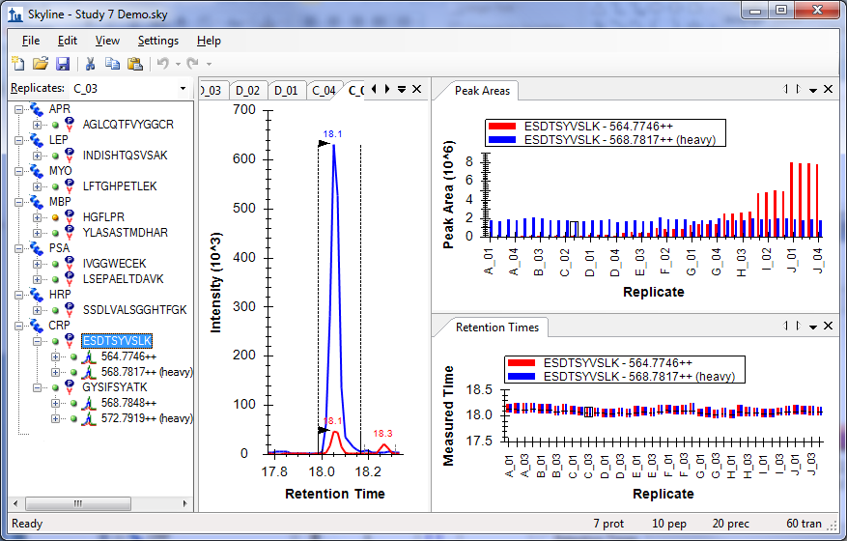
Graphic Display of Information
Notes:
Broad Institute Study 7 data

Slide 7
MS/MS Spectral Library Sources
Global Proteome Machine
MacCoss Lab
NIST
Peptide Atlas
Build your own from peptide search results
  Mascot
  Myrimatch / IDPicker
  OMSSA
  Protein Pilot
  Protein Prospector
  Scaffold – mzIdentML / MGF
  Spectrum Mill
  TPP – pepXML / mzXML files – Peptide Atlas
  X! Tandem
  Waters MSe

Slide 8
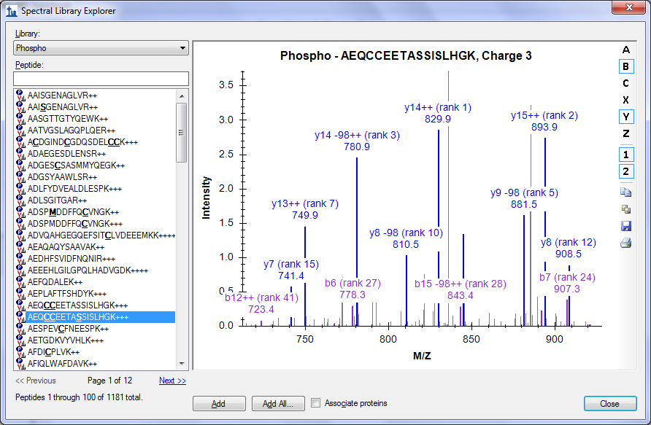
Spectral Library Explorer

Slide 9
Finding Issue Quickly (wrong peak)
IVGYLDEEGVLDQNR
e
100
y9 - 1059.5065+
y8 - 930.4639+
y7 - 801.4213+
y5 - 645.3315+
g
a
t
n
80
e
c
r
e
60
P
a
40
e
r
A
k
20
a
e
P
0
REP20
REP21
REP22
REP23
REP24
REP25
REP26
REP27
REP28
REP29
REP30
Replicate
62
y9 - 1059.5065+
y8 - 930.4639+
y7 - 801.4213+
y5 - 645.3315+
e
60
m
58
i
T
d
56
e
r
u
54
s
a
e
52
M
50
48
0
1
2
3
4
5
6
7
8
9
0
2
2
2
2
2
2
2
2
2
2
3
P
P
P
P
P
P
P
P
P
P
P
E
E
E
E
E
E
E
E
E
E
E
R
R
R
R
R
R
R
R
R
R
R
Replicate
Notes:
MacCoss lab data (unrelated to any VWG study)

Slide 10
Finding Issues at a Glance (interference)
HGFLPR
y5 - 589.3457+
y4 - 532.3242+
y3 - 385.2558+
e
100
g
a
t
80
n
Unlabeled
e
c
r
60
e
P
a
e
40
r
A
k
a
20
e
P
0
1
2
3
4
1
2
3
4
1
2
3
4
1
2
3
4
1
2
3
4
1
2
3
4
0
0
0
0
0
0
0
0
0
0
0
0
0
0
0
0
0
0
0
0
0
0
0
0
_
_
_
_
_
_
_
_
_
_
_
_
_
_
_
_
_
_
_
_
_
_
_
_
1
1
1
1
B
B
B
B
C
C
C
C
D
D
D
D
E
E
E
E
F
F
F
F
A
A
A
A
e
100
g
a
t
80
n
e
c
r
60
Labeled
13C R
e
P
a
e
40
r
A
k
a
20
e
P
0
1
2
3
4
1
2
3
4
1
2
3
4
1
2
3
4
1
2
3
4
1
2
3
4
0
0
0
0
0
0
0
0
0
0
0
0
0
0
0
0
0
0
0
0
0
0
0
0
_
_
_
_
_
_
_
_
_
_
_
_
_
_
_
_
_
_
_
_
_
_
_
_
1
1
1
1
B
B
B
B
C
C
C
C
D
D
D
D
E
E
E
E
F
F
F
F
A
A
A
A
Replicate
Abbatiello, S.E. et al. Clin. Chem. 2010.
Notes:
Buck Institute Study 7 data

Slide 11
Finding Issues Early (lack of precision)
50
Peptide area mean of 10 replicates
50
Peptide area mean of 10 replicates
40
40
New
)
)
6
6
^
^
0
0
1
30
1
30
(
(
a
a
e
e
r
r
A
A
k
20
k
20
a
a
e
e
P
P
10
10
0
)
)
)
)
)
)
)
)
)
0
)
)
)
)
)
)
)
)
)
4
0
1
0
8
1
3
6
5
9
3
3
8
0
4
8
2
8
.
.
.
.
.
.
.
.
.
.
.
.
.
.
.
.
.
.
5
6
7
9
0
1
4
3
5
5
6
7
8
0
0
2
3
4
1
1
1
1
2
2
2
3
3
1
1
1
1
2
2
2
3
3
(
(
(
(
(
(
(
(
(
(
(
(
(
(
(
(
(
(
A
C
G
D
V
N
G
P
V
A
C
G
D
V
N
G
P
V
A
F
G
L
A
V
D
G
F
A
F
G
L
A
V
D
G
F
T
G
D
V
C
L
D
V
F
T
G
D
V
C
L
D
V
F
Peptide
Peptide
Peptide area CV of 10 replicates
Peptide area CV of 10 replicates
0.7
0.7
0.6
0.6
New
V
0.5
V
0.5
C
C
a
a
e
e
r
0.4
r
0.4
A
A
k
k
a
a
e
0.3
e
0.3
P
P
0.2
0.2
0.1
0.1
0.0
)
)
)
)
)
)
)
)
)
0.0
)
)
)
)
)
)
)
)
)
4
0
1
0
8
1
3
6
5
9
3
3
8
0
4
8
2
8
.
.
.
.
.
.
.
.
.
.
.
.
.
.
.
.
.
.
5
6
7
9
0
1
4
3
5
5
6
7
8
0
0
2
3
4
1
1
1
1
2
2
2
3
3
1
1
1
1
2
2
2
3
3
(
(
(
(
(
(
(
(
(
(
(
(
(
(
(
(
(
(
A
C
G
D
V
N
G
P
V
A
C
G
D
V
N
G
P
V
A
F
G
L
A
V
D
G
F
A
F
G
L
A
V
D
G
F
T
G
D
V
C
L
D
V
F
T
G
D
V
C
L
D
V
F
Peptide
Peptide
Notes:
Vanderbilt Study 9S data

Slide 12
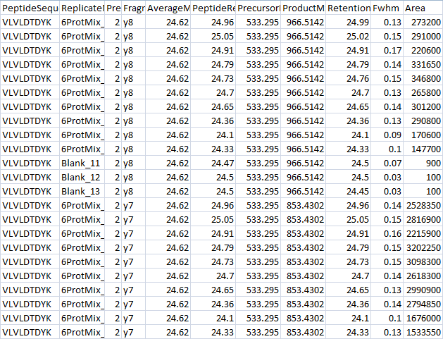
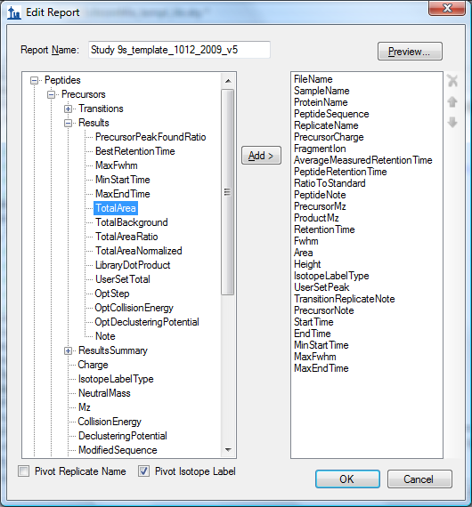
Sharing
Reports
Notes:
Broad Institute Study 9S report data

Slide 13
Downstream Analysis with Statistical Tools
Analysis of Study 9S reports with R
1
2
3
4
5
6
7
8
9
1
0
T
A
A
G
F
C
D
G
G
0
.
3
0
.
2
0
Site
.
1
V
L
D
C
A
V
L
V
N
1
9
2
0
3
2
0
5
2
.
FWHM peak width in min
(maximum for 5 transitions)
3
5
4
0
5
6
.
2
5
6
A
!
L
C
0
6
5
!
L
C
.
1
7
3
D
D
G
8
6
8
6
A
!
L
C
9
5
!
L
C
0
9
8
.
3
0
.
2
0
.
1
1
2
3
4
5
6
7
8
9
1
0
Replicate Number

Slide 14
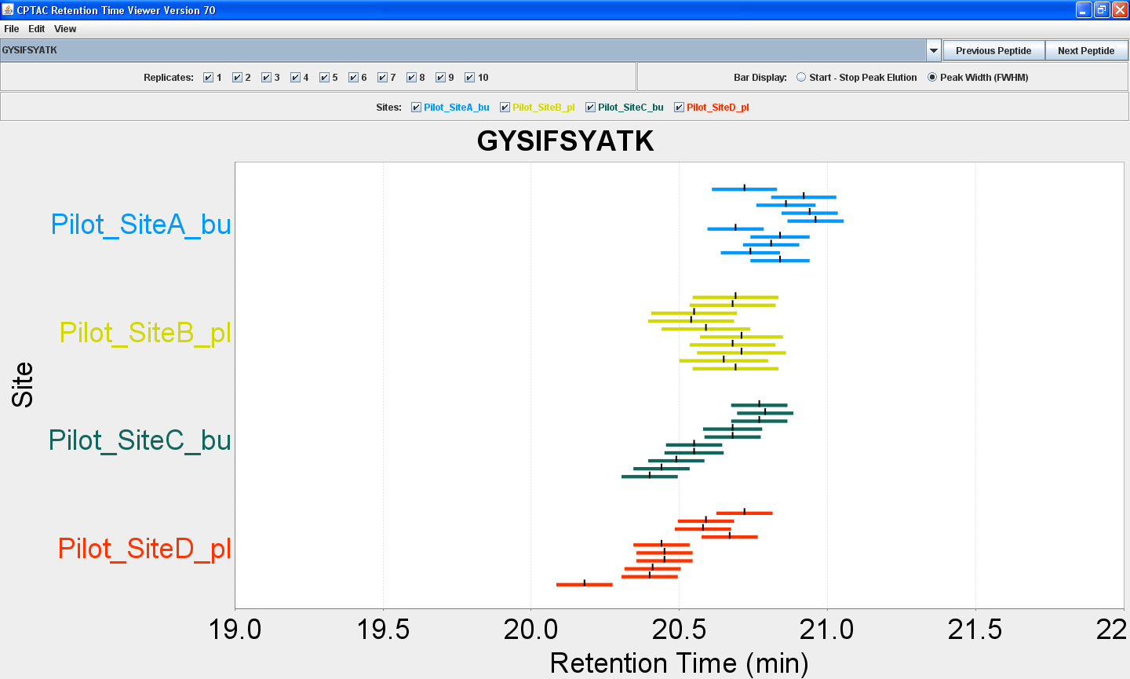
Deeper Analysis with Custom Tools
Analysis of reports with Retention Time Viewer (Java program)
http://www.buckinstitute.org/Labs/thegibson/resources.asp
Notes:
Application by Michael Kusack at Buck Institute
Study 9P data from Birgit

Slide 15
Skyline Adoption (>12,500 Installations)
660 registered users

Slide 16
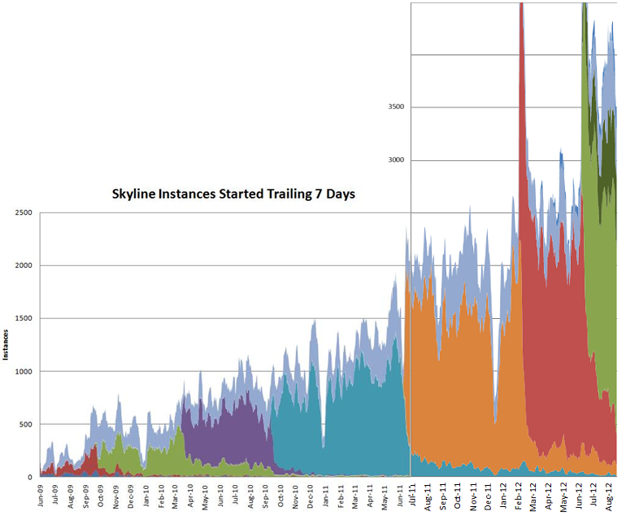
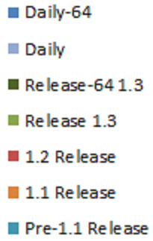
Skyline Use
4500
4000
3500
ASMS
2012
Skyline Instances Started Trailing 7 Days
3000
2500
ASMS
2011
Dev 64 Release
Dev Release
2000
1.3 64 Release
ASMS
2010
1.3 Release
1500
Instances
1.2 Release
1000
1.1 Release
500
Pre-1.1 Release
0
>100 citations

Slide 17
2012 Support Multiple Instrument Vendors
Full-Scan
Exporting isolation lists & native methods
Importing native instrument output files
AB SCIEX SWATH™
Agilent Technologies DIA
Bruker DIA & All Ions DIA
Thermo-Scientific DIA & Multiplexed DIA
Waters MSe™

Slide 18
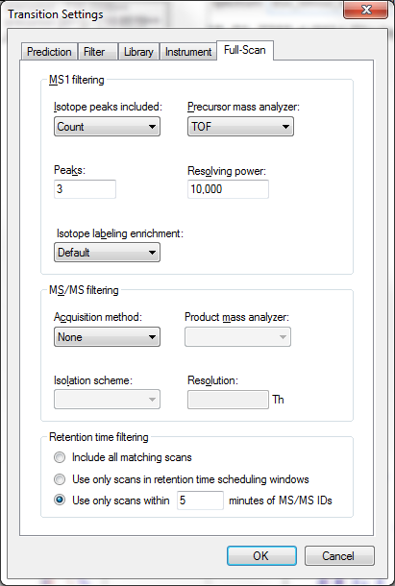
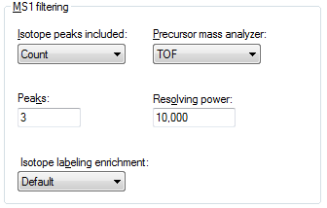
Skyline MS1 Full-Scan Settings
Tutorial

Slide 19
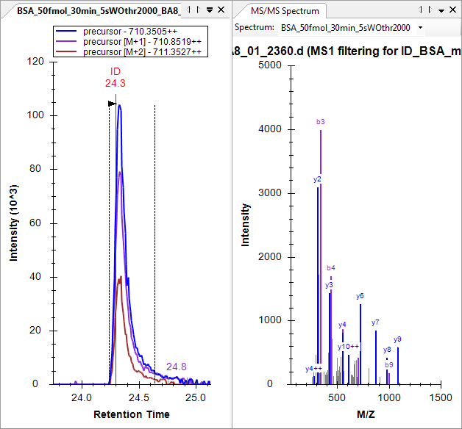
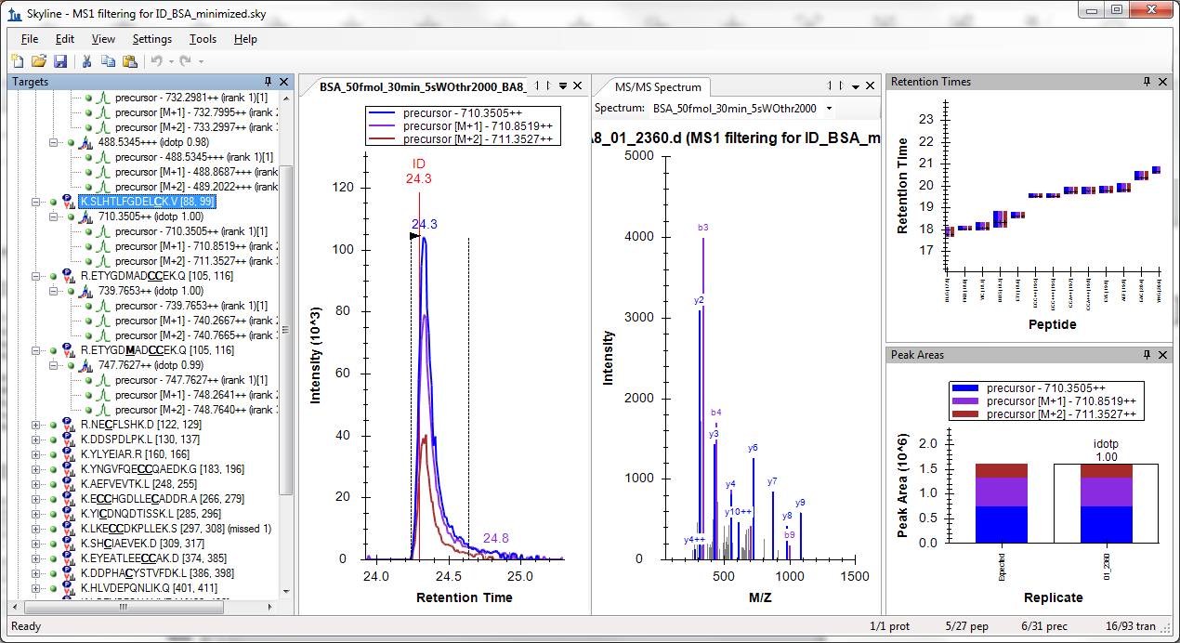
Skyline MS1 Filtering Data
Schilling, B. et al. Mol. Cell. Prot. 2012.

Slide 20
Targeted MS/MS
Mass
Analyzer
Q1 / Trap
CID
Ion
Source
2 m/z isolation
MS/MS scans
m/z
m/z
m/z
intensity
m/z
521.27
time (scan #)

Slide 21
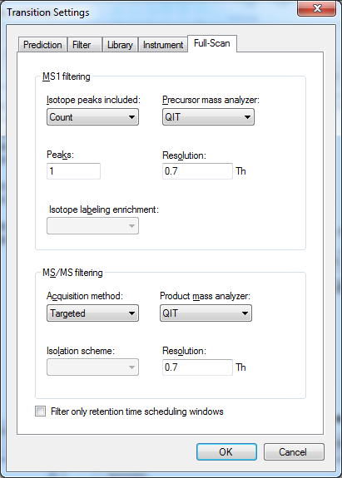
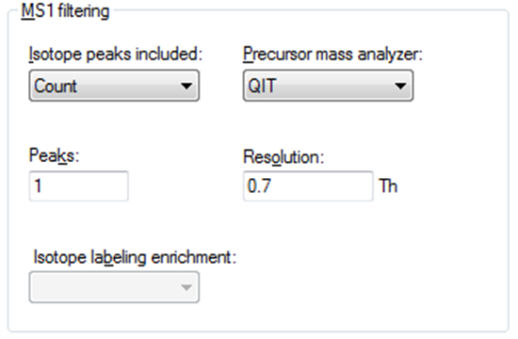
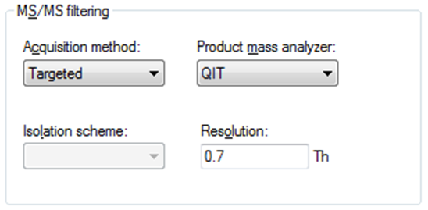
Skyline Targeted MS/MS Settings
Tutorial

Slide 22
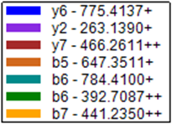
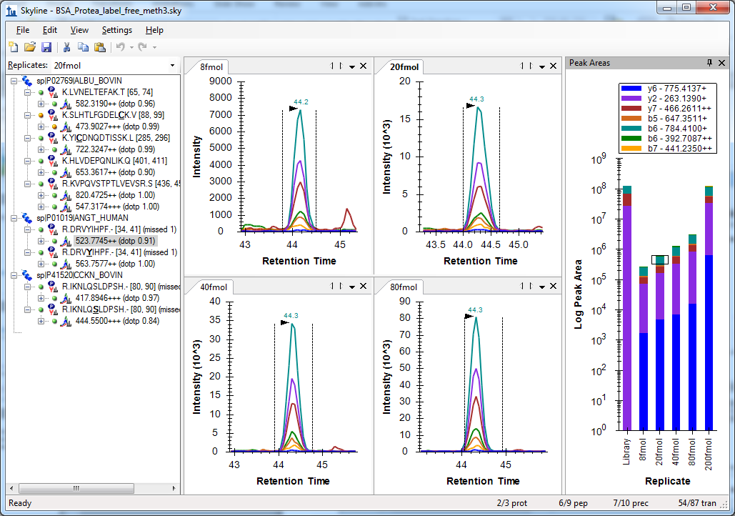
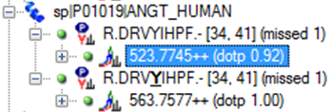
Skyline Targeted MS/MS
Sherrod, S. et al. J. Prot. Res. 2012.

Slide 23
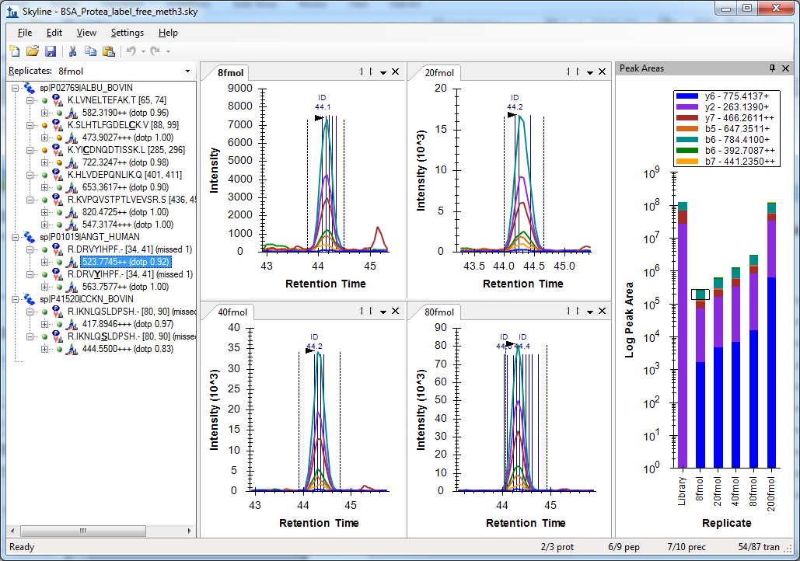
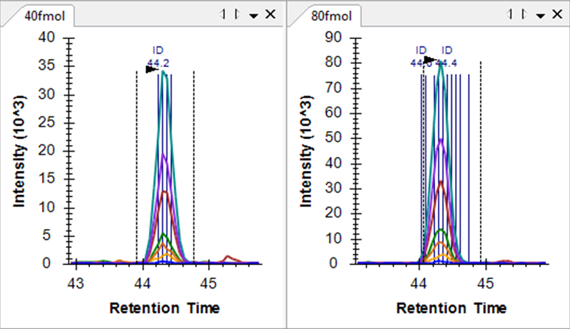
Skyline Targeted MS/MS
Sherrod, S. et al. J. Prot. Res. 2012.

Slide 24
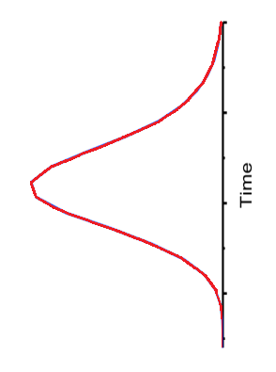
Traditional DIA Isolation Scheme
precursor m/z
SVEDFMAAMQR
Precursor m/z: 616
600
610
616
620
630
640
650
619
VGGNGADYALATK
Precursor m/z: 619
10 m/z
x
x
x
x
Retention time
Venable, J.D. et al. Nat. Meth. 2004.

Slide 25
DIA Chromatogram Extraction
Mass
Analyzer
Q1 / Trap
CID
Ion
Source
10 m/z isolation
MS/MS scans
m/z
m/z
m/z
intensity
m/z
time (scan #)

Slide 26
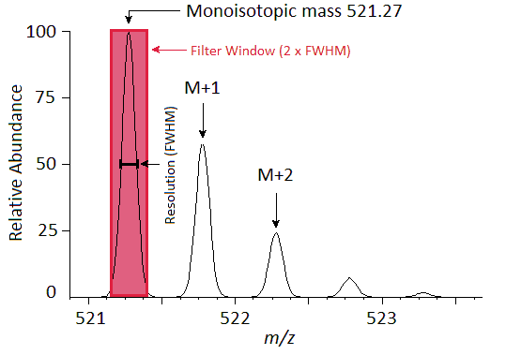
DIA Chromatogram Extraction Trade-Offs
Sensitivity
  Dwell / Accumulation time
  Cycle time
Selectivity lost by wide precursor isolation
Selectivity gained vs. SRM by narrow product extraction
MS/MS scan
Gillet, L.C. et al. Mol. Cell. Prot. 2012.

Slide 27
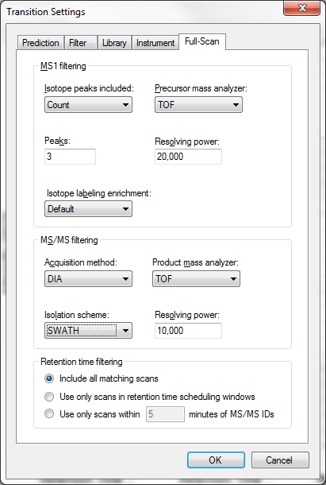
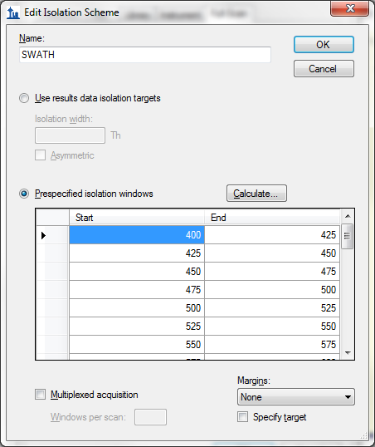
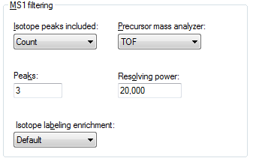
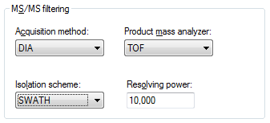
Skyline Bruker DIA Settings
(25 m/z Extraction Windows)
Gillet, L.C. et al. Mol. Cell. Prot. 2012.

Slide 28
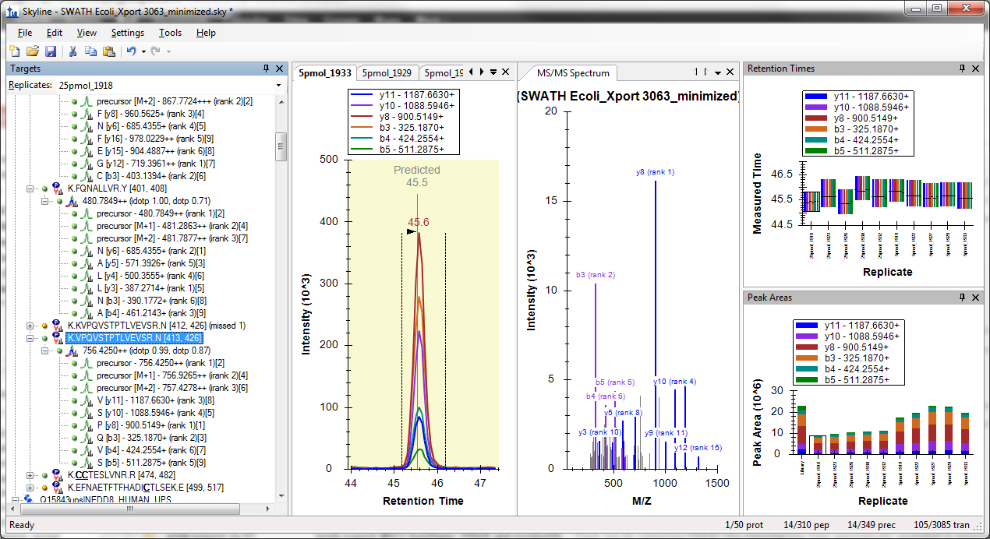
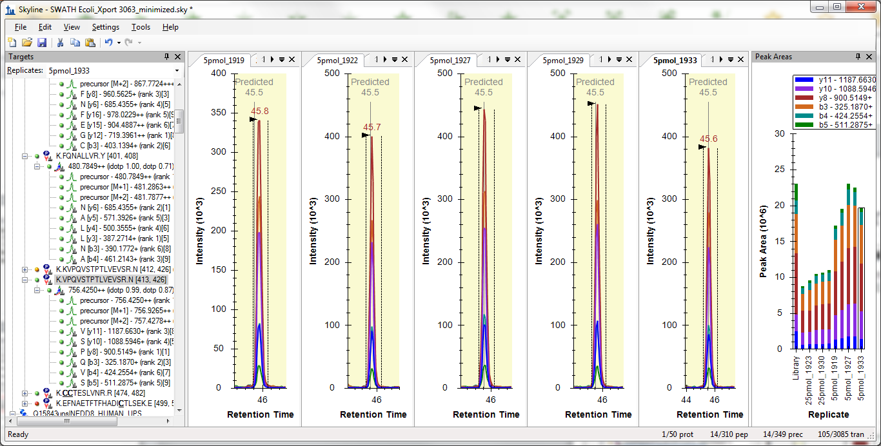
Bruker DIA Data (Product Ions)

Slide 29
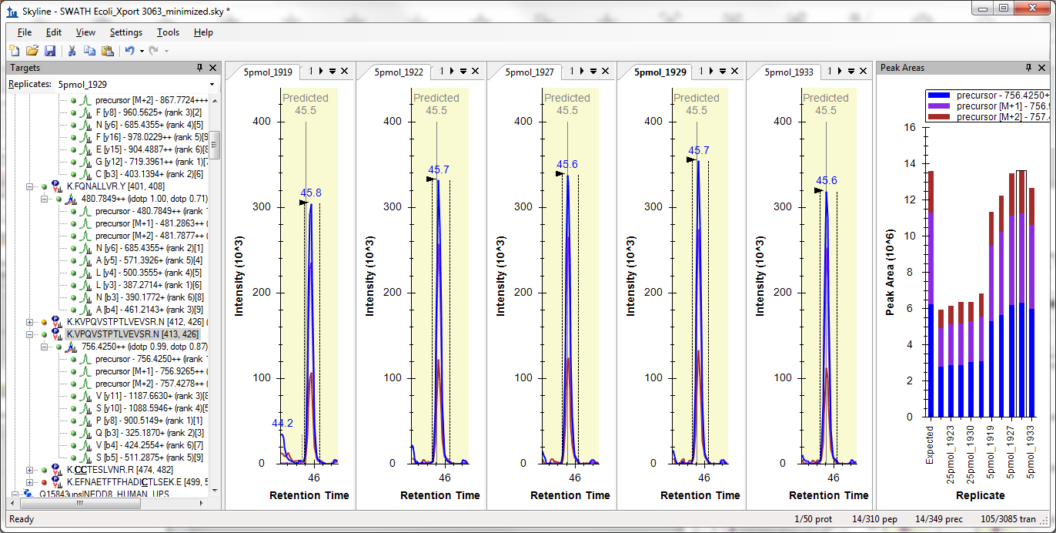
Bruker DIA Data (Precursor Ions)

Slide 30
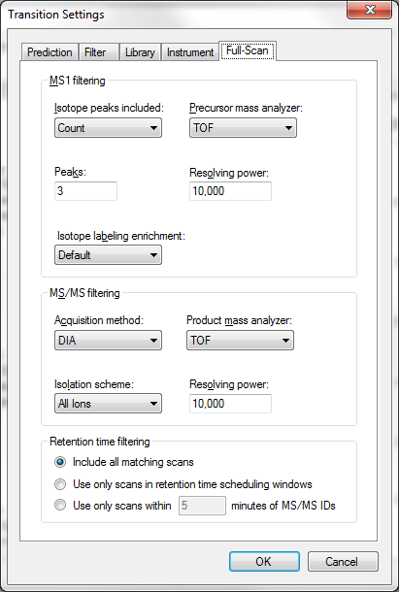
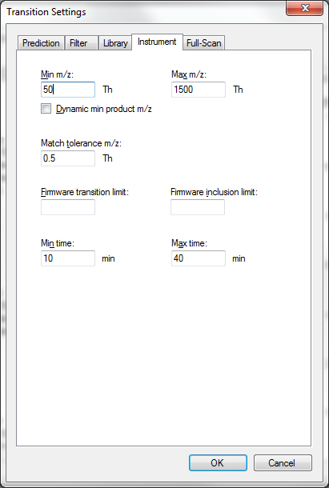
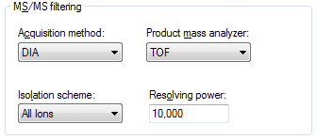

Bruker All Ions DIA Settings
(50 – 1500 m/z Range)

Slide 31
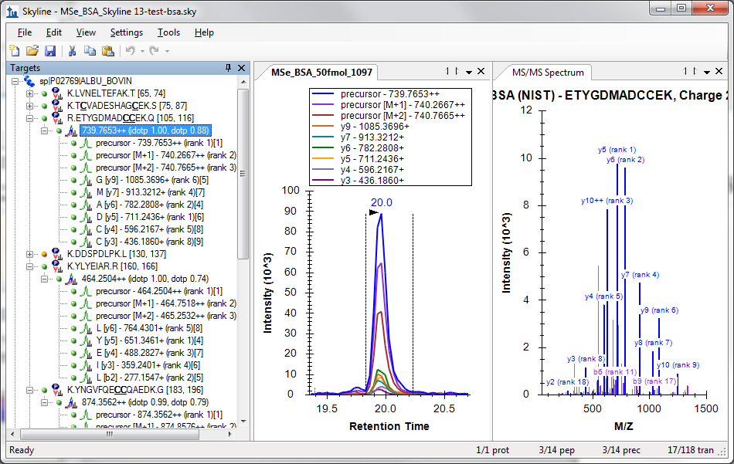
Bruker All Ions DIA Data

Slide 32
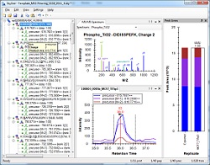
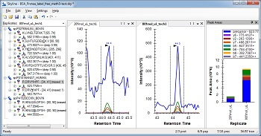
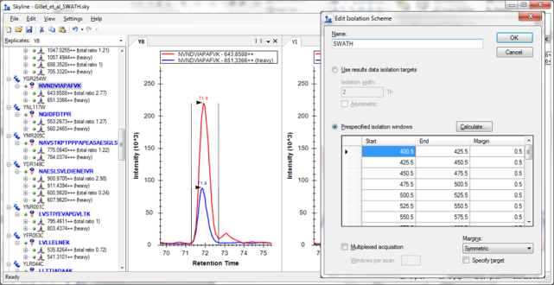
Getting Started
Freely available & Open Source
http://proteome.gs.washington.edu/software/skyline
Self-updating web installation (v1.4 coming soon)
2 full-scan filtering tutorials (DIA coming soon)
Support board and issues list
8 other tutorials & 3 instructional videos (full-scan video soon)
MS1 Full-Scan Filtering
Targeted MS/MS
Data Independent Acquisition
Coming Soon

