Slide 1

Targeted Proteomics
Environment
Rapid Processing of Large Scale Quantitative Proteomics Projects: Integration of Skyline with the CHORUS Cloud
Brendan MacLean; Andrey Bondarenko; Nick Shulman; Oleksii Tymchenko; Christine Wu; Nathan Yates; Michael J. Maccoss

Slide 2
Chromatography-based Quantification
Freely-available, and vendor neutral
SRM
MS1 chromatogram extraction
Targeted MS/MS (PRM)
DIA / SWATH
Acquisition | Targeted | Survey
More Selective | Targeted-MS/MS | DIA
Less Selective | SRM | MS1

Slide 3
DIA Chromatogram Extraction
How many chromatograms to make DIA interesting?
10,000 peptides? (50,000+ transitions)
Whole proteome? (500,000+ transitions)
Hypothesis driven inquiries?
“Kind of defeats the purpose of SWATH”?

Slide 4
DIA Fit-for-Purpose
Discovery Proteomics
  Systematic acquisition without missing data
  Petpide searching tools less mature than DDA
  Chimeric spectra hard to search
Targeted Proteomics
  High level of multiplexing without scheduled acquisition
  Ability to test new hypotheses after acquisition
  Gain selectivity over MS1
  Lose selectivity from SRM and PRM

Slide 5
DIA versus SRM Multiplexing
SRM
  100 transitions unscheduled
  20-30 peptides label-free
  10-15 peptides with labeled pairs
DIA
  Unlimited
Problems with scheduling
  Shifts in chromatography can compromise measurement
  Add setup time and complexity
  More susceptible to human error

Slide 6
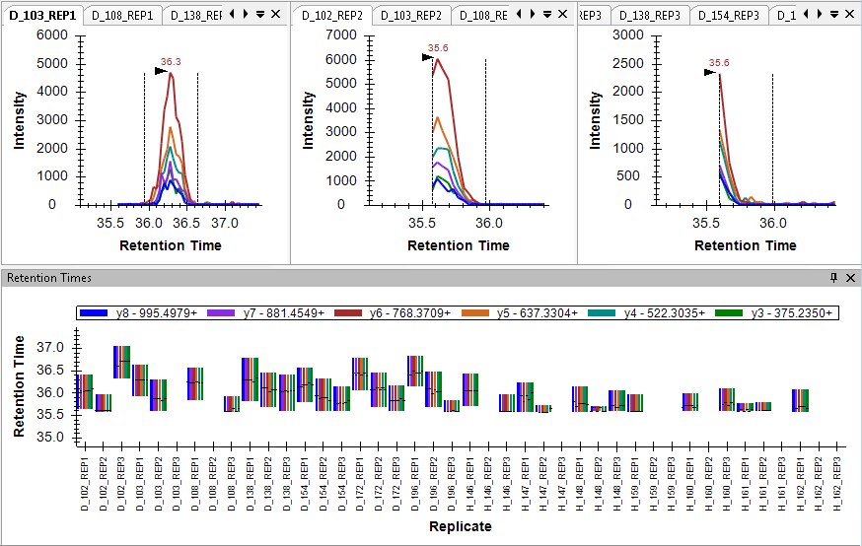
Truncated and Missing Peaks
TGTNLMDFLSR

Slide 7
DIA versus SRM Files and Performance
SRM
  Size: 5 to 20 MB
  Import time: seconds to a few minutes
DIA
  Size: 200 MB to 4000 MB (with IMS 2000 to 8000 MB)
  Import time: 30 seconds to tens of minutes

Slide 8
DIA versus SRM 50 Runs
SRM
  Size: 0.5 GB
  Import time: 10 minutes
DIA
  Size: 100 GB
  Import time: 6 hours
100x Storage and Performance Impact

Slide 9
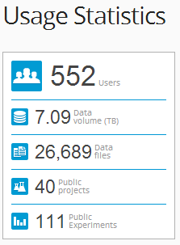
Chorus For Mass Spec File Storage
Google Docs-like interface
Lab-centered security model
Raw data file storage
  Upload as acquired
  Translated into distributed data structure
  Massively parallel cloud data access
Fast chromatogram extraction
Fast single spectrum access
Scalable
In Beta Release for 12 months
>1 TB Downloaded per Month

Slide 10
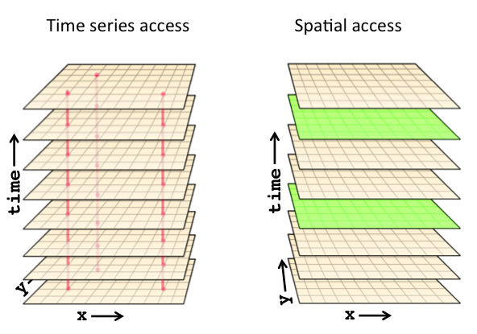
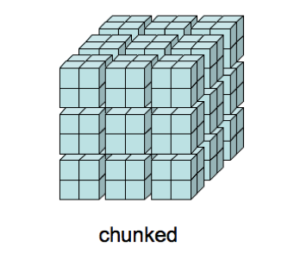
Using a Distributed Data Structure
Traditional Data file storage
Chorus Data Storage
Fast to get a spectrum
Slow to get a chromatogram
Random access to the file
Many processes can be used to extract many chromatograms/spectra using MapReduce

Slide 11
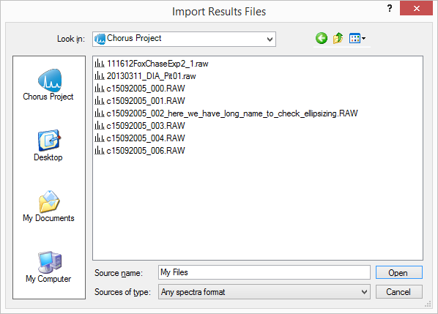
Skyline Direct Access to Chorus

Slide 12
Performance Tests Systems
Desktop
  CPU: i7@3.5 GHz (7.8)
  RAM: 16 GB (7.8)
  Drive: SSD (7.9)
Laptop
  CPU: i7@1.8 GHz (6.9)
  RAM: 8 GB (7.6)
  Drive: SSD (8.65)

Slide 13
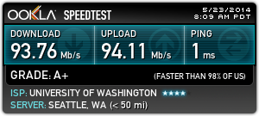
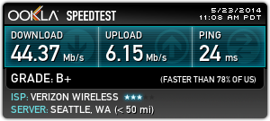
Performance Tests Networks
University of Washington
  Download: 93.76 Mb/s
  Upload: 94.11 Mb/s
Verizon
  Download: 44.37 Mb/s
  Upload: 6.15 Mb/s
Baltimore Hilton
  Download: 11.76 Mb/s
  Upload: 6.34 Mb/s

Slide 14
Data Import Performance

Slide 15
Data Import Performance

Slide 16
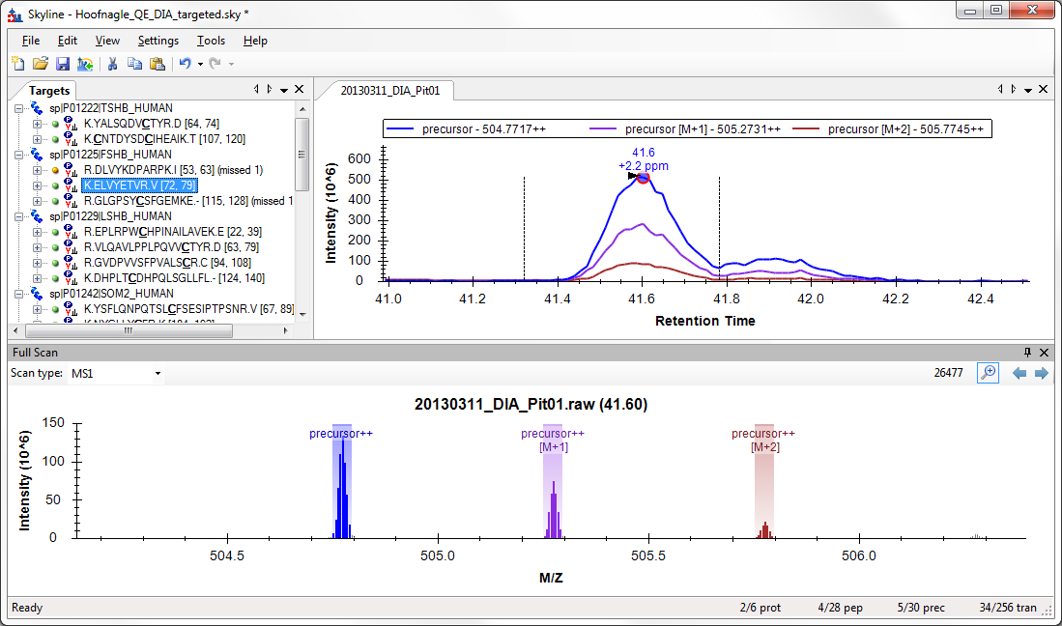
Full Scan Spectrum View

Slide 17
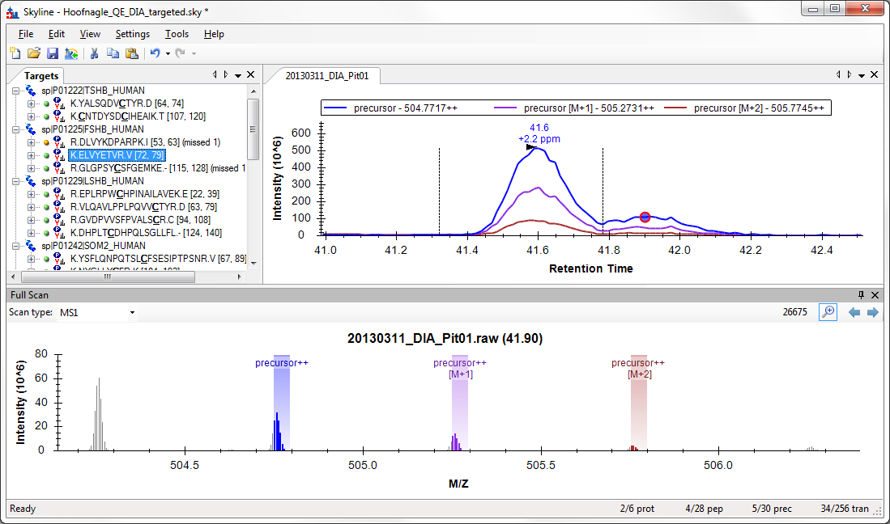
Exploring MS1 Scans

Slide 18
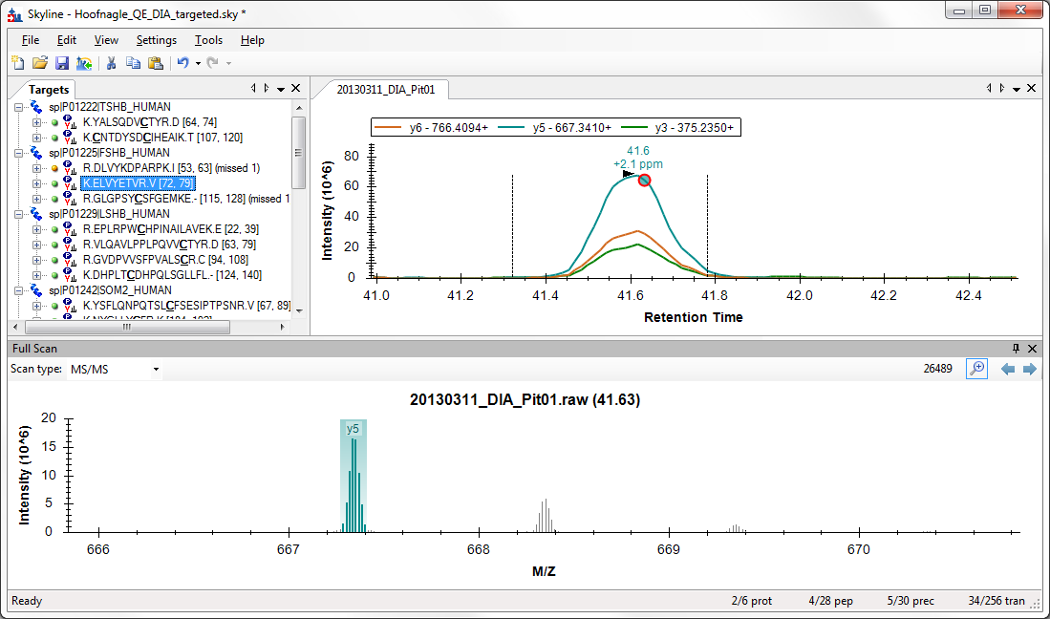
Exploring MS/MS Scans

Slide 19
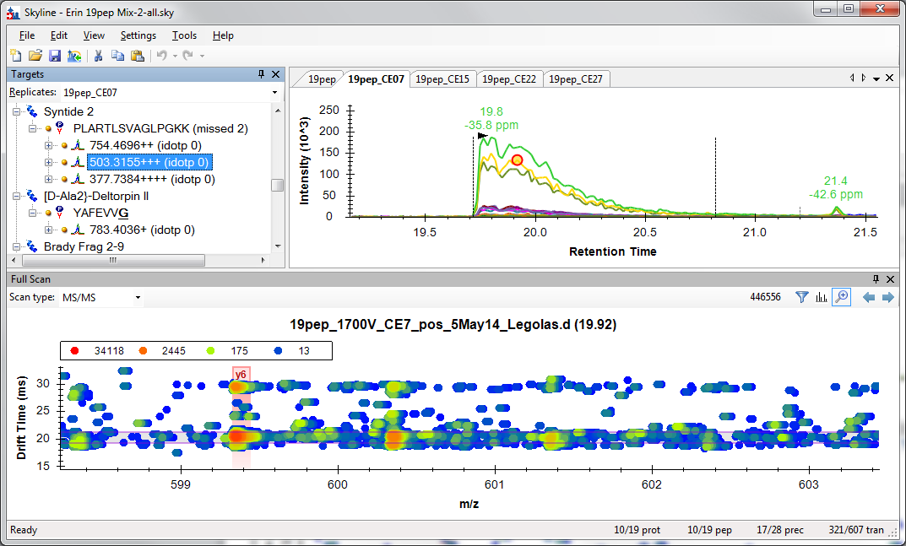
Exploring Ion Mobility MS/MS Scans

Slide 20
Exploring Ion Mobility MS/MS Scans

Slide 21
Imagine
Files automatically posted to Chorus
Fast chromatogram extraction to Skyline
Sharable Skyline documents
Reprocess data on a laptop without download
Spectrum access from anywhere
More processing and viewing options on Chorus
Processed Skyline documents on Panorama
Integrated systems: Chorus, Skyline and Panorama

Slide 22
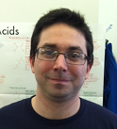
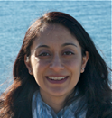
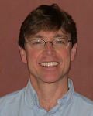
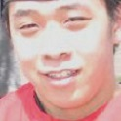
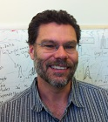
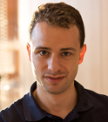
Skyline Team
Nick Shulman
Don Marsh
Brian Pratt
Dario Amodei
Vagisha Sharma
Kaipo Tamura
Yuval Boss
Jarrett Egertson
Max Horrowitz-Gelb
Danny Broudy
Trevor Killeen

Slide 23
Collaborators:
U. of Wa.
  Michael Bereman
  Jim Bolinger
  Jimmy Eng
  Andrew Stergachis
  Sonia Ting
Broad Institute
  Jake Jaffe
  Steve Carr
  Hasmik Keshishian
  D. R. Mani
Buck Institute
  Birgit Schilling
  Matthew Rardin
  Brad Gibson
Duke
  Will Thompson
  Arthur Moseley
IMSB
  Rudolph Aebersold
  Christina Ludwig
  Olga Schubert
  Hannes Röst
  George Rosenburger
  Lucia Espona Pernas
PNNL
  Sam Payne
  Sangtae Kim
Purdue
  Meena Choi
  Olga Vitek
Stanford
  Dario Amodei
  Parag Mallick
Vanderbilt
  Matthew Chambers
  Daniel Liebler
  David Tabb

Slide 24
Instrument Vendor Collaborators
Agilent Technologies
  Christine Miller
  Joe Roark
  Juli Salcedo
  Shripad Torvi
Bruker
  Carsten Baessmann
  Marius Kallhardt
  Stephanie Kaspar
  Pierre-Olivier Schmit
AB Sciex
  David Cox
  Christie Hunter
  Brent Lefebvre
  Steve Tate
Shimadzu
  Alan Baynes
  Junko Iida
  Neil Loftus
  Kiriko Matsuo
Thermo-Scientific
  Sue Abbatiello
  Markus Kellmann
  Andreas Kuehn
  Vlad Zabrouskov
Waters
  James Langridge
  Roy Martin
  Kieran Neeson
  Keith Richards

