Slide 1

Targeted Proteomics
Environment
Targeted Proteomics Quantitative Analysis of Data Independent Acquisition MS/MS in Skyline
Brendan MacLean; Jarrett Egertson; Donald M. Marsh;
Michael J. MacCoss

Slide 2
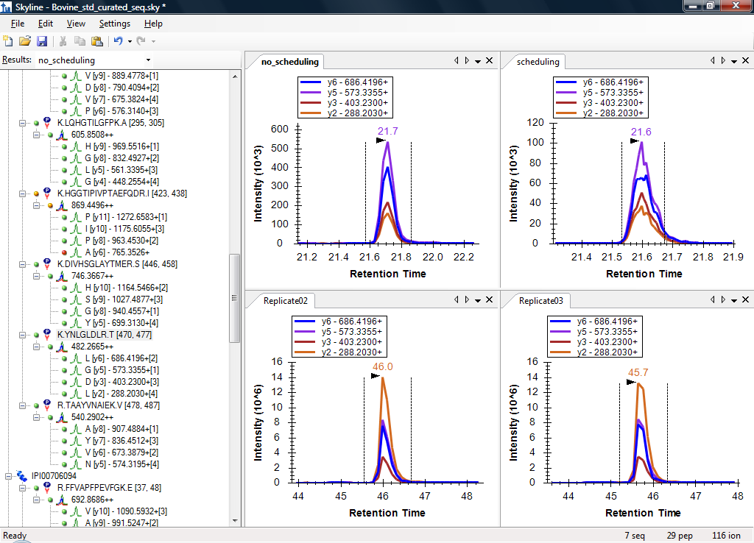
2010 Multi-Instrument SRM Tool for
NCI CPTAC Verification Working Group
AB SCIEX
4000 Q Trap
Thermo-
Scientific
TSQ Ultra
Kessner, D. et al. Bioinformatics. 2008.
Notes:
4000 Q Trap data from Jeff Whiteaker
TSQ data from MacCoss Lab
Unrelated to any VWG study

Slide 3
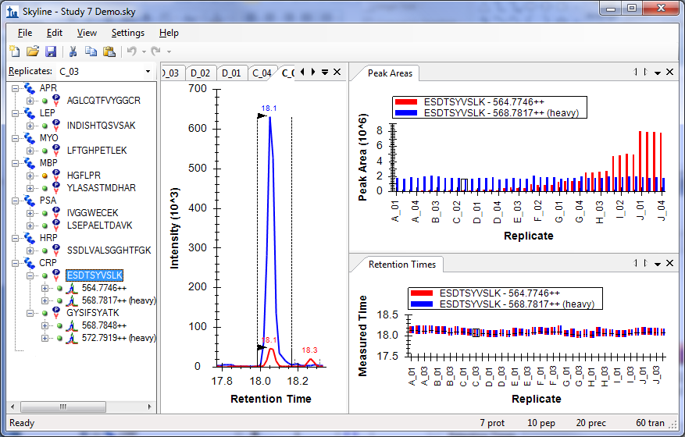
2010 Graphic Display of Information
Notes:
Broad Institute Study 7 data

Slide 4
2010 Skyline Adoption (>1500 installations)

Slide 5
Quantitative Proteomics
Spectrum-based
  Spectral counting
  Isobaric tags
Chromatography-based
  SRM
  MS1 chromatogram extraction
  Targeted MS/MS
  Data independent acquisition (DIA)

Slide 6
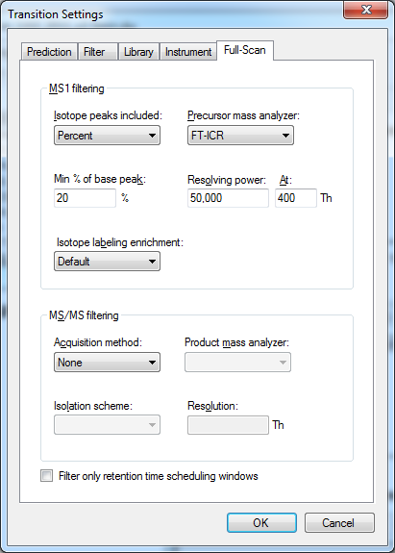
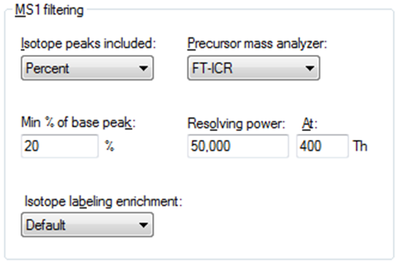
Skyline MS1 Full-Scan Settings
Tutorial

Slide 7
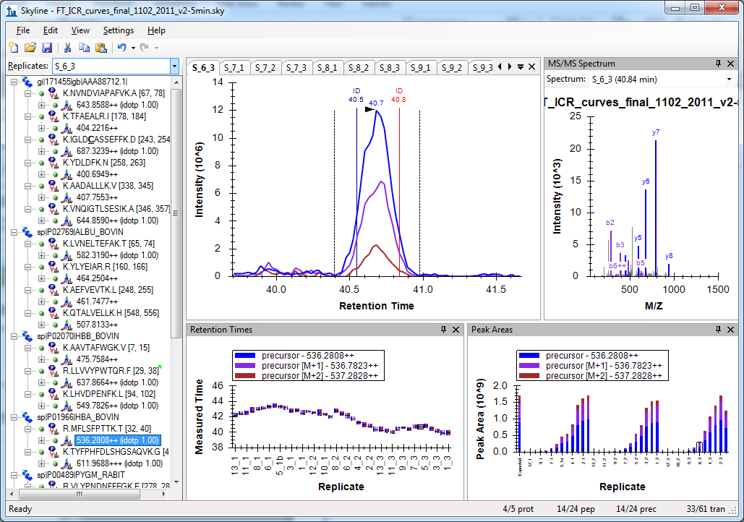
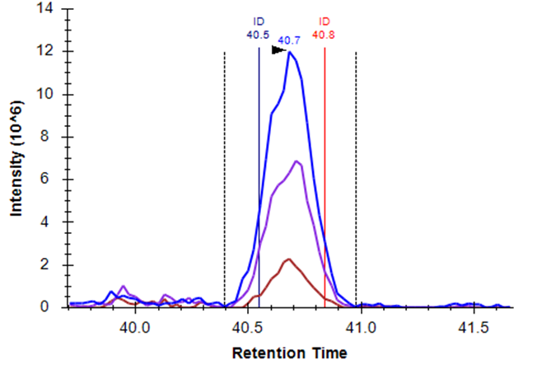
Skyline MS1 Filtering Data
Schilling, B. et al. Mol. Cell. Prot. 2012.

Slide 8
Targeted MS/MS
Mass
Analyzer
Q1 / Trap
CID
Ion
Source
2 m/z isolation
MS/MS scans
m/z
m/z
m/z
intensity
m/z
521.27
time (scan #)

Slide 9
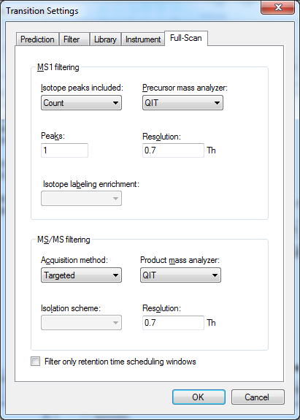
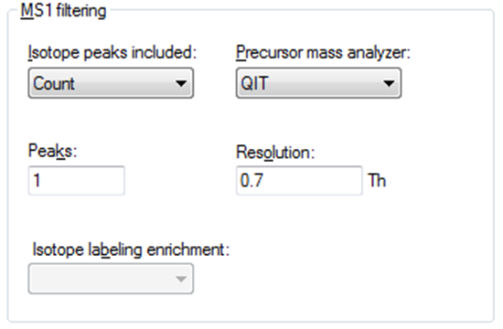
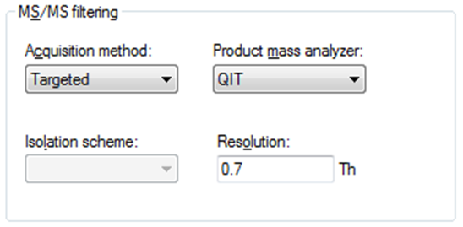
Skyline Targeted MS/MS Settings
Tutorial

Slide 10
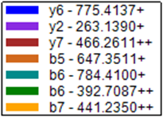
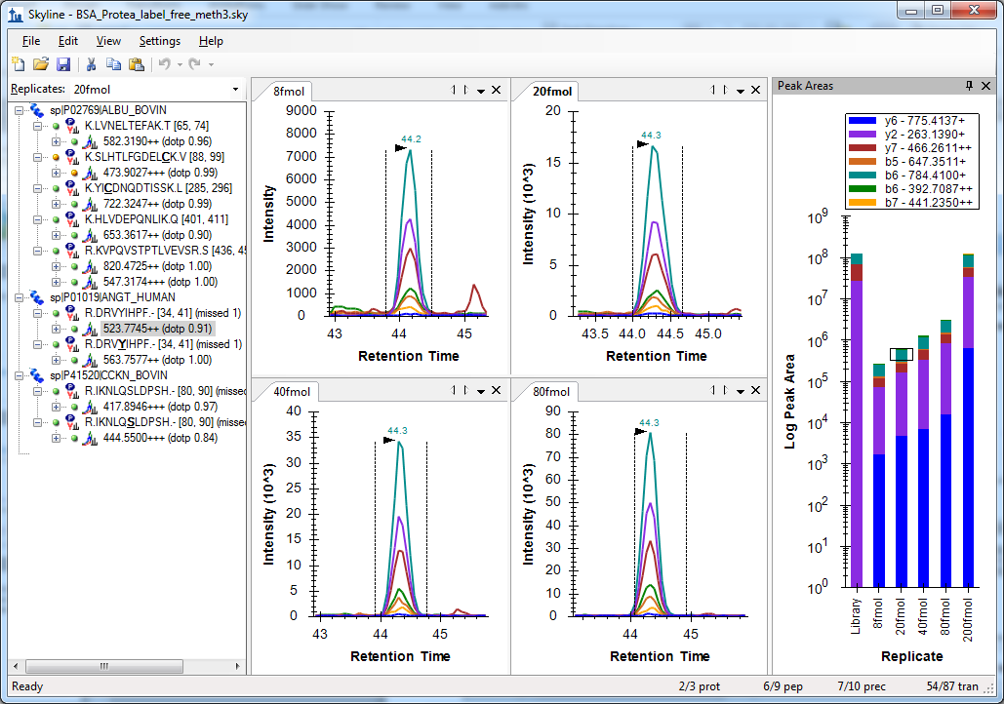
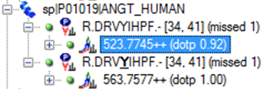
Skyline Targeted MS/MS
Sherrod, S. et al. J. Prot. Res. 2012.

Slide 11
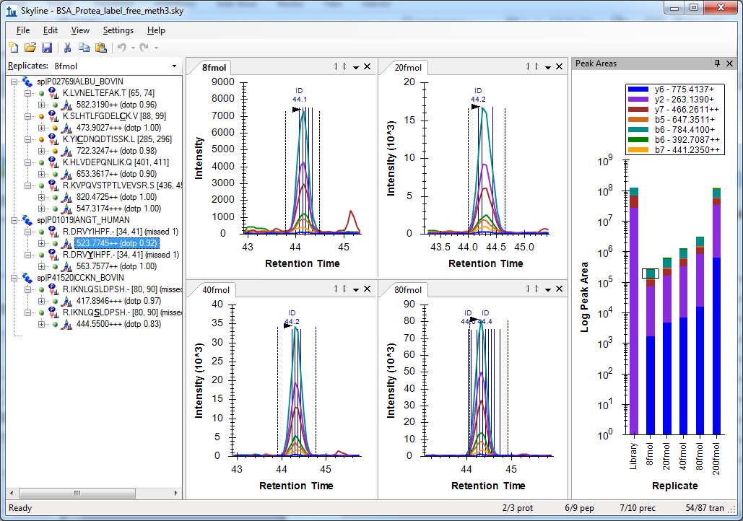
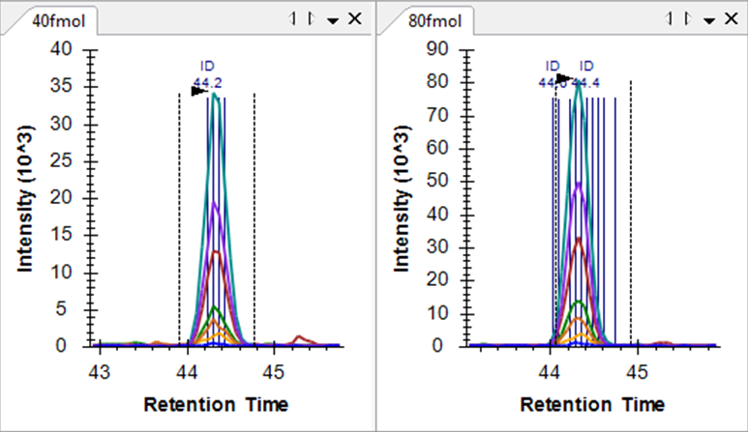
Skyline Targeted MS/MS
Sherrod, S. et al. J. Prot. Res. 2012.

Slide 12
2010 Support Multiple Instrument Vendors
SRM
Exporting transition lists & native methods
Importing native instrument output files
AB SCIEX
Agilent Technologies
Thermo-Scientific
Waters

Slide 13
2012 Support Multiple Instrument Vendors
Full-Scan
Exporting isolation lists & native methods
Importing native instrument output files
AB SCIEX SWATH™
Agilent Technologies DIA
Thermo-Scientific DIA & Multiplexed DIA
Waters MSe™

Slide 14
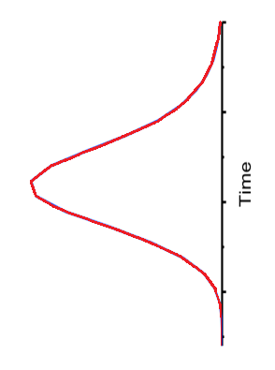
Traditional DIA Isolation Scheme
precursor m/z
SVEDFMAAMQR
Precursor m/z: 616
600
610
616
620
630
640
650
619
VGGNGADYALATK
Precursor m/z: 619
10 m/z
x
x
x
x
Retention time
Venable, J.D. et al. Nat. Meth. 2004.

Slide 15
DIA Chromatogram Extraction
Mass
Analyzer
Q1 / Trap
CID
Ion
Source
10 m/z isolation
MS/MS scans
m/z
m/z
m/z
intensity
m/z
time (scan #)

Slide 16
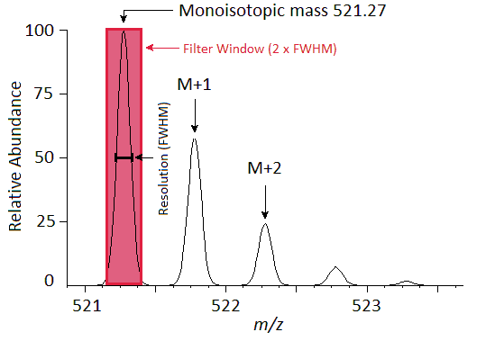
DIA Chromatogram Extraction Trade-Offs
Sensitivity
  Dwell / Accumulation time
  Cycle time
Selectivity lost by wide precursor isolation
Selectivity gained vs. SRM by narrow product extraction
MS/MS scan
Gillet, L.C. et al. Mol. Cell. Prot. 2012.

Slide 17
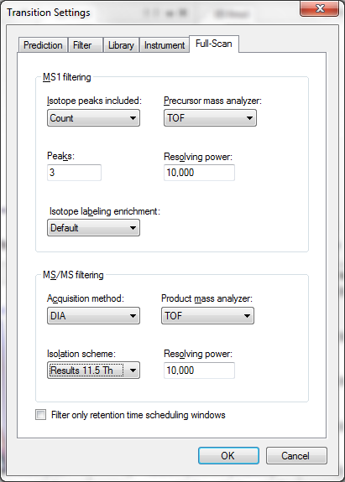
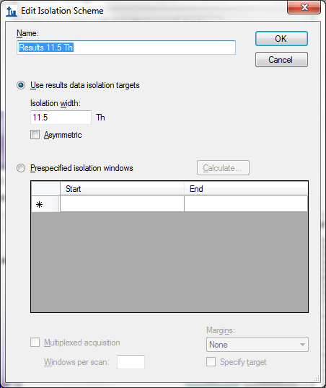
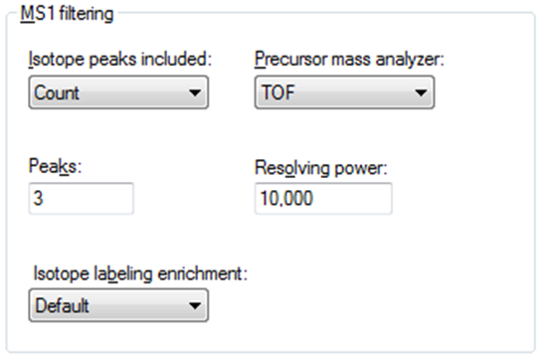
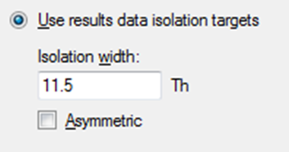
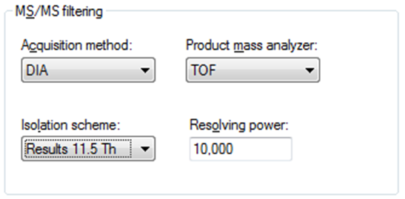
Skyline Agilent DIA Settings
(11.5 m/z Extraction Windows)

Slide 18
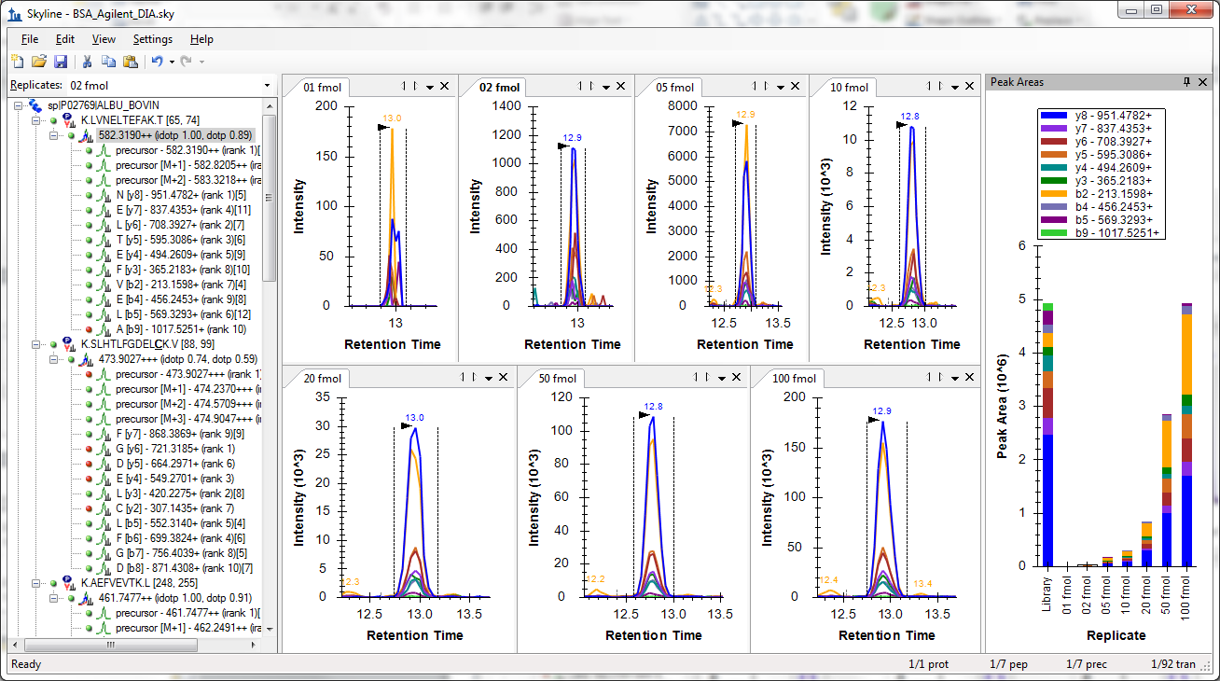
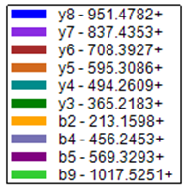

Agilent DIA Data (Product Ions)

Slide 19
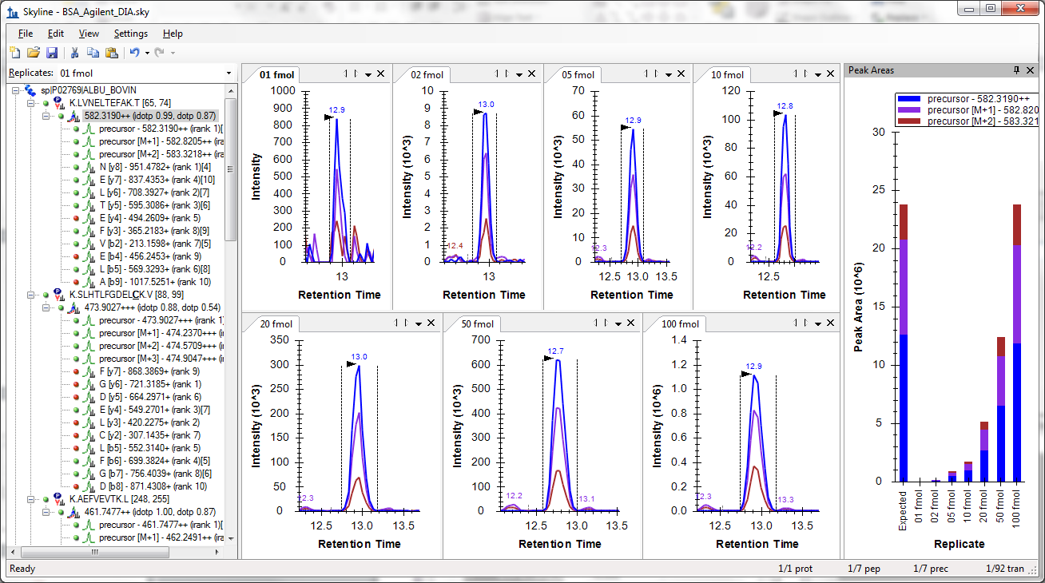


Agilent DIA Data (Precursor Ions)

Slide 20
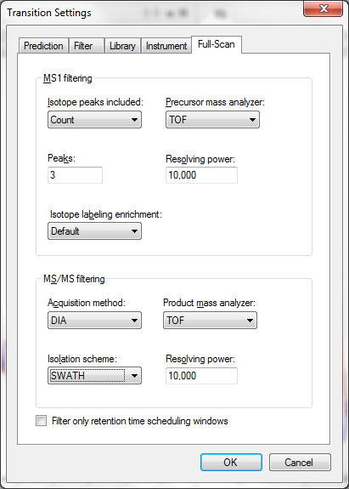
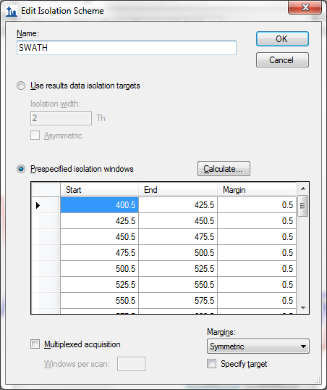
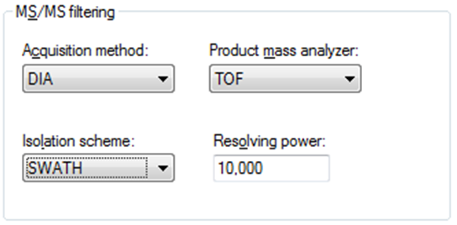
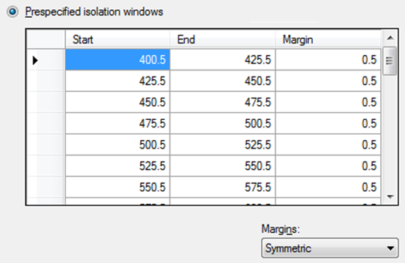
Skyline AB SCIEX SWATH™ Settings in v1.3
(32 x 25 m/z Extraction Windows)
Gillet, L.C. et al. Mol. Cell. Prot. 2012.

Slide 21
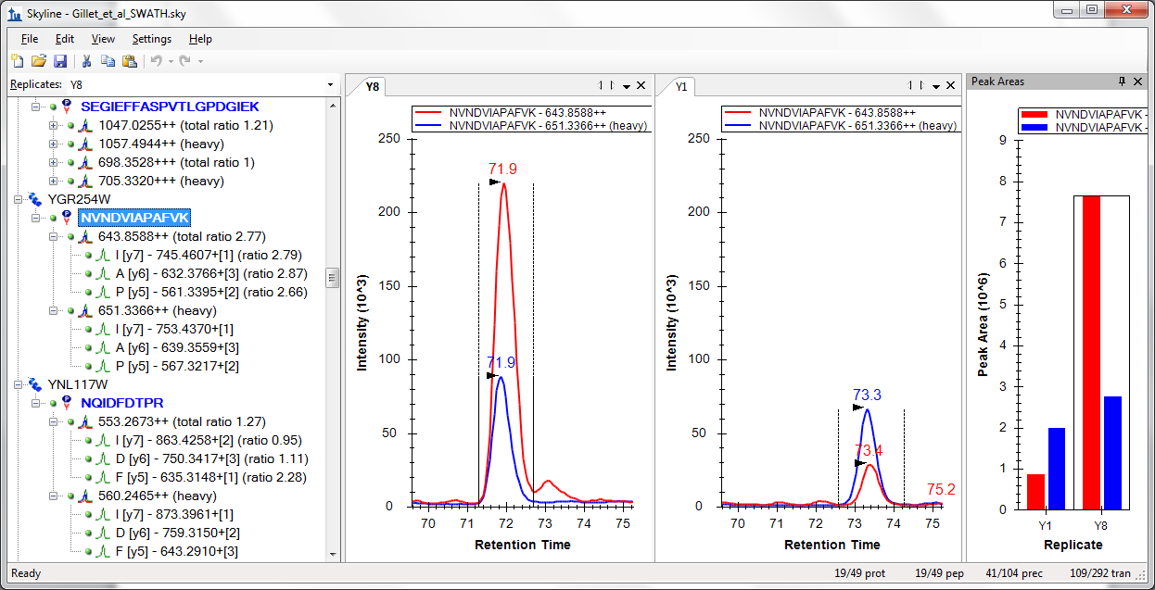
AB SCIEX SWATH™ Data
Gillet, L.C. et al. Mol. Cell. Prot. 2012.

Slide 22
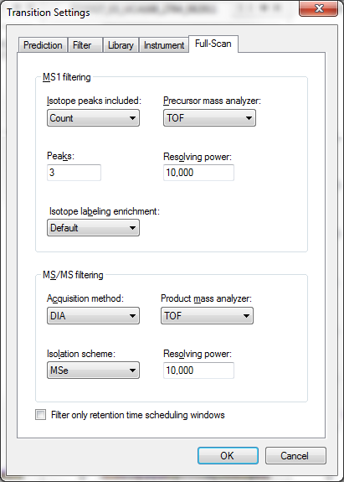
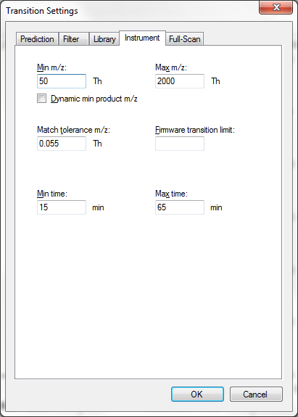
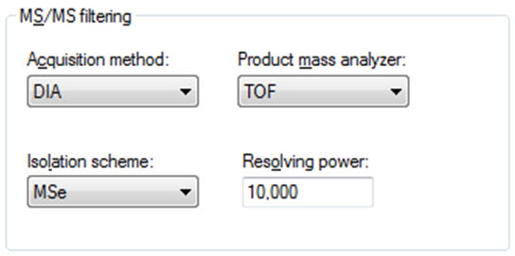

Skyline Waters MSe™ Settings in v1.3
(50 – 2000 m/z Range)

Slide 23
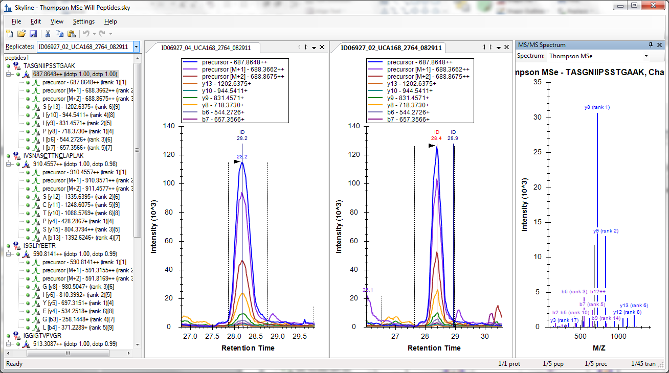
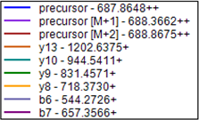

Waters MSe™ Data

Slide 24
Multiplexed DIA (Q Exactive) in v1.3
Jarrett Egertson – Thursday AM – ThP 571
MSX
100 4 m/z-wide windows = 400 m/z (5 random per scan)
Scan N-1
Acquisition
Scan N
Scan N+1
Multiplexed Spectra
Precursor Isolation
De-Multiplexed Spectra
. . .
. . .
Scan N-1
=
Scan N-1
Isolation Window
Scan N
Scan N
x
De-Multiplexing
Scan N+1
Scan N+1
. . .
m/z
. . .
Isolation Window
(present = 1; absent = 0)
m/z

Slide 25
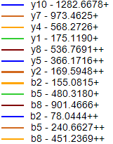
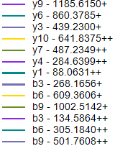
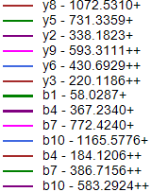
Multiplexed DIA Data (before)
Jarrett Egertson – Thursday AM – ThP 571

Slide 26
Multiplexed DIA Data (after)
Jarrett Egertson – Thursday AM – ThP 571

Slide 27
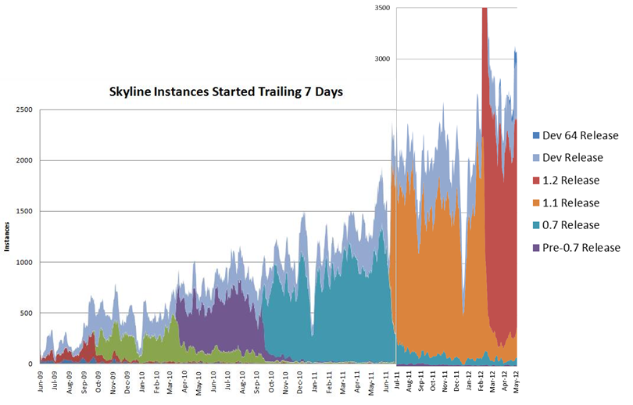
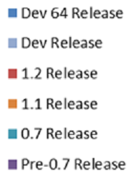
2012 Skyline Adoption (>10,000 installations)
3500
Skyline Instances Started Trailing 7 Days
3000
2500
ASMS
2011
Dev 64 Release
Dev Release
2000
1.2 Release
ASMS
2010
1500
1.1 Release
Instances
0.7 Release
1000
Pre-0.7 Release
500
0

Slide 28
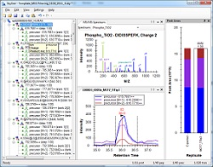
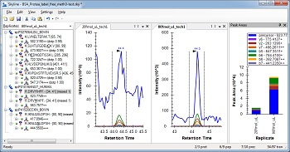
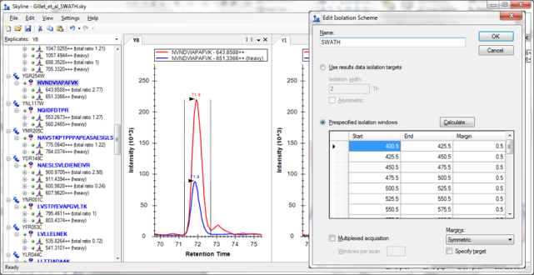
Getting Started
Freely available & Open Source
http://proteome.gs.washington.edu/software/skyline
Self-updating web installation (v1.3 coming soon)
2 full-scan filtering tutorials (DIA coming soon)
Support board and issues list
8 other tutorials & 3 instructional videos (full-scan video soon)
MS1 Full-Scan Filtering
Targeted MS/MS
Data Independent Acquisition
Coming Soon

Slide 29

Acknowledgments:
Skyline Team
  Nick Shulman
  Vagisha Sharma
  Barbara Frewen
  Michael Bereman
Buck Institute
  Birgit Schilling
  Matthew Rardin
  Brad Gibson
ETH
  Rudolph Aebersold
  Ludovic Gillet
  Christina Ludwig
Vanderbilt
  Matthew Chambers
  Amy Ham
  Daniel Liebler
Duke
  Will Thompson
  Arthur Moseley
AB Sciex
  Fadi Abdi
  David Cox
  Christie Hunter
  Brent Lefebvre
Agilent Technologies
  Christine Miller
  Joe Roark
  Pat Perkins
Thermo-Scientific
  Markus Kellmann
  Andreas Kuehn
  Vlad Zabrouskov
Waters
  Laurence Firth
  James Langridge
  Roy Martin
  Kieran Neeson
  Keith Richards
WP 407 - Vagisha Sharma
A private repository of targeted proteomics assays for Skyline
This work is funded by grants from NIH/NIGMS, NIH/NHGRI, Agilent Technologies and Thermo-Fisher Scientific.

